Slide 1
Clean Water and Drinking Water State Revolving Funds and the Bipartisan Infrastructure Law
Hawaii Rural Water Technical Assistance and Training Conference
May 2023

Slide 2
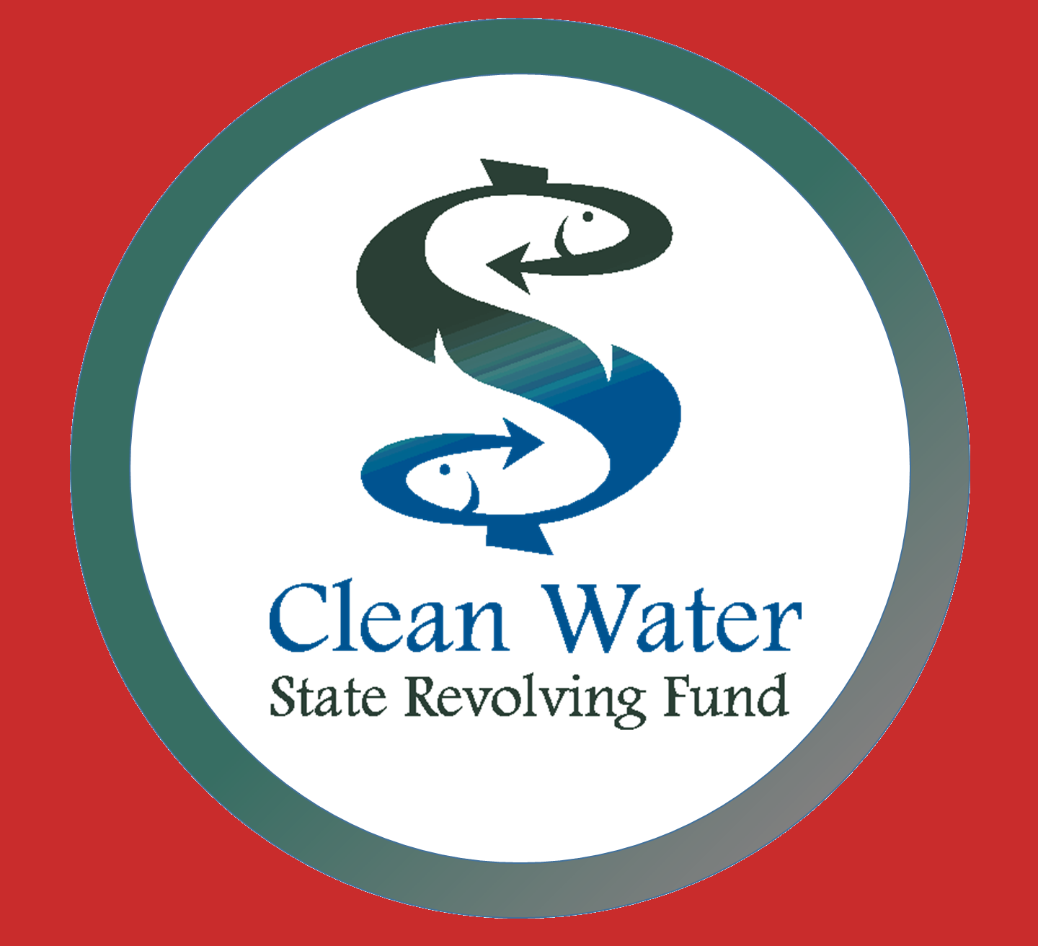
What are the State Revolving Funds?
Congress
EPA
Water Quality
And Public Health
Projects
Low-Cost Financing
Seed Money
State Legislature
Loan
Repayments
State Government
(DOH WWB and SDWB)

Slide 3
State Revolving Funds: Roles
EPA’s Role
Awards capitalization grants to states
States’ Role
Design SRF programs to reflect the needs of their state
Apply for funding for the state SRF program
Understand program eligibilities and requirements
Participate in the SRF public review process
Select projects for funding
Program oversight
Communities’ Role
Provides grant terms and conditions
Accept applications
Score and rank projects
Provides guidance

Slide 4
Hawaii SRF Program Information
Terms up to 30 years or the useful life of the project, whichever is less
Below-market interest rates:
CWSRF: 1.25%
DWSRF: 1.75% – 2.75%
May also include additional subsidies (e.g., 0 interest, loan forgiveness, no fees = FREE money!)
Principal repayment starts up to 12 months after project completion (CWSRF) and 18 months after project completion (DWSRF)

Slide 5
Who is Eligible to Use the SRF?
CWSRF:
DWSRF:
CWSRF-eligible entities are dependent upon project type:
Municipalities, Counties, intermunicipal, interstate, or State agencies.
POTW
Nonprofit entities
Private, for-profit entities
Watershed groups
Community groups
Homeowners Associations
Individuals
And more…
Public or private community water systems
A system serving at least 15 service connections used by year-round residents, or regularly serves at least 25 year-round residents
Nonprofit non-community water systems
Including schools, publicly-owned campgrounds, parks, churches

Slide 6
What Type of Projects Can Be Funded by the CWSRF?
Centralized Wastewater Treatment
Energy and Water Conservation
Water Reuse/Efficiency
Stormwater
Agricultural Best Management Practices
Groundwater quality
Resource Extraction water quality
Planning/Assessments and Monitoring
Landfill water quality
Habitat and Ecosystem Restoration
Desalination
Decentralized Wastewater Treatment including Cesspool Conversions
Surface Water Quality
Contaminated Site Remediation
Access our Eligibility Handbook, which includes example projects:
https://www.epa.gov/sites/default/files/2016-07/documents/overview_of_cwsrf_eligibilities_may_2016.pdf

Slide 7
What Type of Projects Can Be Funded by the DWSRF?
Treatment
Transmission & Distribution
Storage
Source
Consolidation
Creation of New Systems
Planning & Design
Access our Eligibility Handbook, which includes example projects: https://www.epa.gov/dwsrf/drinking-water-state-revolving-fund-eligibility-handbook

Slide 8
Bipartisan Infrastructure Law (Infrastructure Investment and Jobs Act)
Bipartisan Infrastructure Law Public Law No: 117-58
BIL/IIJA
Signed by President Biden on November 15, 2021.
Historic investment in programs and initiatives to build safer, healthier, cleaner communities.
Includes $50 billion to the EPA to strengthen the nation’s drinking water and wastewater systems – the single largest investment in water and ww that the federal government has ever made.
Approximately $43.4B of this funding through the existing CWSRFs and DWSRFs.

Slide 9
Available SRF Funding in the BIL
Appropriation | FY 2022 ($) | FY 2023 ($) | FY 2024 ($) | FY 2025 ($) | FY 2026 ($) | Five Year Total ($)
CWSRF General Supplemental | 1,902,000,000 | 2,202,000,000 | 2,403,000,000 | 2,603,000,000 | 2,603,000,000 | 11,713,000,000
CWSRF Emerging Contaminants | 100,000,000 | 225,000,000 | 225,000,000 | 225,000,000 | 225,000,000 | 1,000,000,000
DWSRF General Supplemental | 1,902,000,000 | 2,202,000,000 | 2,403,000,000 | 2,603,000,000 | 2,603,000,000 | 11,713,000,000
DWSRF Emerging Contaminants | 800,000,000 | 800,000,000 | 800,000,000 | 800,000,000 | 800,000,000 | 4,000,000,000
DWSRF Lead Service Line Replacement | 3,000,000,000 | 3,000,000,000 | 3,000,000,000 | 3,000,000,000 | 3,000,000,000 | 15,000,000,000
9

Slide 10
Hawaii FY22 and FY23 SRF Funding in the BIL
Appropriation | FY 2022 ($) | FY 2023 ($)
CWSRF General Supplemental | 13,785,000 | 17,055,000
CWSRF Emerging Contaminants | 725,000 | 1,743,000
DWSRF General Supplemental | 17,992,000 | 21,055,000
DWSRF Emerging Contaminants | 7,555,000 | 7,640,000
DWSRF Lead Service Line Replacement | 28,350,000 | 28,650,000

Slide 11
Increasing Investment in Disadvantaged Communities
Use of Additional Subsidy (forgiveness of principal or grants)
49% must go to disadvantaged communities/address affordability (DWSRF + CWSRF Supplemental, DWSRF Lead Service Line Funding)
At least 25% must go to disadvantaged communities or public water systems serving less than 25,000 people (DWSRF Emerging Contaminants)
Disadvantaged Community Definition and Affordability Criteria
Each state is responsible for setting the definition of disadvantaged community definition and affordability criteria

Slide 12
Technical Assistance to Help Communities Access BIL SRF Funding
Need: Many communities need support to develop quality SRF projects and apply for SRF funding
Goal: Expand availability of technical assistance (TA) to help underserved communities access SRF funding, in partnership with states, tribes and territories
Focuses:
Proactive outreach to disadvantaged and underserved communities in rural, urban, suburban, and tribal areas
Community-centered, locally driven solutions
SRF applications that result in sustainable, affordable, and resilient projects
Office of Water
12

Slide 13
Identify water challenges
EPA WaterTA Supports Communities to:
Plan for solutions
Increase community engagement
Build technical, financial, managerial capacity
Develop application materials to access water infrastructure funding
Office of Water

Slide 14
Region 9 Environmental Finance Centers
BIL Water Infrastructure EFCs
Rural Community Assistance Corporation
Scope: Direct TA and Training for Disadvantaged Communities
Coverage: All Region 9 States, Tribes, and Territories
Hawaii Community Foundation
Scope: Direct TA and Training for Disadvantaged Communities/ Workforce Development
Coverage: Hawaiian Islands
Multi-Media EFC
Sacramento State University
Scope: TA Support to State SRF Programs (as funded)
Coverage: All Region 9 States, Tribes, and Territories (as funded)

Slide 15
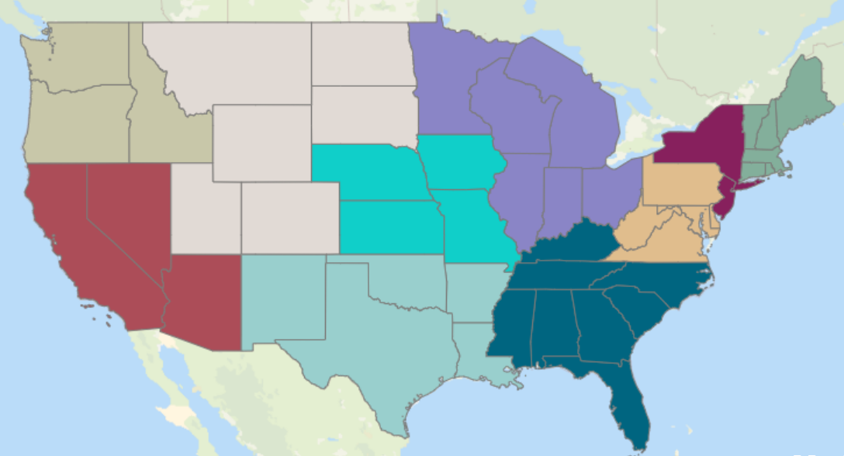
Selected EFCs National BIL
Rural Community Assistance Partnership
EPIC
U.S. Water Alliance
Moonshot Missions

Slide 16
Other EPA Technical Assistance Programs
Rural, Small, and Tribal Wastewater Technical Assistance
Rural Community Assistance Partnership
National Rural Water Association
University of New Mexico – Environmental Finance Center
Training and Technical Assistance for Small Systems
Rural Community Assistance Partnership
National Rural Water Association

Slide 17
Summary of Possible TA Services
Planning and Assessment
Community Engagement
Project Development
Preliminary Engineering Reports
Decision-maker and Board Education
Ongoing Engagement and Outreach
Water Systems Partnerships
Funding and Financing
Identify Funding Options
Financial Planning
Environmental Reviews
Asset Management
Partnerships and Engagement
Plan Development and Coordination
Program Management Support
Bid Support
Change Order Review
Domestic Preference and Davis Bacon Assistance
Application Support
Project Inspection
Lead Service Line Inventories
Project Design
Studies and Assessments
Capacity Building and Training
Rates and Revenue Analyses
17

Slide 18
Request Assistance
Request support by filling out simple online WaterTA Request Form
Learn More
Please visit epa.gov/waterTA for more information including a
Fact Sheet summarizing all of EPA’s TA programs.

Slide 19
H₂O Community Solutions Teams (CST) Pilot Initiative
This pilot initiative is to help underserved communities and local water utilities identify their water infrastructure needs, plan and design infrastructure projects, and apply for SRF funding.
Kauai County on-site wastewater system upgrade for cesspool replacements
The goal is for the county to serve as a pass-through entity for SRF funding that supports replacement of residential cesspools. The CST TA is supporting the State and County to set up the program by identifying requirements and provide examples from other State programs.
Hawaii County Department of Water Supply: Drinking Water and Water Conservation
The county’s goal is to secure funding to support supply and demand planning, conduct water conservation planning to meet statewide goals, and support implementing infrastructure projects associated with SRF-approved Programmatic Financing (Pro-Fi) in 2022 HI DWSRF IUP. The CST TA is supporting the County in initial steps towards water conservation; development of a comprehensive Asset Management Plan; and development of a Master Plan for SCADA (Supervisory Control and Data Acquisition) system to assist with monitoring water production, usage, water loss, non-revenue water, and other critical parameters).

Slide 20
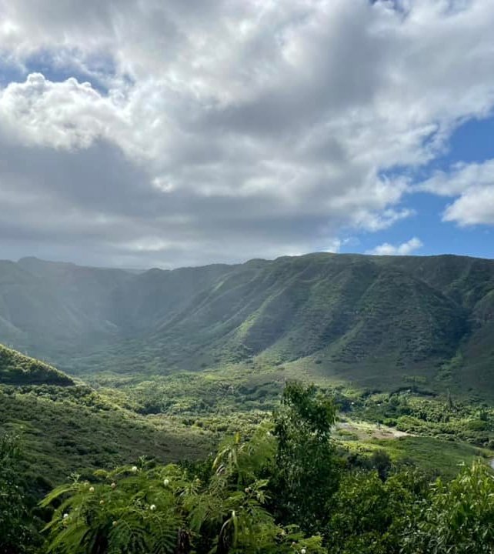
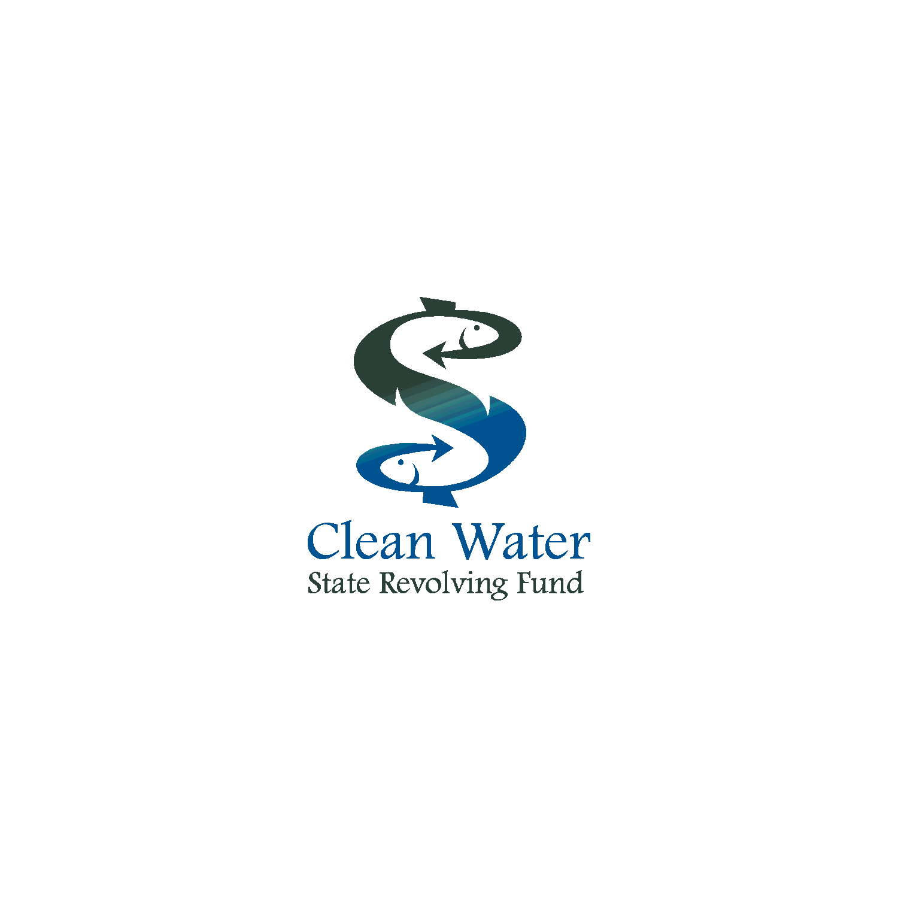
Questions? Please reach out with ideas, suggestions, questions!
Barry Pollock, US EPA Sara Jacobs, US EPA
pollock.barry@epa.gov jacobs.sara@epa.gov
Jill Bletz, US EPA Juanita Licata, US EPA
Bletz.jillian@epa.gov licata.Juanita@epa.gov
Sina Pruder, HI DOH, CWSRF
sina.pruder@doh.hawaii.gov
https://health.hawaii.gov/wastewater/home/cwsrf/
Joan Corrigan, HI DOH, DWSRF
joan.corrigan@doh.hawaii.gov
https://health.hawaii.gov/sdwb/drinking-water-state-revolving-fund/

