Slide 1
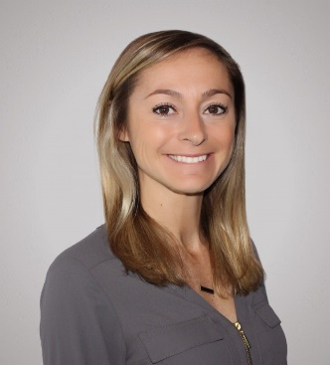
Contructing the Nation’s Largest IX Rein PFAS Water Treatment Plant
Kelsey Hakes
khakes@aqvets.com (949) 531-0786
Notes:
Check all Trademarks and registers on slides

Slide 2
Orange County Water District
Understanding each underdrain limitation is important when making design decisions.
OCWD was formed in 1933 to:
Manage the OC Goundwater Basin
Protect rights to Santa Ana River Water
Provide groundwater to
19 municipal and special water districts
2.5 million residents
Basin provides 77% of the water supply for north & central OC
Notes:
Update picture with issys inside vessel

Slide 3
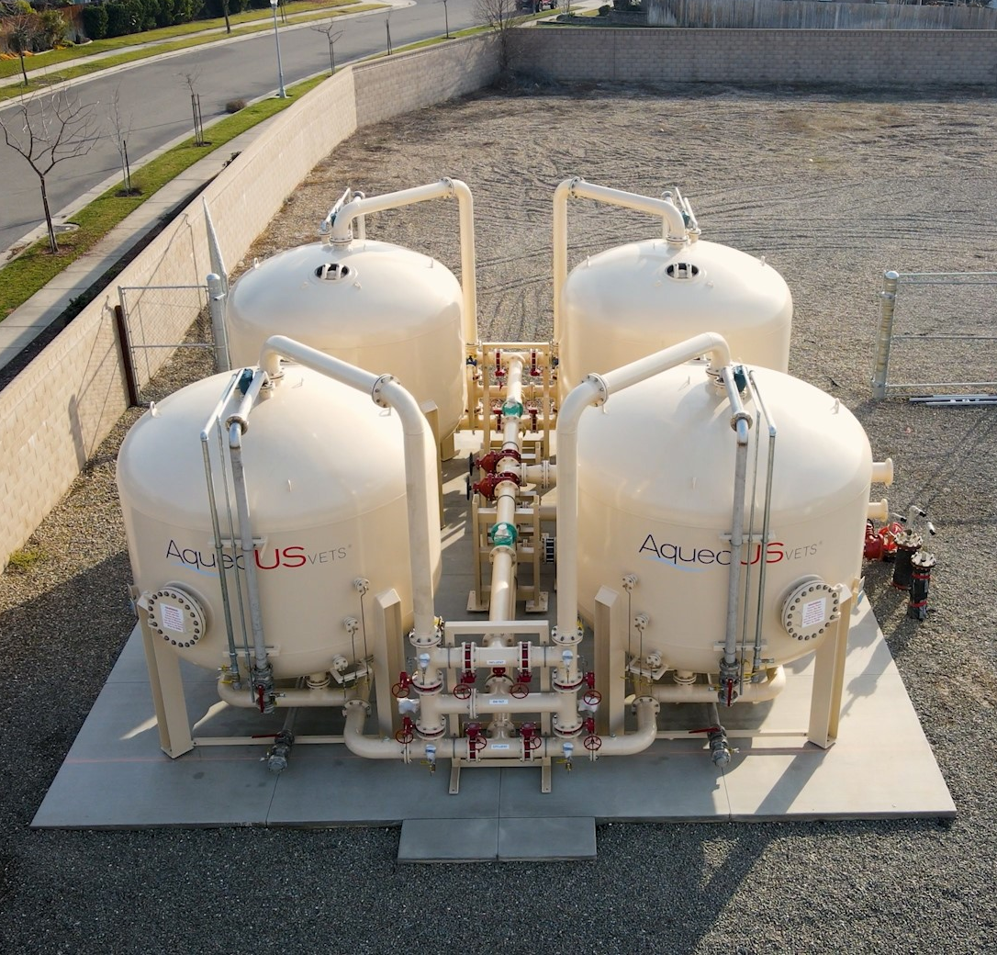
Section 2
PFAS Removal Treatment Solutions

Slide 4
PUT RECAP BULLET POINTS
Summary
Important Reminders

Slide 5
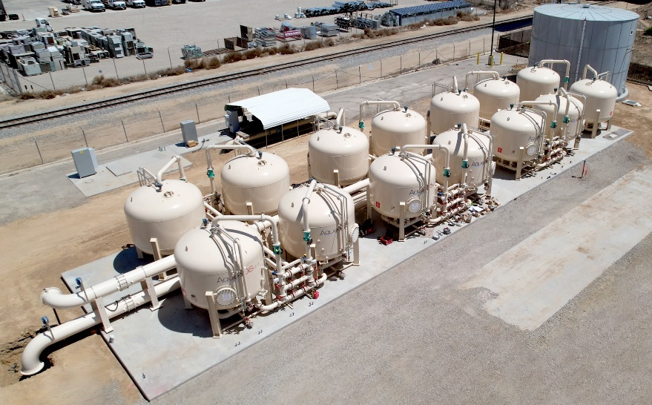
Representative Customers
AV has projects with local and nationally recognized owners, engineers, and contracting firms
Owners & End Users
Engineers
Contracting Firms

Slide 6
Questions?
Visit our website for more information
www.aqueousvets.com

