Slide 1
EPA Drinking Water Regulatory Update
HRWA Conference
May 24, 2023
Anna Yen, USEPA Region 9, Drinking Water Section
San Francisco, CA

Slide 2
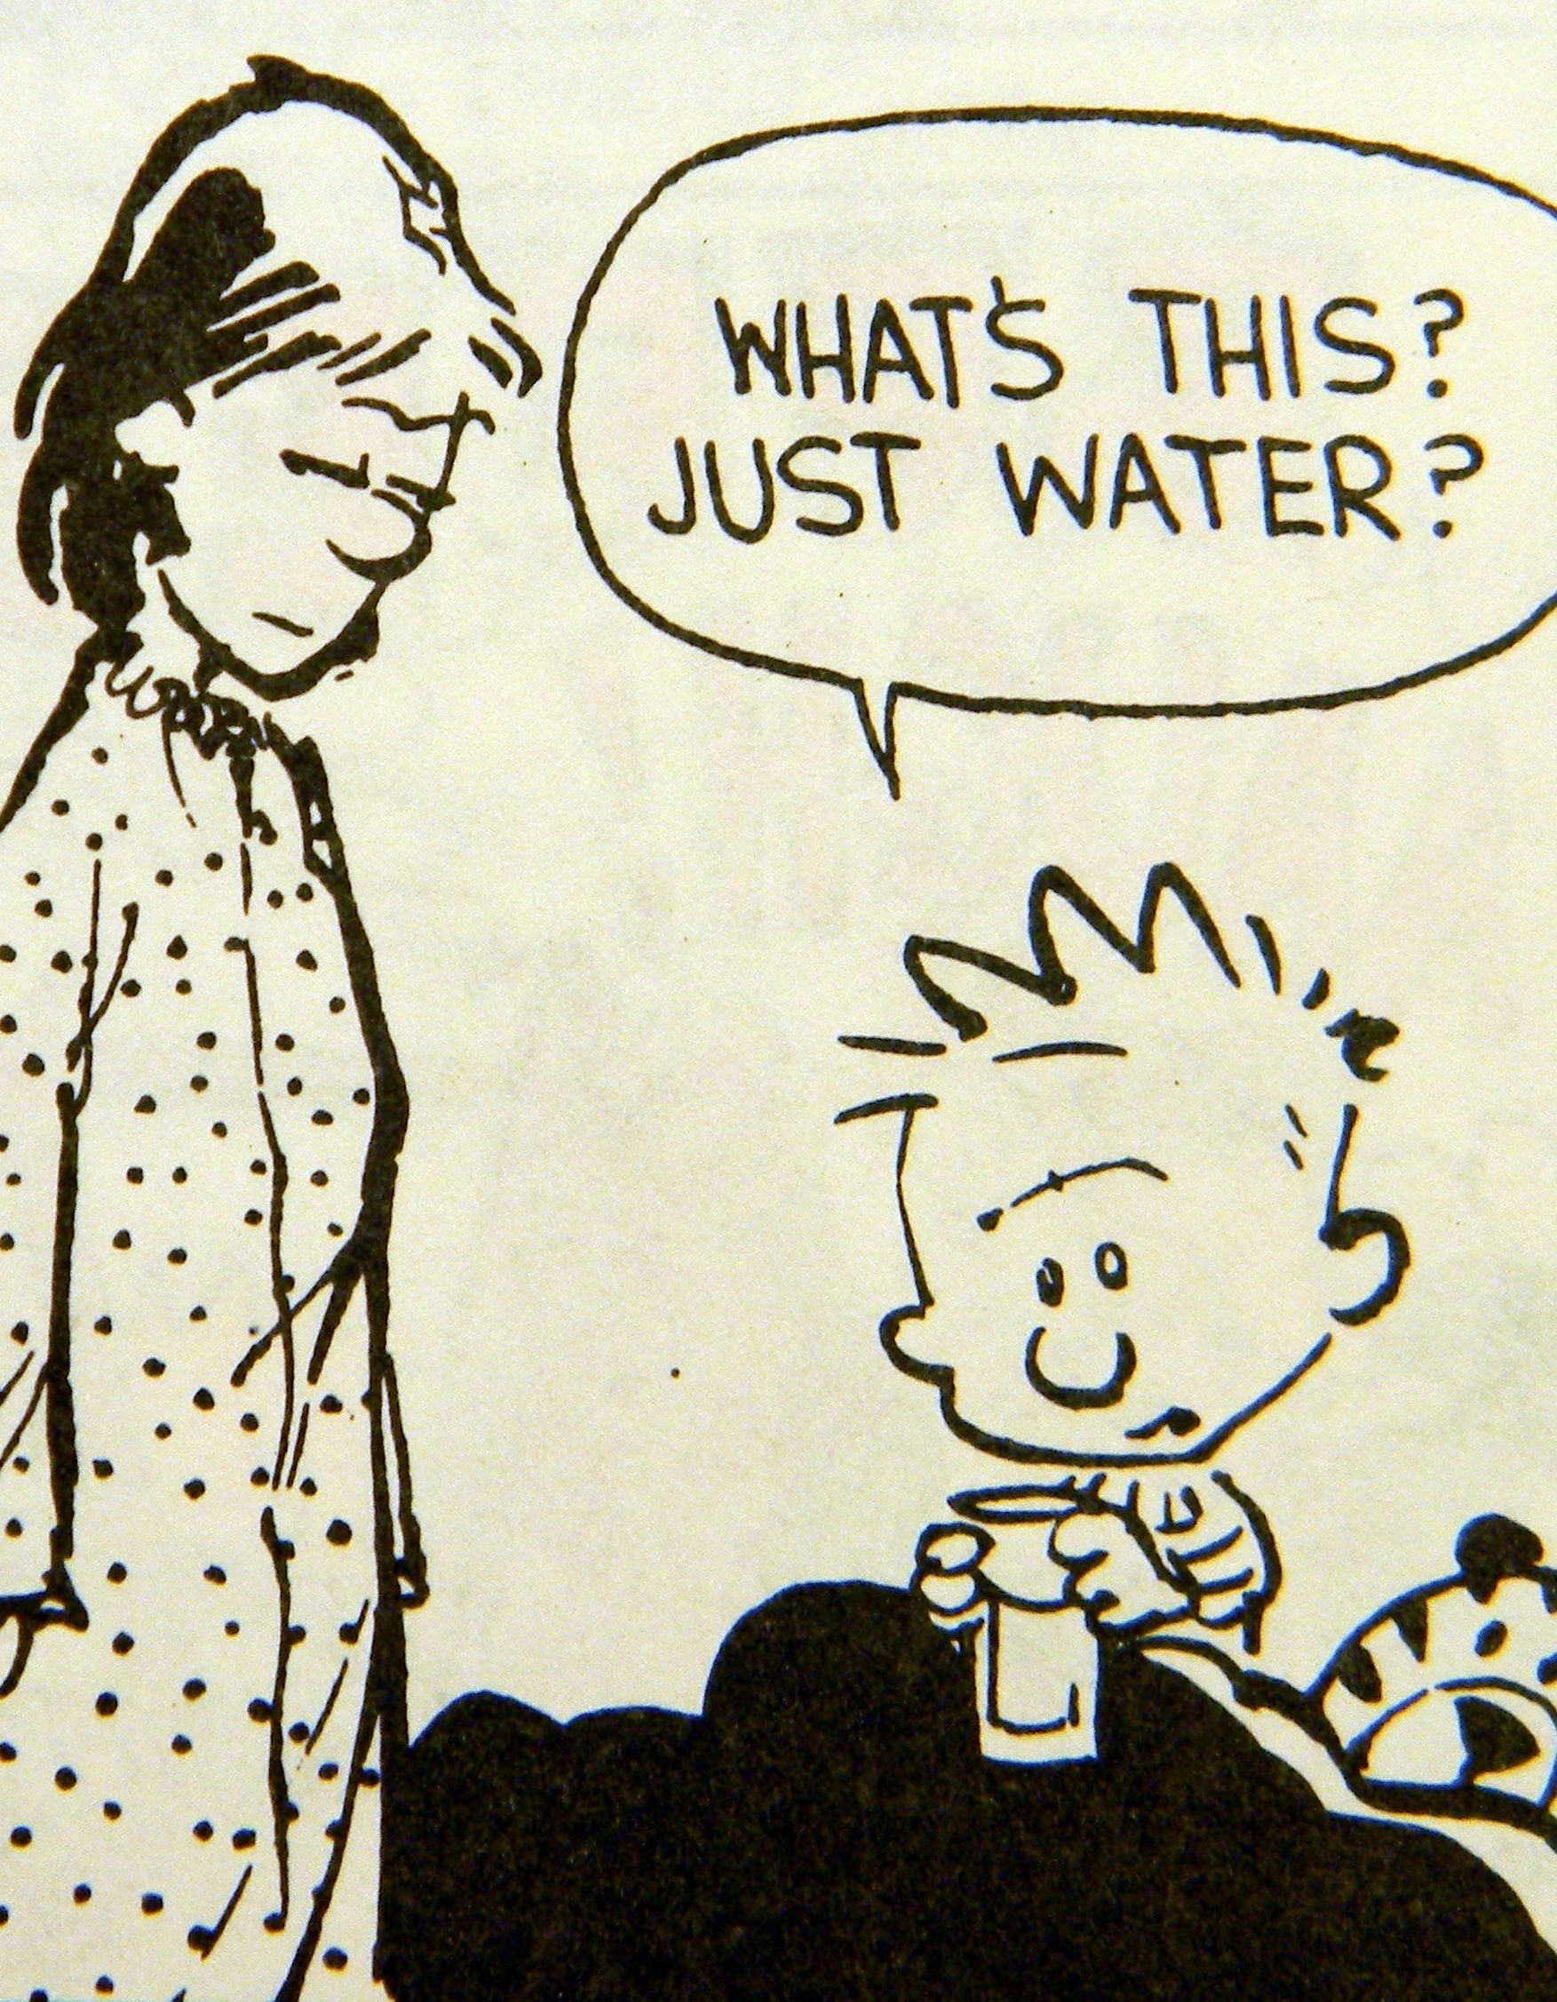
01
UCMR 5
02
PFAS Proposed Rule
03
LCRR/LCRI
04
AWIA
05
Cybersecurity
Unregulated Contaminant Monitoring Rule 5
Lead and Copper Rule Revisions/
Lead and Copper Rule Improvements
America’s Water Infrastructure Act

Slide 3
EPA REGULATORY PROCESS
Notes:
Contaminant Candidate List – list of contaminants that are currently not subject to regulation but are known or anticipated to occur in public water systems and that may pose risks to drinking water.
On July 19, 2021, EPA published the Draft 5th CCL.
UCMR 5 – just finalized.
Reg Det 4 – reissued final in Feb 2021.
6 Yr Review:
Jan 2017: 6-Yr Rvw 3 results were announced.
2023: Data collection for 6-Yr Rvw 4

Slide 4
Unregulated Contaminant Monitoring Rule
UCMR Cycle 5
(New): Applies to systems > 3300 persons
EPA Methods 537.1 and 533
EPA Method 533 focuses on “short chain” PFAS (C4-12)
Both methods needed to cover 29 PFAS compounds
Proposed Rule | March 11, 2021
Final Rule | Dec. 27, 2021
Monitoring | 2023-2025
29 PFAS Compounds & Lithium
Notes:
**Bessie Lee (HRWA) will be presenting on UCMR5 this afternoon, after lunch.
No more than 30 contaminants
Issue every 5 years
Up to now, it applied to systems serving >10K (and subset of randomly selected small)
Completed Cycle 4 monitoring at the end of CY2020, for cyanotoxins, pesticides, disinfection byproducts, alcohols, and synthetic VOCs.
UCMR5
- Proposal: 3/11/21. UCMR5 list contains 29 PFAS compounds (includes all 6 from UCMR3) + Lithium.
- Final: Published 12/27/2021. Monitoring cycle: 2023-2025.

Slide 5
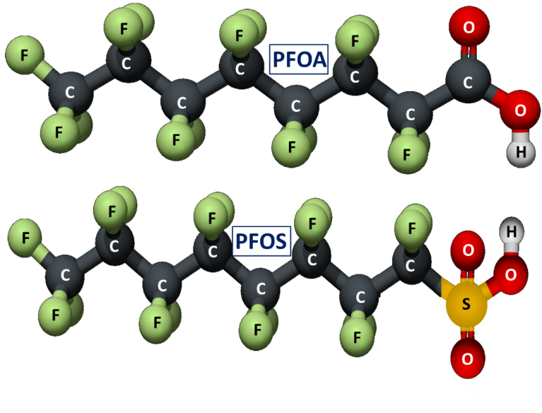
[Expected] Fall 2023
Reg Determination 4 – PFAS Rulemaking
March 29, 2023
Feb 22, 2021
Re-issuance of Final Reg Determination
60 day public
comment period
Final Rule
March 14, 2023
[Expected]
Fall 2026
Proposed Rule Released
Rule takes effect 3 years after promulgation
Proposed Rule Published
Notes:
Rulemaking:
Mar. 14, 2023: Announced proposed rule, released pre-publication notice.
Mar. 29, 2023: Notice of proposed rule was published in the FR.
60-day comment period
Virtual public hearing: May 4, 2023.
Statutorily, EPA has 24 months from positive reg det to proposed rule. And 18 months from proposed rule to final rule.
History:
February 20, 2020: Issued proposed determination to regulate two chemicals (PFOA/PFOS) and not to regulate six other chemicals
January 19, 2021: Final determination announced
January 20, 2021: Subject to EO Regulatory Review
February 22, 2021: Re-issuance of final determination (ratified on 3/3/2021)
Not to regulate: 1,1-dichloroethane, acetochlor, methyl bromide, metolachlor, nitrobenzene, and RDX
- No determination: 1,2,3-TCP, 1,4-Dioxane, Strontium. Based on occurrence, state-level focus, health effects, and/or public input about a previous preliminary determination, EPA discussed these contaminants in detail but did not make preliminary determinations on the three contaminants in the March 2020 Regulatory Determinations Federal Register Notice.
1,2,3-TCP: EPA needs better information on occurrence below the Minimum Reporting Level (MRL) in order to make an informed determination about a meaningful opportunity. Health Reference Level (HRL) is 75 times lower than the MRL.
1,4-Dioxane: Opportunity to reduce public health risk may not be significant. UCMR 3 data indicate 1,4-dioxane exposure expected to result in less than two baseline cancer cases per year. There are ongoing efforts to examine cancer and other health effects.
Strontium: EPA made a preliminary positive regulatory determination in 2014, but a decision to delay a final determination was made in 2016 based on uncertainties around treatment and health effects

Slide 6
Regulatory Determination 4 – PFAS Rulemaking
[Expected] Fall 2023
You can share your input on the proposal by submitting a comment through the public docket, identified by Docket ID No. EPA-HQ-OW-2022-0114
https://www.regulations.gov
60 day public
comment period
Final Rule
March 14, 2023
Proposed Rule Released
May 30, 2023
Comments Due
March 29, 2023
Proposed Rule Published
Notes:
60-day comment period: comments must be received by May 30, 2023
Virtual public hearing: May 4, 2023.
To attend and register to speak, use online registration form.
Deadline for registering to speak: April 28
Number of online connections is lim’d.
Statutorily, EPA has 24 months from positive reg det to proposed rule. And 18 months from proposed rule to final rule.
Latest final rule September 2024. Expedited timeline means we’ll likely see it Fall 2023.

Slide 7
Updated Health Advisory Levels (June 2022)
Chemical | Lifetime Health Advisory Level (ppt) | Minimum Reporting Level* (ppt)
PFOA | 0.004 (Interim) | 4
PFOS | 0.02 (Interim) | 4
GenX Chemicals | 10 (Final) | 5
PFBS | 2,000 (Final) | 3
* UCMR 5 MRL (minimum quantitation level, with 95% confidence, achieved by >75% labs using specified method).
https://www.epa.gov/pfas
Notes:
June 15, 2022, EPA issued updated interim drinking water health advisories for PFOA and PFOS, replacing the 70 ppt LHA issued in 2016.
Updated advisories were based on new science and lifetime exposure, which indicated adverse health impacts for PFOA and PFOS at levels lower than those previously understood.
EPA looked at 400 new studies that were made available since 2016 (when EPA last published tox assessments for PFOA/PFOS).
Majority are human epidemiology studies.
New RfDs for PFOA/FPOS far lower than prior.
PFOA = likely carcinogen vs suggestive evidence of carcinogencity.
PFOS = not change in “suggestive evidence of carcinogenicity.
GenX Chemicals: suitable substitute for PFOA
PFBS: suitable substitute for PFOS

Slide 8
Proposed Rule: Individual MCLs for PFOA, PFOS + Hazard Index (HI)
Compound | Proposed MCLG | Proposed MCL (enforceable levels)
PFOA | 0 ppt* | 4.0 ppt*
PFOS | 0 ppt* | 4.0 ppt*
PFNA | 1.0 (unitless) Hazard Index | 1.0 (unitless) Hazard Index
PFHxS
PFBS | Table Entry
HFPO-DA (commonly referred to as GenX Chemicals) | Table Entry
$$HI MCL= \sum{\frac{measured conc.}{HBWC}}= \left(\frac{\left[{GenX}_{water}\right]}{\left[10 ng/L\right]}\right) + \left(\frac{\left[{PFBS}_{water}\right]}{\left[2000 ng/L\right]}\right) + \left(\frac{\left[{PFNA}_{water}\right]}{\left[10 ng/L\right]}\right) + \left(\frac{\left[{PFHxS}_{water}\right]}{\left[9 ng/L\right]}\right)$$
HBWC = Health Based Water Concentration = the level at which no health effects are expected for that PFAS
Notes:
Why the HI?
Co-occur, additive effects
Draft Method 1633 – a single lab validated method to test for 40 PFAS compounds

Slide 9
For RAA

Slide 10
Hawaii BIL Funding – FY22 Allotments
Program | FY22 Allotment
DWSRF Supplemental | $18.0M
DWSRF LSL Replacement | $28.4M
DWSRF for Emerging Contaminants | $7.56M
EC SDC Grant | $~18M*
* FY22 + FY23 combined
Notes:
** My co-workers, Barry Pollock and Sara Jacobs, in the Infrastructure Section will be talking about BIL funding & TA, etc. – for both DW & CWA side of the house - right after my presentation (after the break). AND
** EPA’s regulatory partner at DOH, Joan Corrigan, will be talking specifically about DW BIL funding and from a state perspective tomorrow!

Slide 11
PFAS Rulemaking
EPA Requests Comment On:
Whether public water systems can feasibly treat to 4 ppt or below.
Using a Hazard Index approach for PFHxS, GenX Chemicals, PFNA, and PFBS.
Whether establishing a traditional MCLG and MCL for PFHxS, GenX Chemicals, PFNA, and PFBS instead of or in addition to the HI approach would change public health protection or improve clarity toward implementing the rule.
Whether to allow additional flexibilities for States to composite up to three water samples for systems that have multiple entry points and are near other systems with similar source waters.
Whether EPA should allow the granting of monitoring waivers of up to nine years based on sampling results or previously acquired monitoring data.
…
You can share your input on the proposal by submitting a comment through the public docket, identified by Docket ID No. EPA-HQ-OW-2022-0114
https://www.regulations.gov
Notes:
This is not the full list; just some examples of what EPA is requesting comment on in the proposed rule.

Slide 12
GOAL 1
GOAL 2
GOAL 3
LEAD & COPPER RULE REVISIONS (LCRR)
Better protect children at schools and childcare facilities
Get the lead out of our nation’s drinking water
Empower communities through information
Notes:
** There will be a presentation on LCRR tomorrow, presented by HRWA.
Goal 1: For the first time, systems will be required to test at school and childcare facilities.
Goal 2: Get lead out through better science and better testing of targeted sites
Goal 3: Empower consumers by providing information on where lead service lines exist and how to protect their family

Slide 13
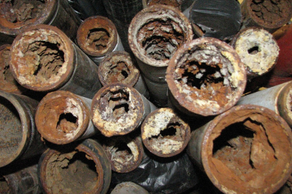
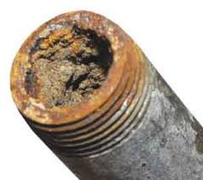
Jan 2000
Nov 13, 2019
LCRR – History of Rule
1991
Dec 2006
Lead and Copper Rule Minor Revisions
Proposed Lead and Copper Rule Revisions
Lead and Copper Rule
Lead and Copper Rule Short-Term Revisions
Notes:
Timeline: 1991 (Initial LCR), 2000 (Minor Revisions), 2006 (Short-term Revisions)
Fast-forward to November 13, 2019: FRN of proposed LCRR (October 10, 2019 – pre-publication of draft LCRR)
- February 12, 2020: Extended comment period closed. (initially, 60-day public comment period, extended to 90 days)
- Received 79K comments.

Slide 14
LCRR – Timeline
Nov 13, 2019
Jan 20, 2021
October 16, 2024
Proposed Lead and Copper Rule Revisions
Subject to EO Regulatory Review
Compliance date
Jan 15, 2021
Jun 10, 2021
Meanwhile, LCRI Rulemaking in development. Proposed by EOY. Final before 10/16/24.
Final Lead and Copper Rule Revisions
Ratified rule with effective date of 12/16/2021
Notes:
January 15, 2021: FRN publication of final LCRR (12/22/2020 released pre-publication version)
January 20, 2021: EO: Subject to Regulatory Freeze and Review:
On June 10, 2021: EPA ratified the rule undertaking two actions -
Extension of the effective date to 12/16/21. EPA delayed the effective date to undertake a review of the rule in a deliberate and thorough manner consistent with the public health purposes of the SDWA and terms and objectives of the EO.
Extension of the compliance date to 10/16/2024. EPA delayed the compliance dates to maintain same time period between effective date and the compliance date and provide PWSs with adequate time to take actions to assure compliance.
EPA hosted meetings to engage with the public and stakeholders, particularly from communities that are most at-risk of exposure to lead in drinking water.
2 public listening sessions
10 community virtual roundtables
Tribal communities virtual roundtable
National associations meeting
National co-regulator meeting

Slide 15
LCRR – Key Provisions
Service Line Materials Inventory
New Sample Site Tiering
Lead Trigger Level (TL) of 10 ppb
Lead Testing in Schools and Child Care Facilities
Small System (and NTNC) Compliance Options
Find and Fix
Notes:
** EPA’s regulatory partner at DOH, Mike Miyahira, will be presenting specifically on the materials inventory later this morning, right before lunch.
But I will say this – With the LCRI coming, this requirement in the LCRR is not going to change.
Key changes in the lead and copper rule revisions. Brief summary:
Service Line Materials Inventory: includes utility +PRIVATE ownership, initial inventory due by compliance date (10/16/24), inventory to be publicly available, and water systems >50K to make inv publicly avail electronically. LSL Inventory to identify: LSLs, Lead status UNK, galvanized lines requiring replacement, non-lead SLs. Lead connectors (goosenecks, pigtails) not required. Annual update unless on reduced m/r.
EPA issued Lead Service Line Material Inventory guidance on 8/4/2022.
New Sample Site Tiering: 3 to 5 tiers. T1/T2 (Single Family Residence/Multi-Family Residence w/LSL) + T3 (SFR w/galvanized downstr of a LSL or downstream from lead gooseneck/pigtail or connector) + T4 (SFR w/copper pipe and lead solder installed before date of State’s Pb ban + T5 (SFR/MFR with representative plumbing or UNK)
Lead Trigger Level (TL) of 10 ppb: 10-15 ppb: must fully replace LSLs – set annual goal of LSL replacement to be approved by state; [no reduced triennial sampling, annual at standard # of sites, re-optimize if CCT installed, CCT study if CCT not installed]
- For systems > AL of 15 ppb, must fully replace a minimum of 3% of known LSLs annually.
Find and Fix: Any sample>15ppb (action level). Follow up w/in 30 days + WQP w/in 5 days. [Det. if CCT fix needed (localized to system-wide CCT change, spot flushing, DS O/M, looping). ]
Lead Testing in Schools and Child Care Facilities (applicable to CWSs, mandatory testing at elementary schools): Inventory and PE w/in 3 yr of pub date. 20% of facilities/yr. 5 samples/school, 2 samples/childcare fac.
Small System (and NTNC) Compliance Options: All NTNWS/CWS <10K. If >10ppb TL, LSL replacement, CCT, POU, replacement of lead bearing materials (limited)

Slide 16
LCRR – Key Provisions
Service Line Materials Inventory
Have you started yet?
Notes:
With the LCRI coming, this requirement in the LCRR is not going to change.
Service Line Materials Inventory: includes utility +PRIVATE ownership, initial inventory due by compliance date (10/16/24), inventory to be publicly available, and water systems >50K to make inv publicly avail electronically. LSL Inventory to identify: LSLs, Lead status UNK, galvanized lines requiring replacement, non-lead SLs. Lead connectors (goosenecks, pigtails) not required. Annual update unless on reduced m/r.
EPA issued Lead Service Line Material Inventory guidance on 8/4/2022.

Slide 17
LCRR – Key Provisions
Service Line Materials Inventory
Have you started yet?
Start NOW.
Notes:
With the LCRI coming, this requirement in the LCRR is not going to change.
Service Line Materials Inventory: includes utility +PRIVATE ownership, initial inventory due by compliance date (10/16/24), inventory to be publicly available, and water systems >50K to make inv publicly avail electronically. LSL Inventory to identify: LSLs, Lead status UNK, galvanized lines requiring replacement, non-lead SLs. Lead connectors (goosenecks, pigtails) not required. Annual update unless on reduced m/r.
EPA issued Lead Service Line Material Inventory guidance on 8/4/2022.

Slide 18
Lead & Copper Rule Improvements (LCRI)
EPA intends to propose changes regarding the following:
Replace All Lead Service Lines as Quickly as Feasible
EPA projected that only 5-6% of known LSLs would be replaced over the 35-year period of analysis for the rulemaking.
The Bipartisan Infrastructure Law (BIL) provides $15 billion in funding over the next five years for LSLR
Evaluate Options to Prioritize Historically Underserved Communities
Strengthen Compliance Tap Sampling Requirements
5th L sampling vs. 1st L sampling: using the higher number
Reduce Complexity Associated with Action and Trigger Levels
Notes:
Out of the $15B, the FY22 allocation is $2.9B to States, Tribes, & territories. Hawaii’s FY22 allotment is $28.35M.
Action & Trigger Levels: The agency will evaluate options to consolidate and potentially lower the LCRR’s action and trigger levels. Will consider elim’n of the trigger level if action level is lowered.

Slide 19
America’s Water Infrastructure Act (AWIA)
Unregulated
Contaminant
Monitoring
Risk and Resilience Assessments & Emergency Response Plans
Consumer
Confidence
Reports
Notes:
America’s Water Infrastructure Act 2018 resulted in the most significant changes to the SDWA since 1996. It imposes EPA action for 30 program areas.

Slide 20
AWIA
Revisions to the Consumer Confidence Report (CCR) Rule
Content (ALEs, CCT)
Form (Electronic)
Frequency (Semi-annual)
Proposal: Mar. 28, 2023 (signed)
Final: March 2024
Notes:
Intent: AWIA Section 2008* revises requirements for content, form, manner and frequency of CCRs for CWSs>10K.
New key provisions:
All CWSs to report corrosion control efforts and action level exceedances requiring corrective action
Allows for electronic delivery
Twice a year delivery for CWSs>10K
National Drinking Water Advisory Council (NDWAC) Working Group to provide input.
NRDC filed lawsuit against EPA on 1/19/21. Pending Consent Decree with NRDC to inform CCR development schedule.

Slide 21
Biannual (Twice Per Year) Delivery for Community Water Systems ≥ 10K
Notes:
CWSs serving >=10K persons:
Must distribute a 6-month update with the annual CCR by 12/31 that includes:
Info about any violations and/or ALEs 1/1-6/30 of the current year
Newly avail UCMR monitoring results from the prev reporting yr.
*For those w/zero of #1 or #2 above, must resend the annual CCR by 12/31.

Slide 22
Revised CCR Rule Timeline
April 5, 2023
Notes:
The proposed rule was published in the FR on April 5, 2023.
EPA was accepting comments on the proposed rule through May 22, 2023.
EPA is scheduled to sign the final Revised CCR Rule by March 15, 2024.
EPA is proposing that CWSs and primacy agencies must comply with new requirements beginning in 2025.
Primacy agencies can request a 2-yr extension to submit revised primacy packages → spring 2028.
CMD=compliance monitoring data

Slide 23
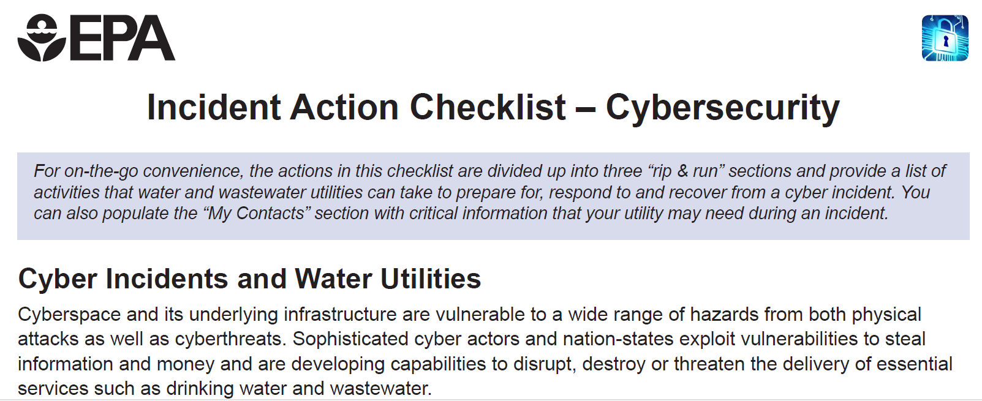
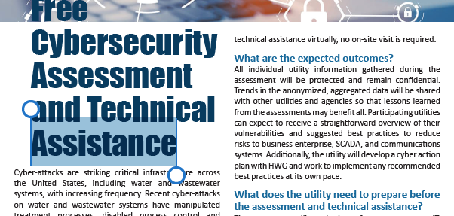
Cybersecurity
“Top threat facing business and critical infrastructure in the United States”….FBI and DHS.
“SolarWinds hack was one of the biggest cybersecurity breaches of the 21st century. It triggered a much larger supply chain incident that affected thousands of organizations, including the U.S. government.”….Whatis.TechTarget.com.
“Water utilities face increasing risk to Cyber Attack”...SCADAfence.
“Water systems should examine cybersecurity vulnerabilities and develop a cybersecurity risk management program”….AWWA.
5
Notes:
Cyber-attacks against PWSs are increasing. Past incidents have shown that these attacks have the potential to disable or contaminate the delivery of drinking water to consumers
Cybersecurity is a priority to improve resiliency of water sector to cyberattacks.
Hardening to address cybersecurity has been via voluntary programs thru TTA.
Recent survey and reports show that PWSs have failed to adopt basic cybersecurity best practices and are at high risk of being victimized by a cyber-attack
Across all water sectors, DHS and FBI have reported a 300% increase in attacks against critical infrastructure..
Use of operational technology, including industrial control systems like SCADA, in the production and distribution of drinking water has become widespread among PWSs of all sizes and types.
These control systems have allowed PWSs to reduce onsite staffing and to operate collection, treatment, and distribution system processes more efficiently. Notably, they permit remote monitoring and operation by offsite personnel, including third parties.
However, operational technology is also vulnerable to being disabled or manipulated through malicious cyber activity, which are occurring with increasing frequency.
Documented activity has have utilized various techniques, such as stolen credentials from authorized users, malicious URLs and websites, vulnerabilities in software applications, compromised third party software and service providers, insecure remote access systems, insider attacks, and others. Intrusion by a cyber threat actor into an operational technology network can compromise the ability of a water system to produce and/or distribute safe drinking water.
For example, incidents of malicious cyber activity on PWSs have shut down critical treatment processes, locked up control system networks behind ransomware, and disabled communications used to monitor and control distribution system infrastructure like pumping stations.

Slide 24
Cybersecurity
Cybersecurity
EPA Interpretative Memorandum – March 3, 2023
What Action is EPA Taking?
States to evaluate cybersecurity during sanitary surveys
Target PWSs using operational technology
Address cybersecurity gaps determined to be significant
How will States and PWSs Comply?
Self assessment or 3rd party assessment of cybersecurity practices
State evaluation of cybersecurity practices during sanitary surveys
Alternative State Program for Water System Cybersecurity
What Technical Support is EPA Offering?
Guidance (draft)
Optional checklist of cybersecurity practices
Training (states, PWSs)
EPA Technical Assistance
EPA Water Sector Cybersecurity Evaluation Program
EPA Water Sector Cybersecurity TA Program
https://www.epa.gov/waterriskassessment/epa-cybersecurity-water-sector
5
Notes:
Past incidents have shown that cyber-attacks have the potential to disable or contaminate the delivery of drinking water to consumers.
Recent survey and reports show that PWSs have failed to adopt basic cybersecurity best practices and are at high risk of being victimized by a cyber-attack.
EPA’s interpretation uses existing regulatory authority to ensure that all states regularly evaluate cybersecurity at their PWSs.
The goal is to correct gaps in cybersecurity that could impact safe drinking water.
Sanitary surveys allow for state discretion to determine cybersecurity gaps are significant and steps a PWS should take to address.
Target PWSs: PWS uses an Industrial Control System or other operational technology as part of the equipment or operation of any required component of the sanitary survey, then the state must evaluate the adequacy of the cybersecurity of that operational technology, including the cybersecurity of interdependent systems, for producing and distributing safe drinking water.
EPA providing flexibility to states with multiple approaches
(1) Self assessment/3rd party:
States may require PWSs to conduct a self-assessment. PWSs could use any state-approved method (DOH CISA, IST, AWWA, ISO), including optional EPA checklist (in guidance).
PWS could undergo an assessment by a state-approved outside party (e.g., EPA Water Sector Cybersecurity Evaluation Program or CISA Cybersecurity Advisor.
Must be completed prior to state sanitary survey and made available to state. State to confirm completion and identify cybersecurity gaps are SD.
(2) State Evaluation
(3) Alternative State Program for Water System Cybersecurity
State use a cybersecurity program other than sanitary surveys to meet requirement (eg, state homeland security agency initiative)
EPA Technical Assistance
EPA’s Water Sector Cybersecurity Evaluation Program will conduct the necessary cybersecurity assessments of PWSs and identify gaps, including potential significant deficiencies, for state review during the sanitary survey.
EPA’s Water Sector Cybersecurity Technical Assistance Program will provide a response (email or phone) by an SME within 2 days to questions from states and PWSs on cybersecurity gaps, remediation actions, and other sanitary survey questions.
While this guidance is designed to be used right away, EPA is also requesting public comment on Sections 4-8 of the guidance and all Appendices until May 31, 2023. To submit comments, please email wicrd-outreach@epa.gov.

Slide 25
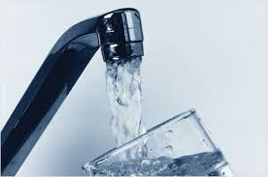
Anna Yen, P.E.
US EPA Region 9
yen.anna@epa.gov
(415) 972-3976
Any Questions?

