Slide 1
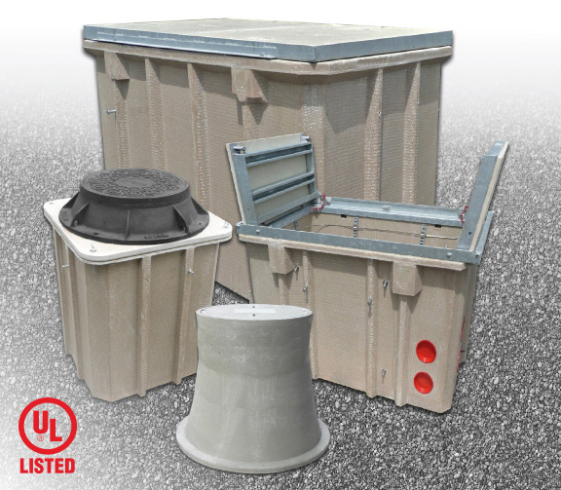
Raffi Soghomonian (Hubbell/ Armorcast)
Advantages of Polymer Concrete vs Concrete

Slide 2
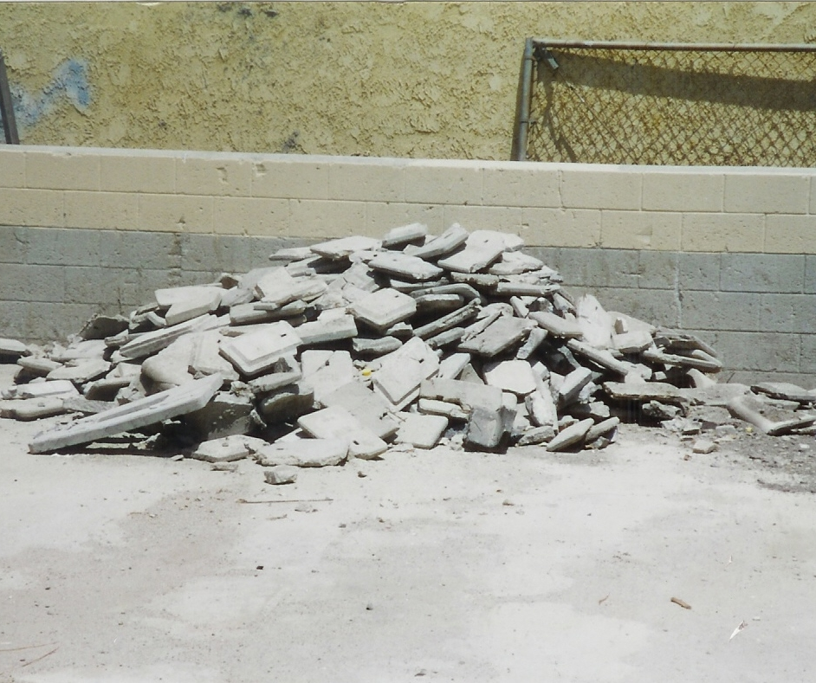
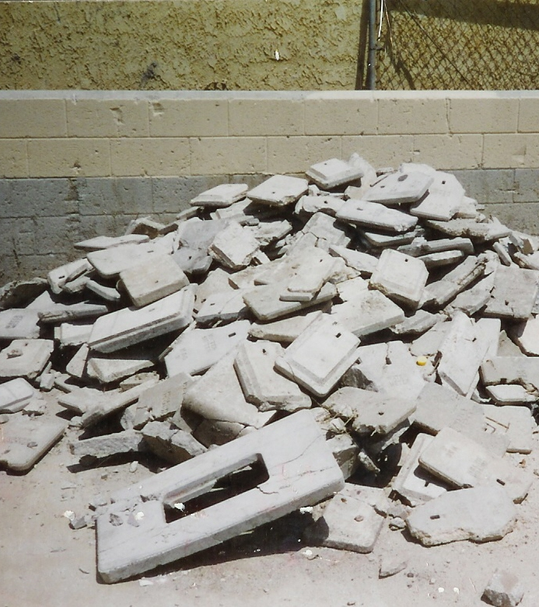
The Problem

Slide 3
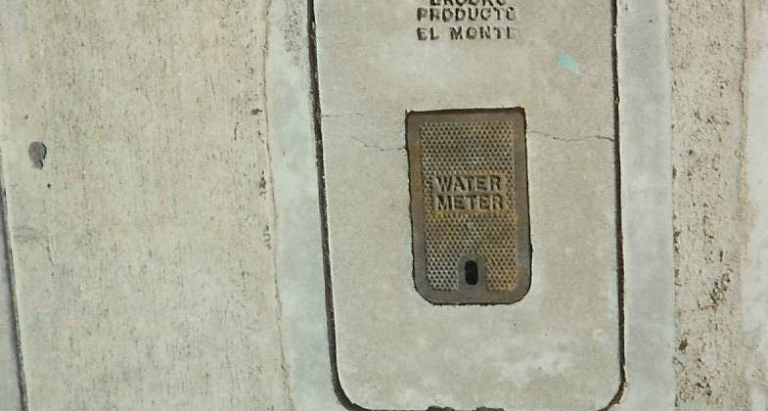
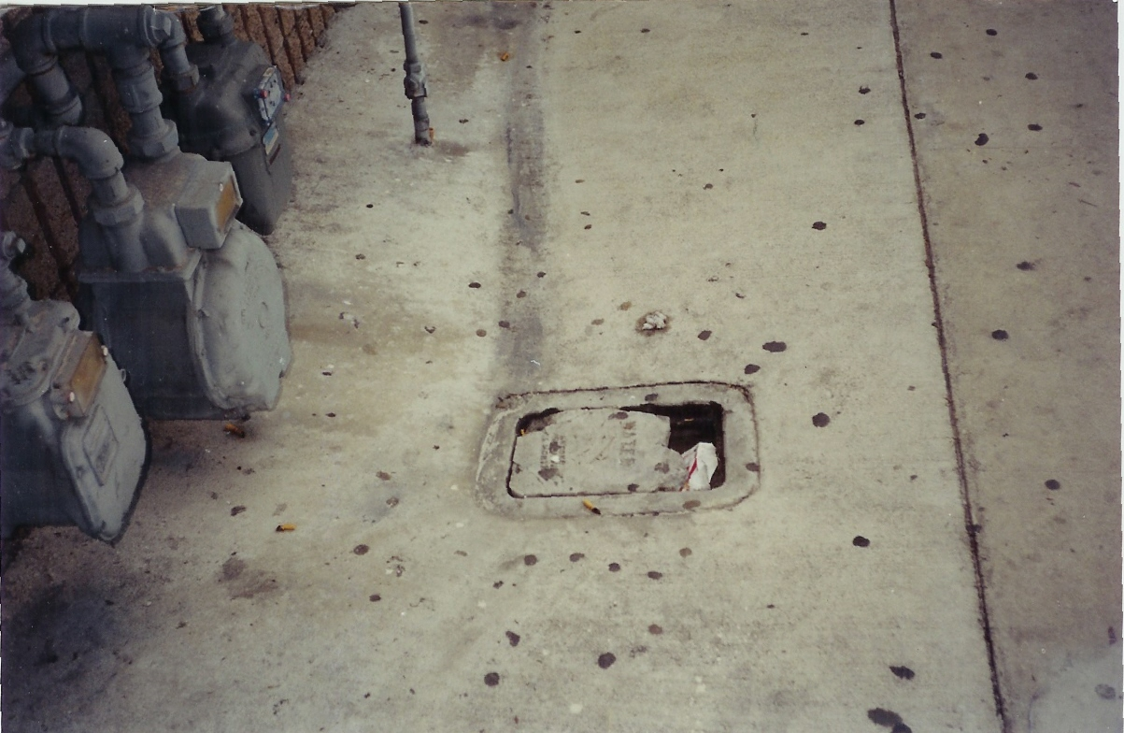

Slide 4
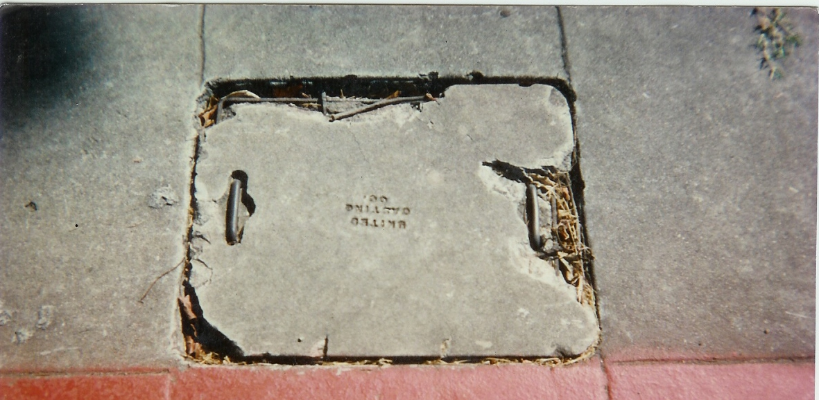
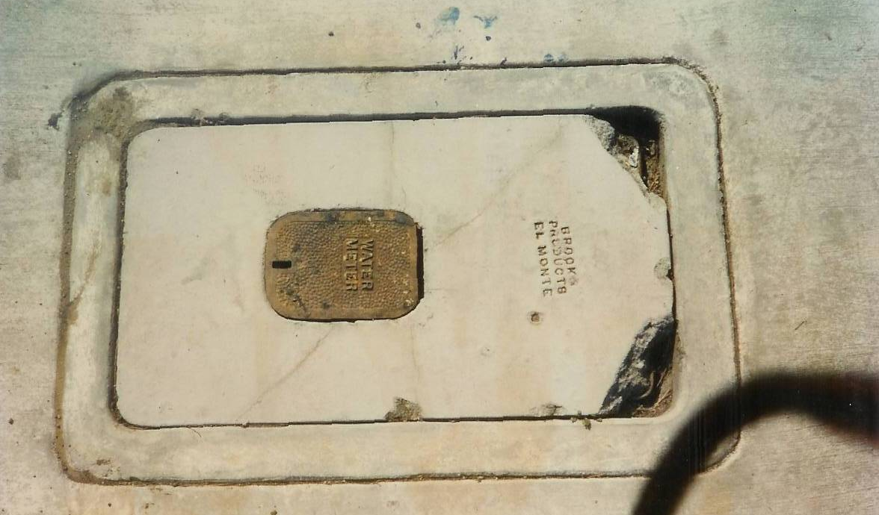

Slide 5
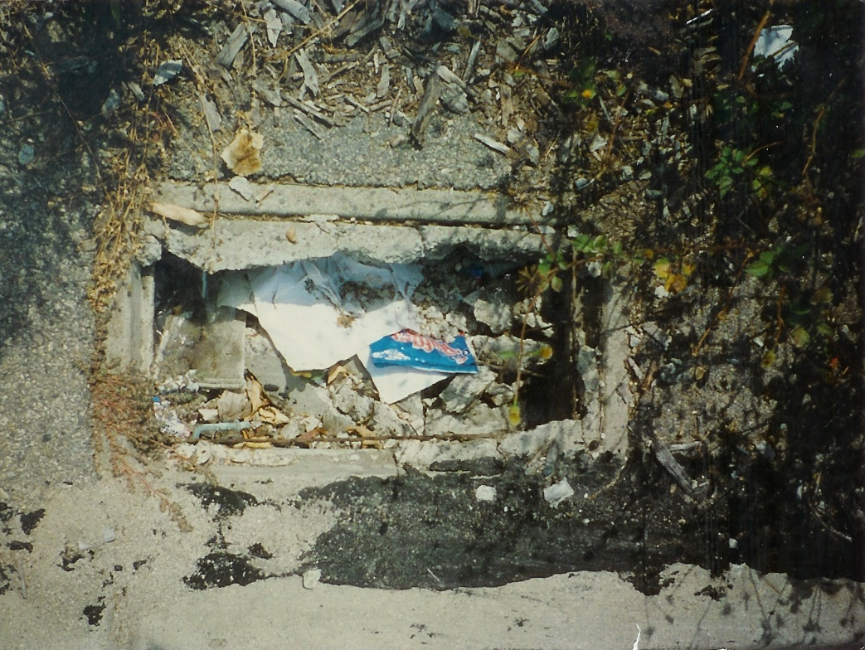
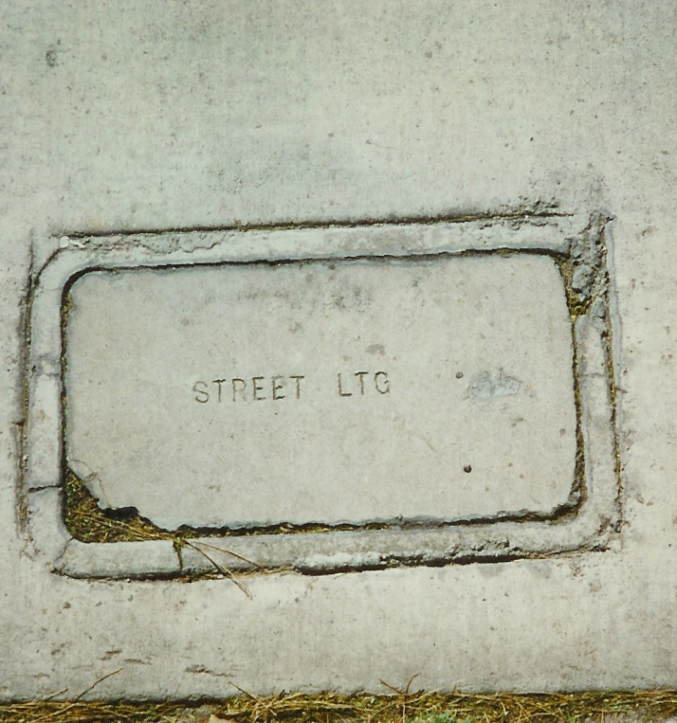

Slide 6
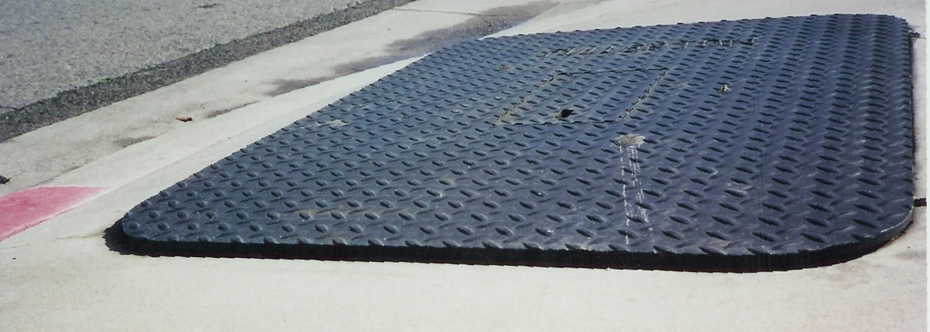
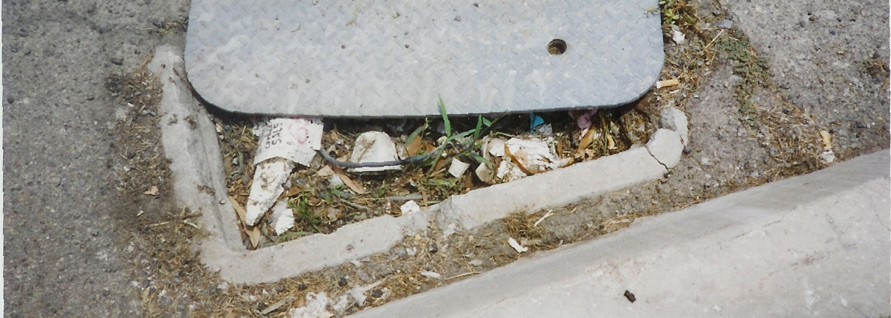

Slide 7
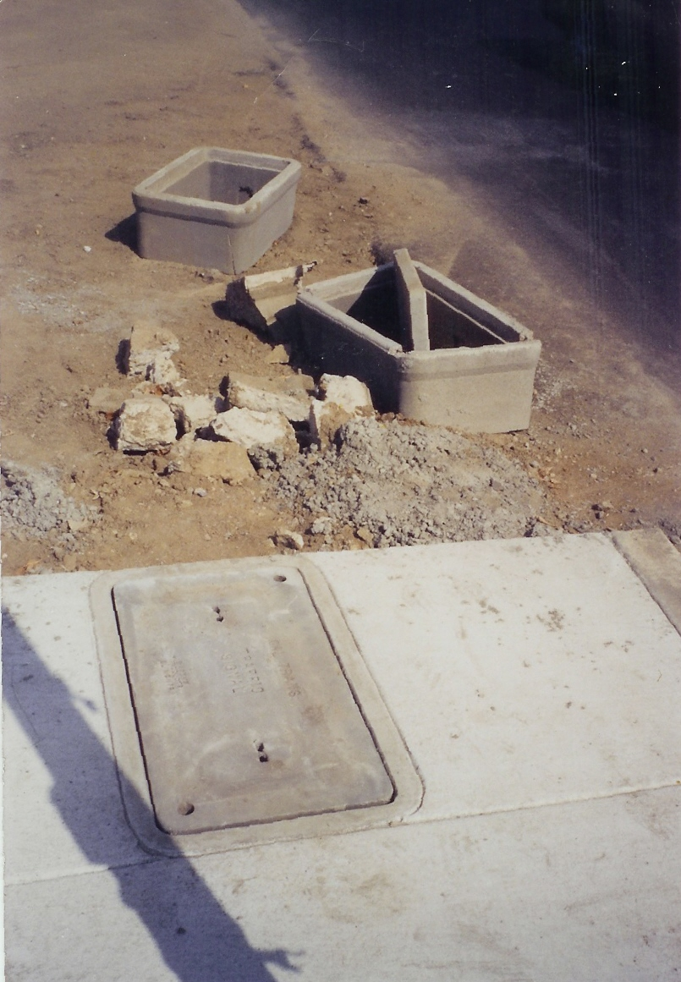

Slide 8
And The Solution…
POLYMER CONCRETE

Slide 9
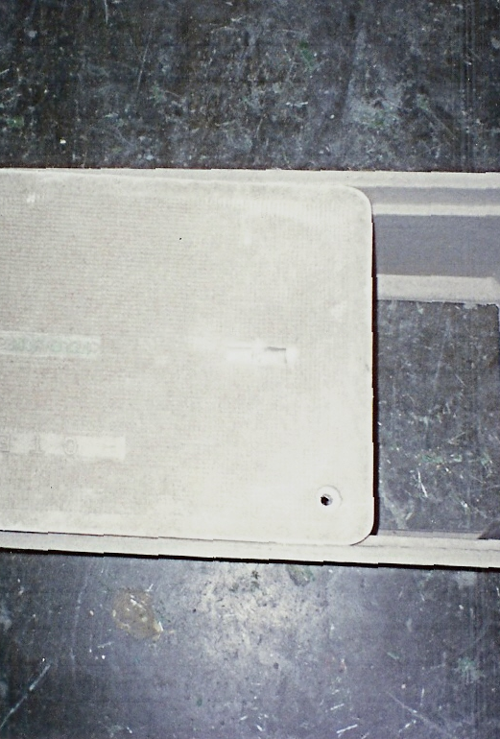
What is Polymer Concrete?
Polymer Concrete or Reinforced Polymer Mortar (RPM) is a term applied to a series of “filled” or “extended” plastic resin binder system having a structural fiber reinforcement for strength and durability. These systems were derived from the Fiberglass Reinforced Plastic (FRP) concept normally referred to as fiberglass

Slide 10
The evolution of “RPM” began with a desire to reduce the raw material costs of “FRP” products by extending or reducing the amount of plastic resin required for each part. This was accomplished by using low-cost fillers such as sand of the granular consistency “Face Powder”. These initial attempts were successfully applied to several common products where physical product mass was paramount in the end-product usage.

Slide 11
As the “RPM” research and development progressed, it became apparent that the “fillers” could be blended to obtain a desirable physical and chemical properties equal or superior to “FRP” as well as other generally used materials. This discovery widened the probable application of “RPM”.
When the raw materials are combined through a process of mixing, molding, and curing, an extremely powerful bond is formed.

Slide 12
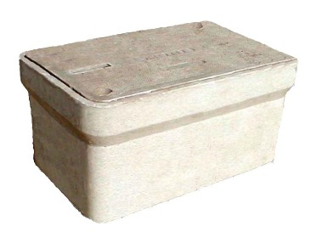
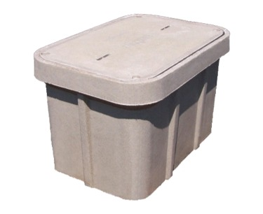
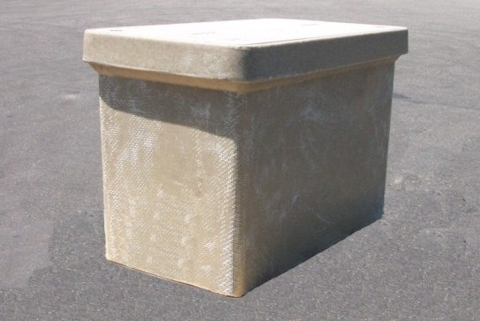
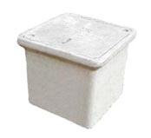
Polymer Concrete Meter Boxes
Polymer Concrete Meter Boxes are available in sizes ranging from 06”x 08” to 30”x 48” and depths ranging
from 6” to 48”

Slide 13
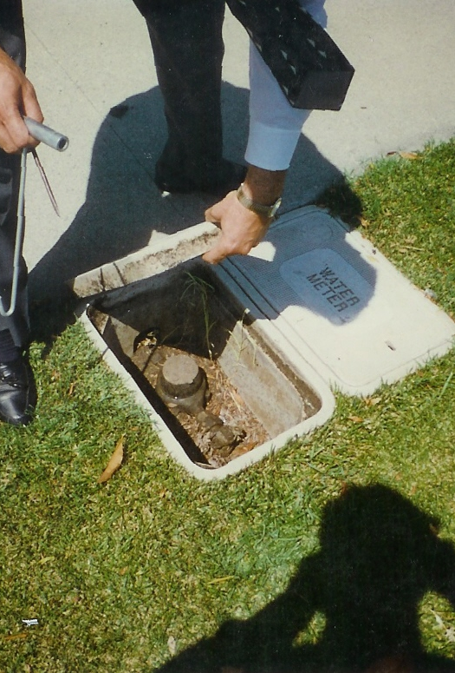
Polymer Concrete Properties
Higher compressive, shear and tensile strength lighter weight than conventional concrete
Thinner walls and lower weights up to 75% less weight
Very Low water absorption compared to concrete (<1% vs. 9%)
Higher slip resistance than concrete
Meets ADA Slip Resistance Requirements
Non-metallic reinforcement, Fiberglass Roving. No risk of corrosion
Resistant to spalling
Excellent chemical and weathering resistance unaffected by Freeze/Thaw Cycles
Higher impact resistance
Higher load carrying capacity
ease of installation and less installation and maintenance cost

Slide 14
POLYMER CONCRETE LOAD RATINGS
Designed to Industry Specifications
Western Underground Committee – WUC 3.6
ANSI / SCTE77-2017
UL LISTED
ASTM
AASHTO
Customer Specifications
Products to Meet Specific Load Rating Requirements
Pedestrian – Green Belt
10K (Tier 8)
20K (Tier 15)
33K (Tier 22)
H20-44 (Heavy Traffic – Roadway Applications)

Slide 15
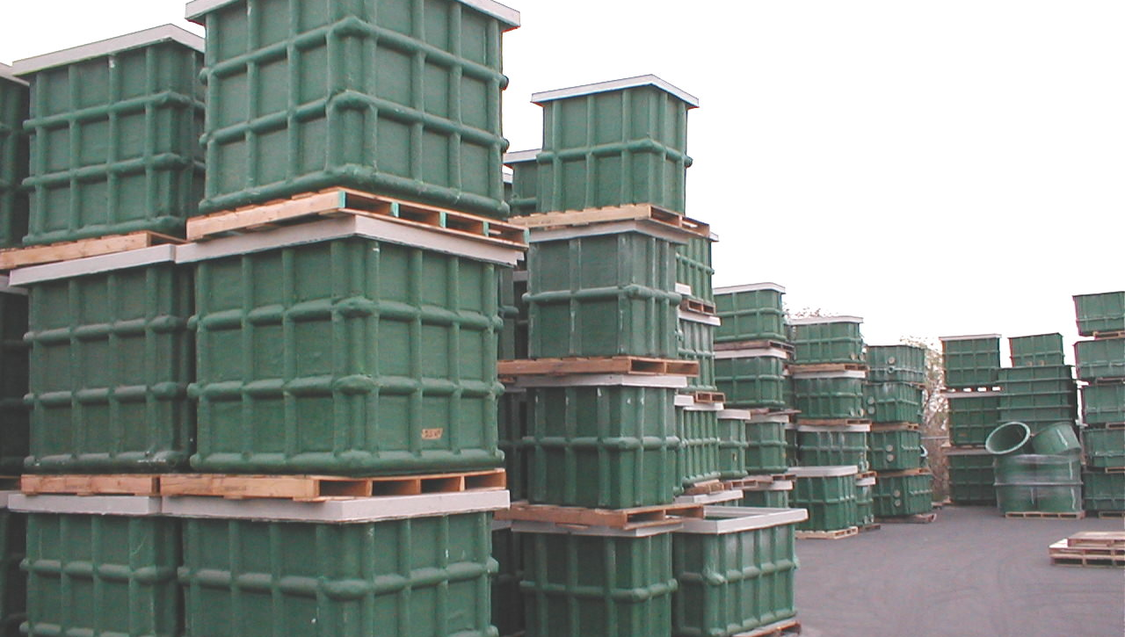
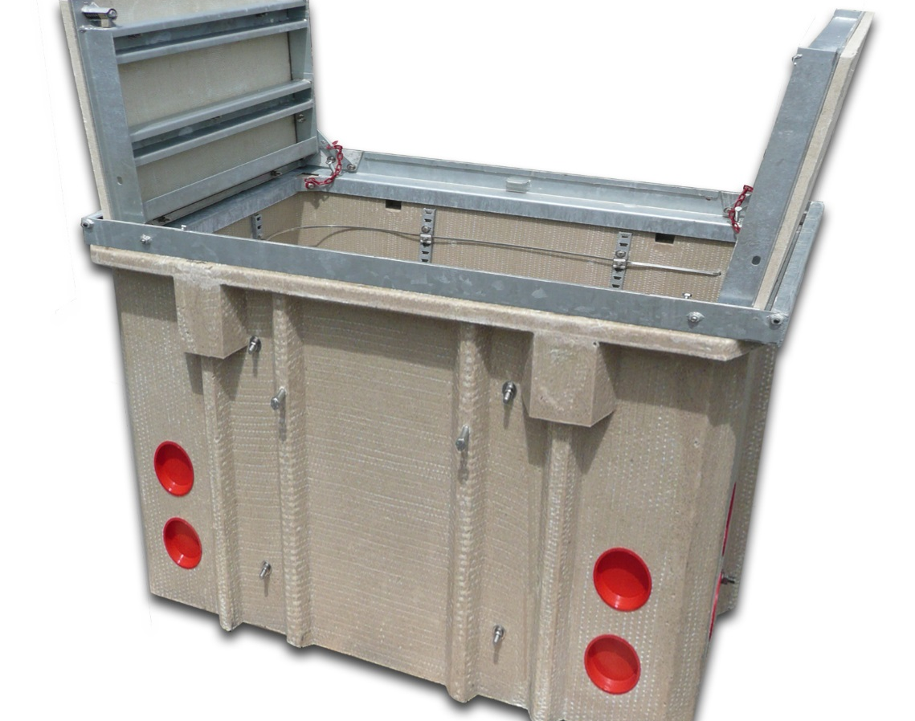
Vaults
Polymer Concrete or Fiberglass Construction
Lightweight replacement solution for conventional concrete vaults
Lower installation cost
Available in 10K or 20K Load Rating
Open Bottom, Solid Bottom or Intercept Base
Torsion assist covers &Polymer Concrete flush mount covers are available

Slide 16
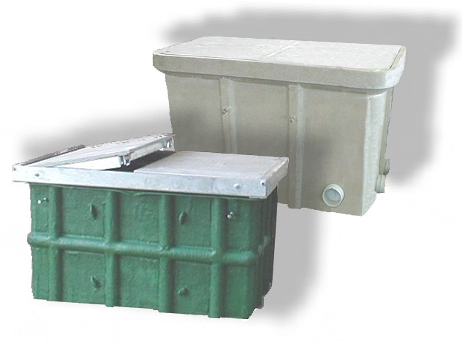
Polymer Concrete & FRP Vaults
SIZES
30” x 48”
30” x 60”
36” x 36”
36” x 60”
44” x 60”
48” x 48”
48” x 60”
48” x 72”
48” x 78”
48” x 96”
OPTIONS INCLUDE
Open Bottom
Solid Bottom
Intercept Base
Extensions
Torsion Assist covers
Mouseholes
Terminators
Cable Racks
EMS Markers
Pulling Eyes
Standard Depths
18” to 48”
C

Slide 17
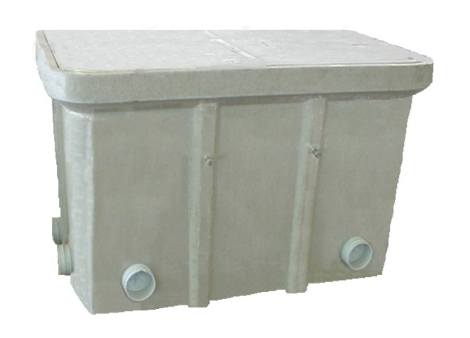
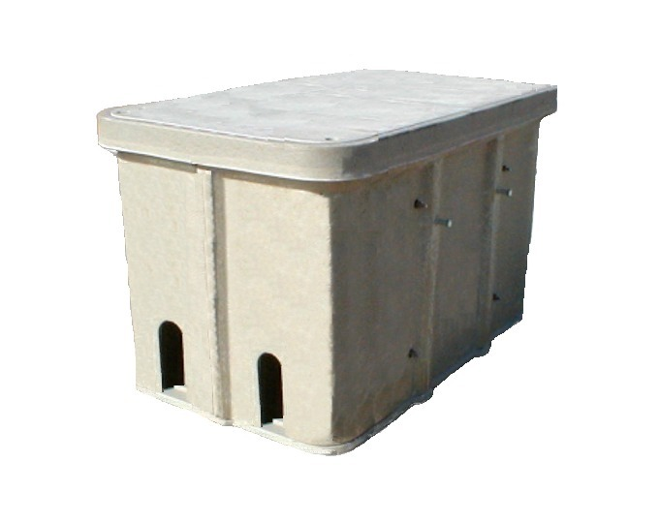
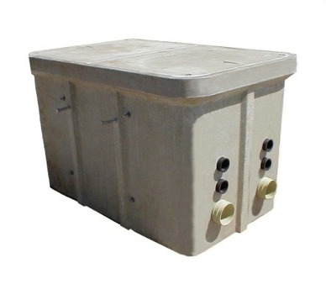
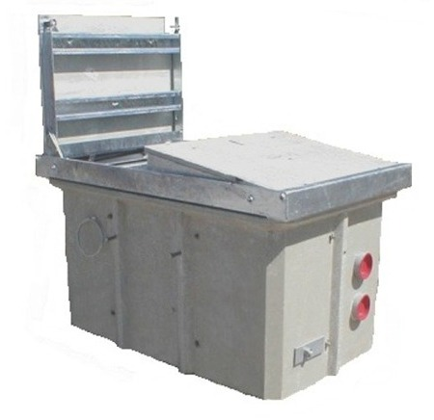
Polymer Concrete Vaults
Various Styles Include:
Open Bottom
Intercept Base
Solid Base
Torsion Assist
C

Slide 18
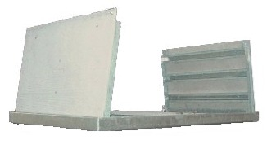

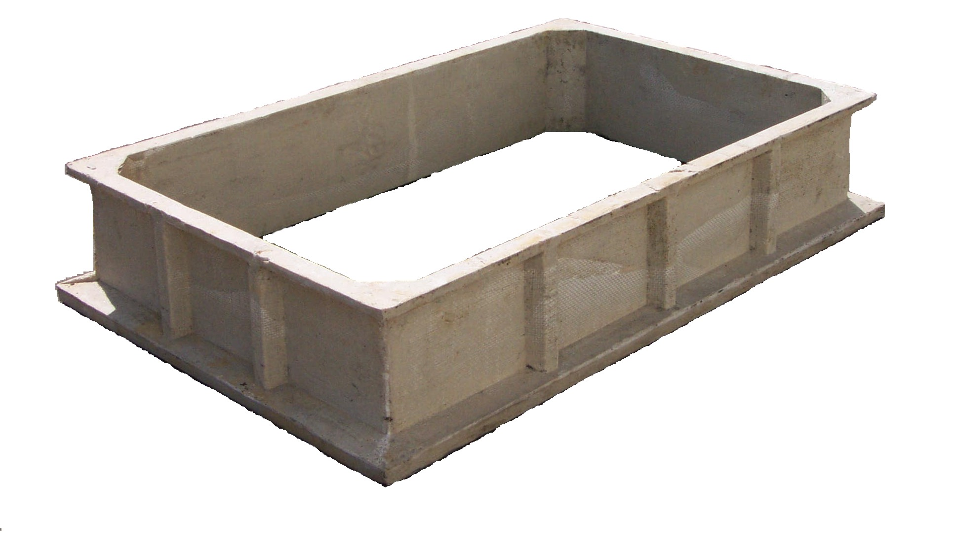
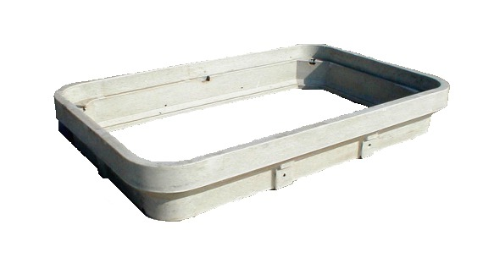
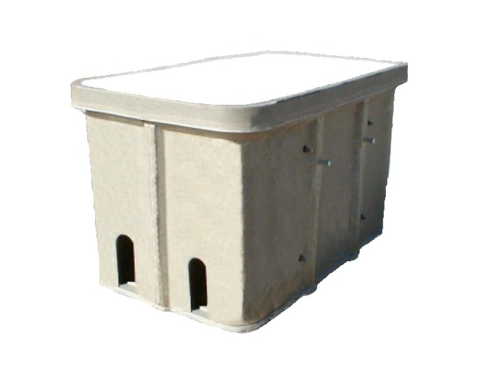
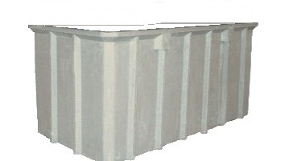
Polymer Concrete Vault Extensions
Easy Field Install
C

Slide 19
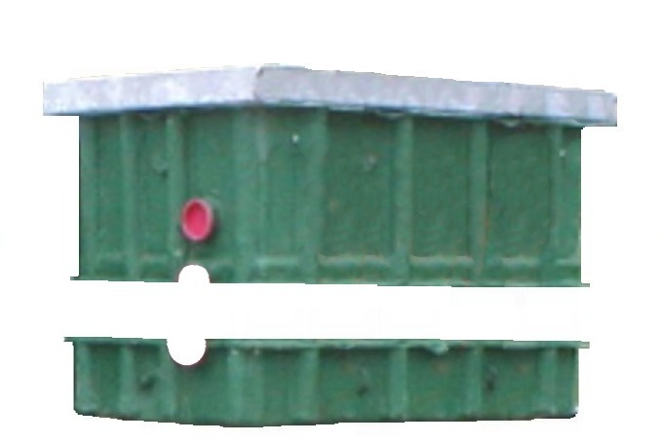
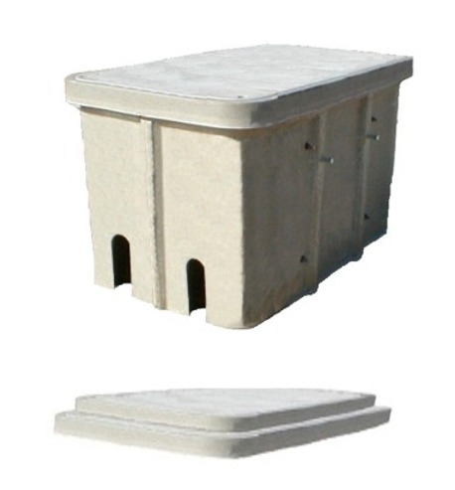
Intercept Vaults
Available in numerous sizes and configurations in either Polymer Concrete or Fiberglass
Designed to intercept and slide under existing ducts or conduits
Available in 10K or 20K load ratings
Vault body secures to installed vault base
Contact factory for sizes and details
C

Slide 20
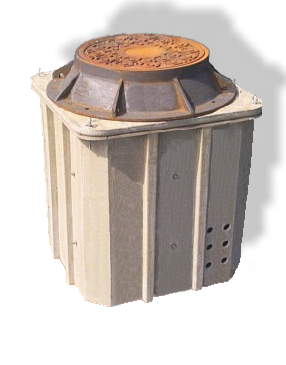
Manhole Assemblies
Lightweight Replacements Alternative for Heavy and Cumbersome Concrete Manholes
AASHTO – H20 Load Rated
Polymer Concrete Construction
No Cranes Required For Handling Or Installation
Backhoe Can Easily Set All Sizes
Sizes Range From 3’ x 5’ to 4’ x 8’, In Various Depths
Round Manholes Also Available, Contact Factory
Options include Terminators, Mouseholes, Ladders, Cable Racks, Pull Eyes, etc.
C

Slide 21
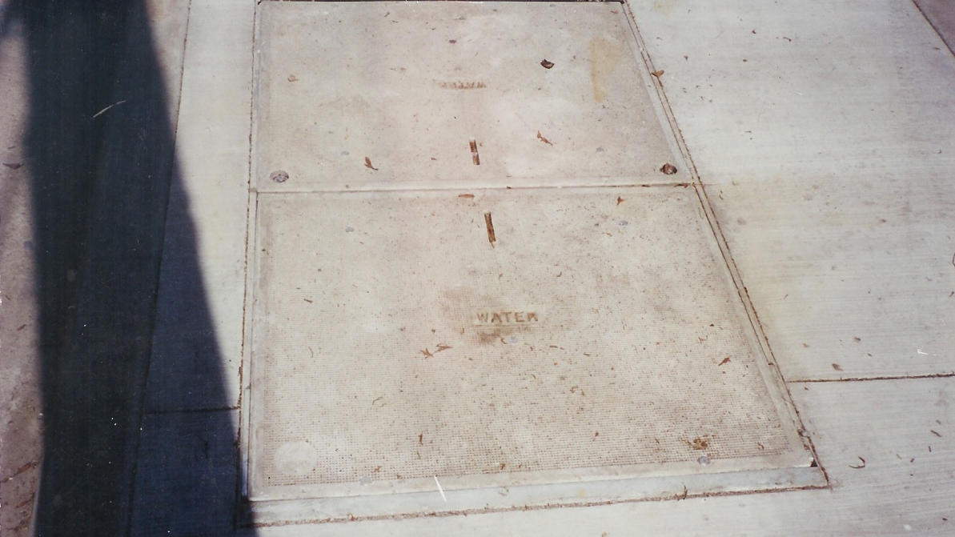
Torsion Assist Vaults

Slide 22
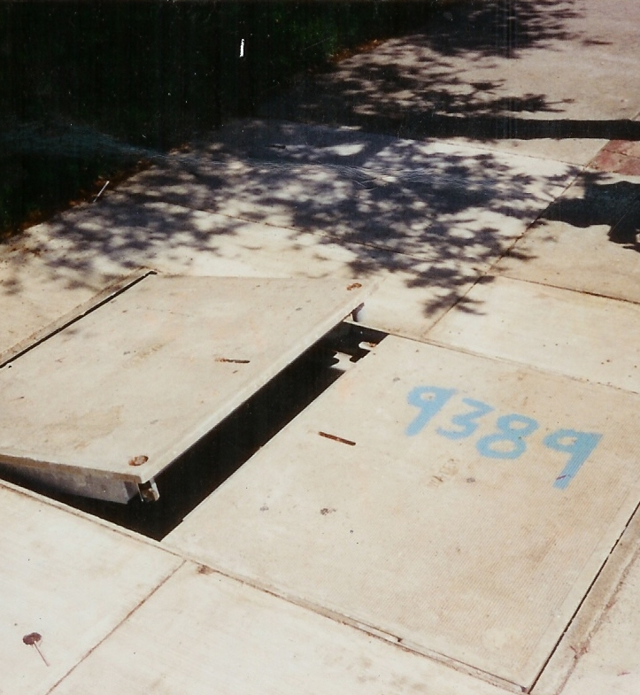
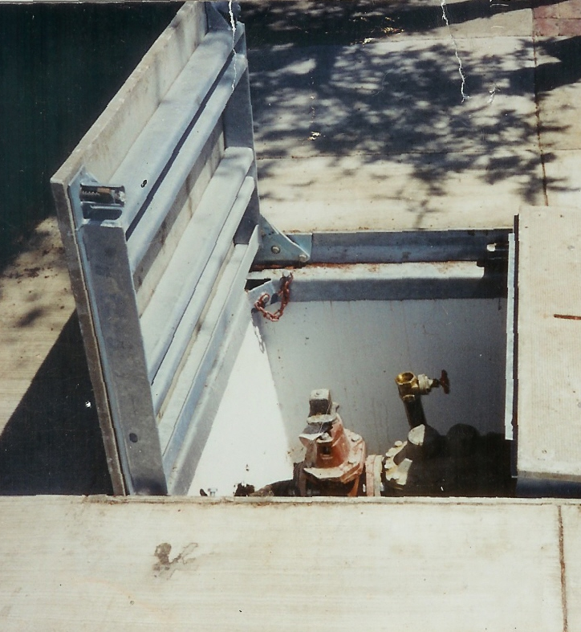

Slide 23
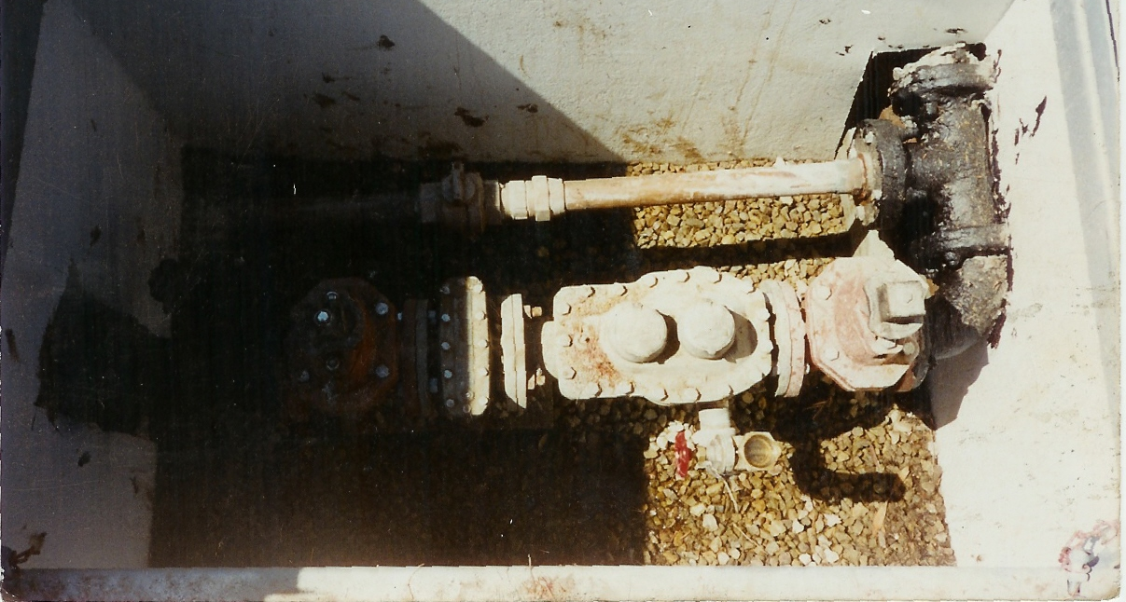
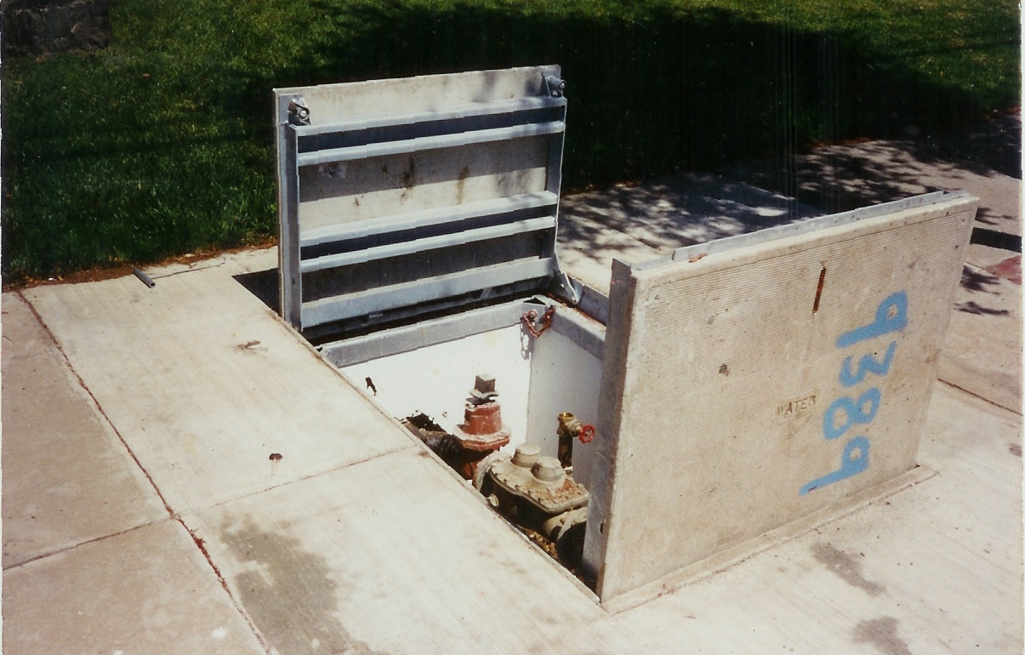

Slide 24
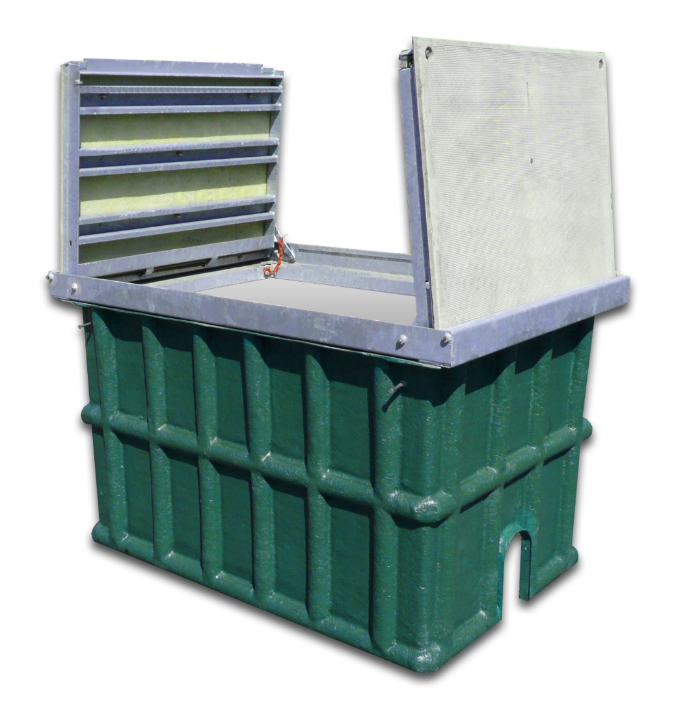
VAULT INSTALLATION

Slide 25
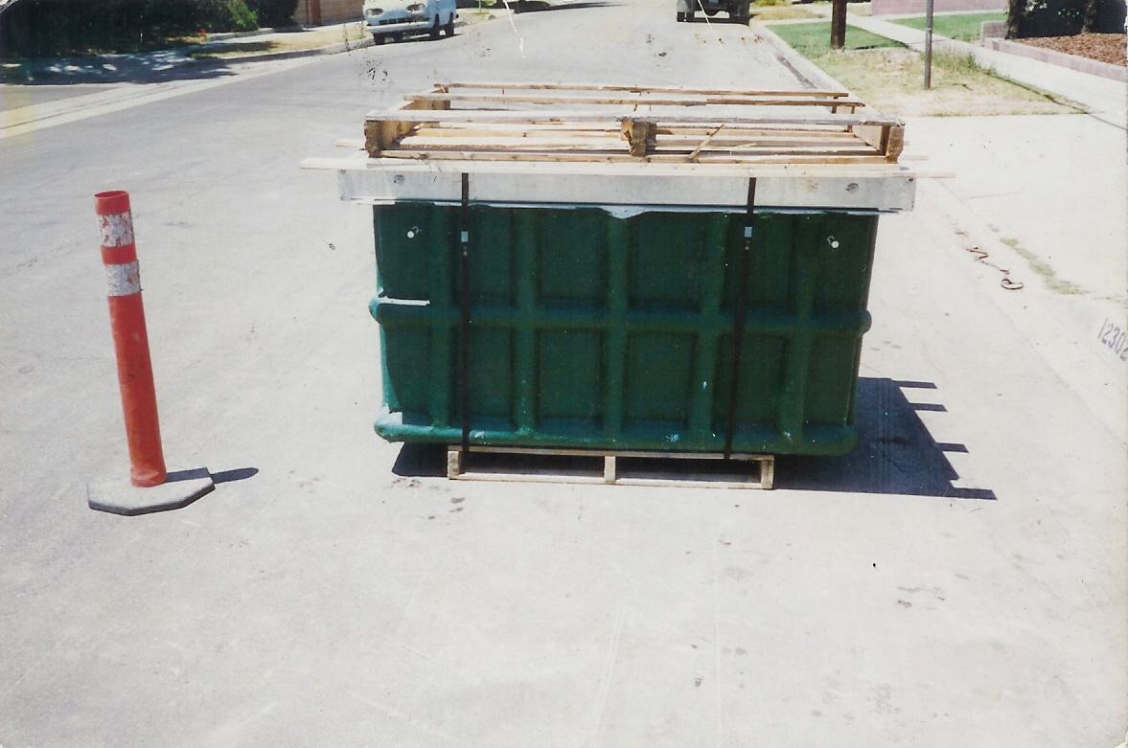
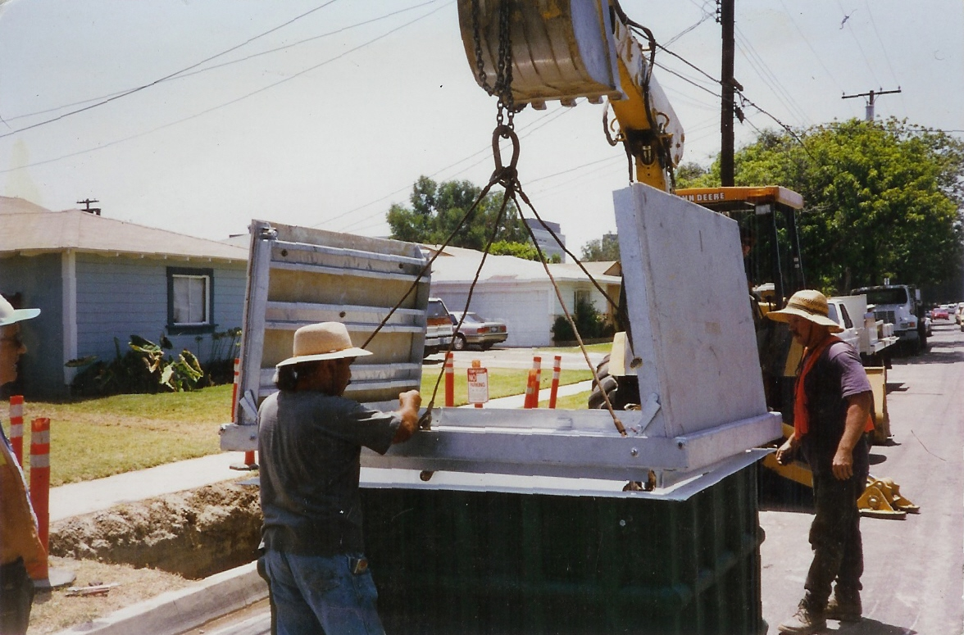
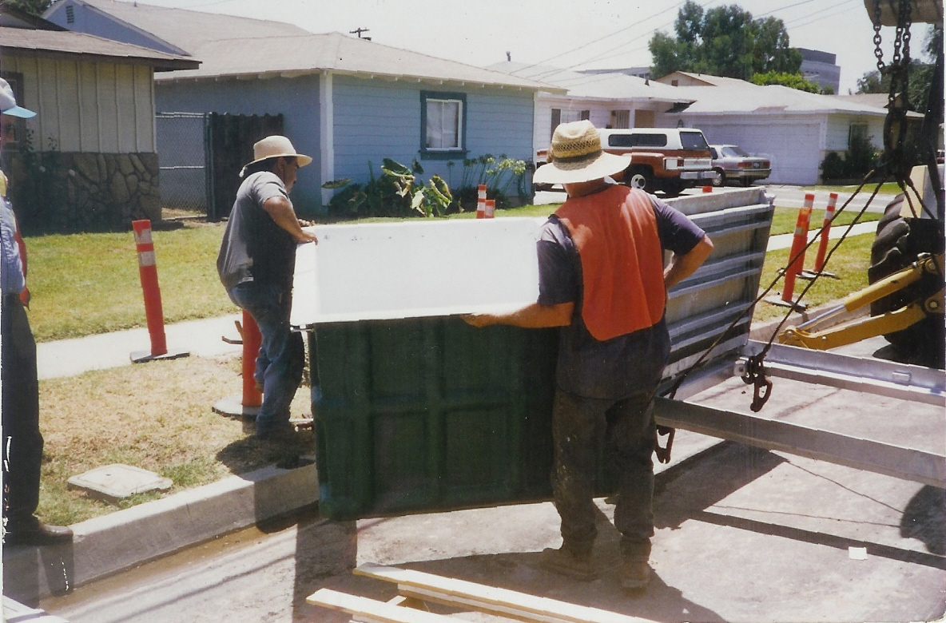
Preparation & Installation

Slide 26
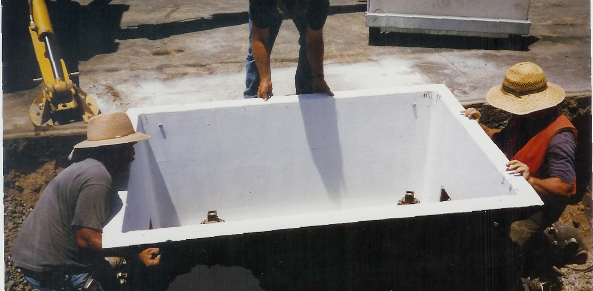
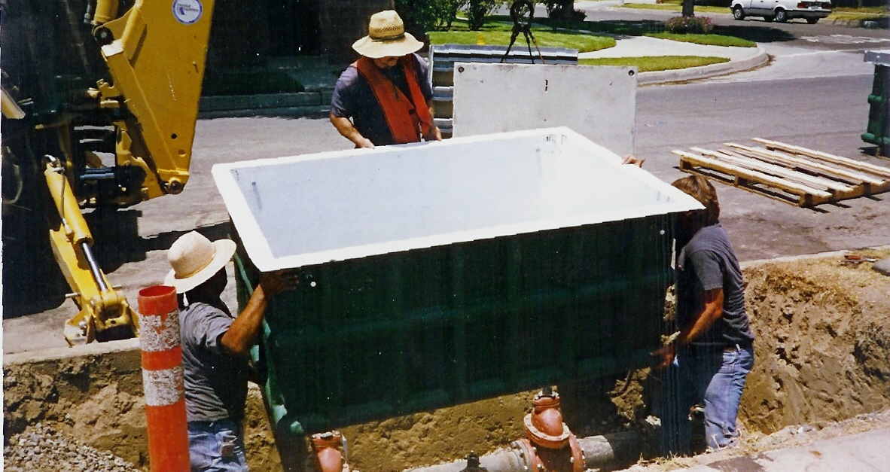
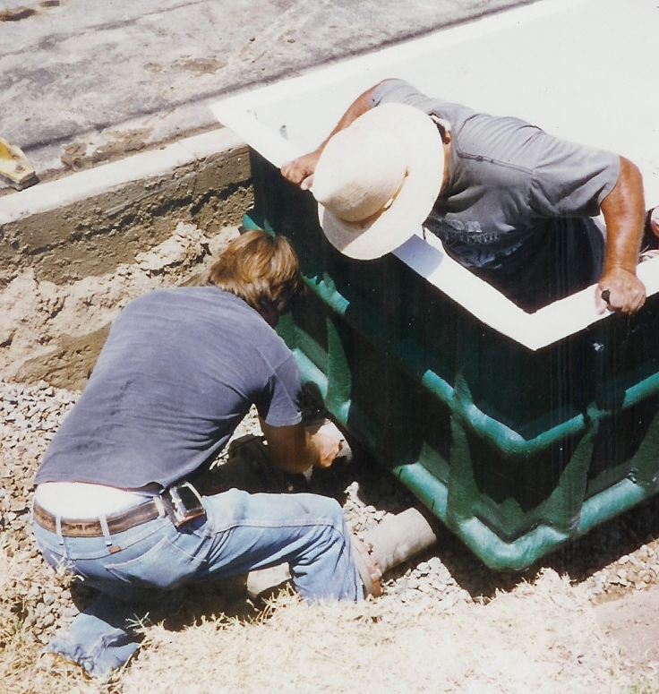

Slide 27
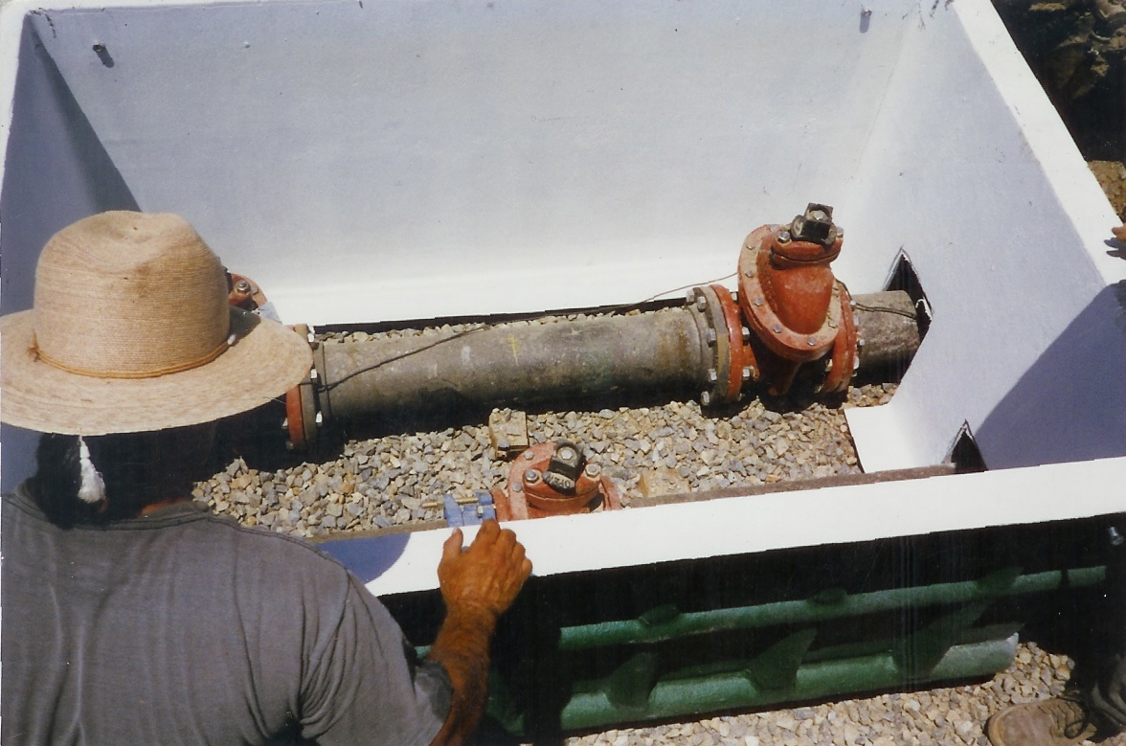
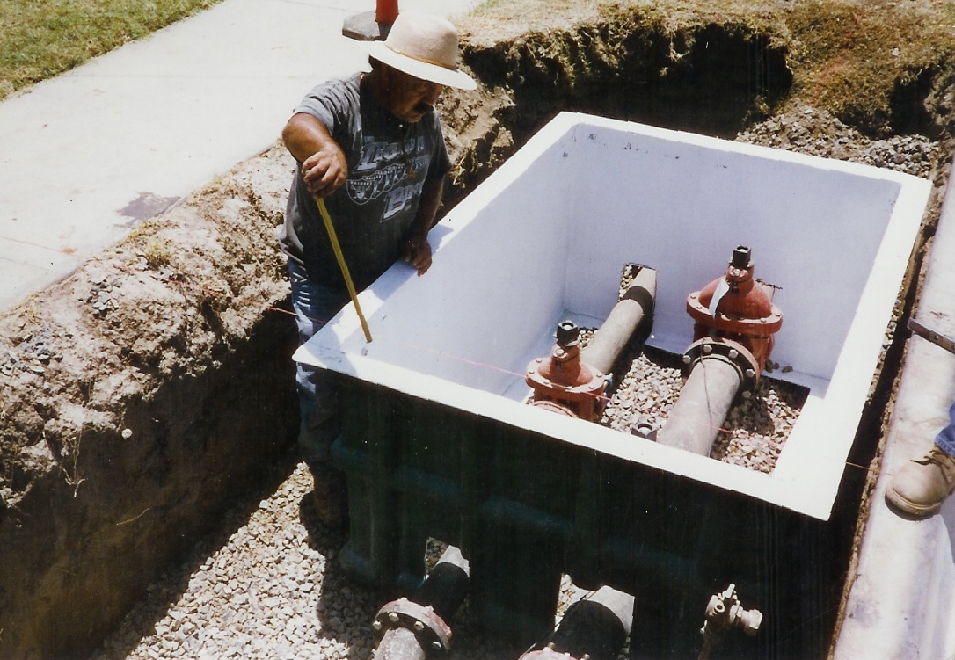
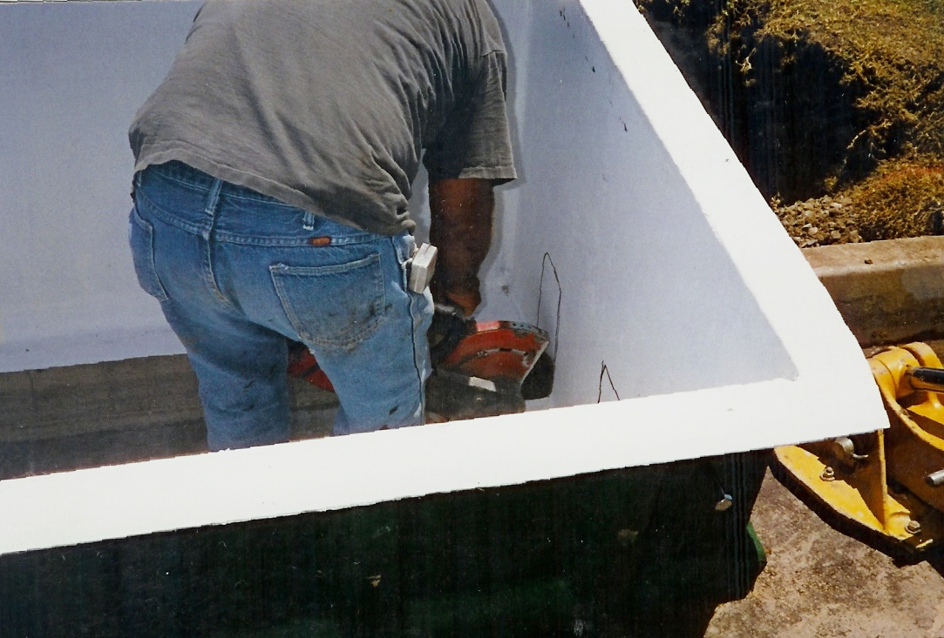

Slide 28
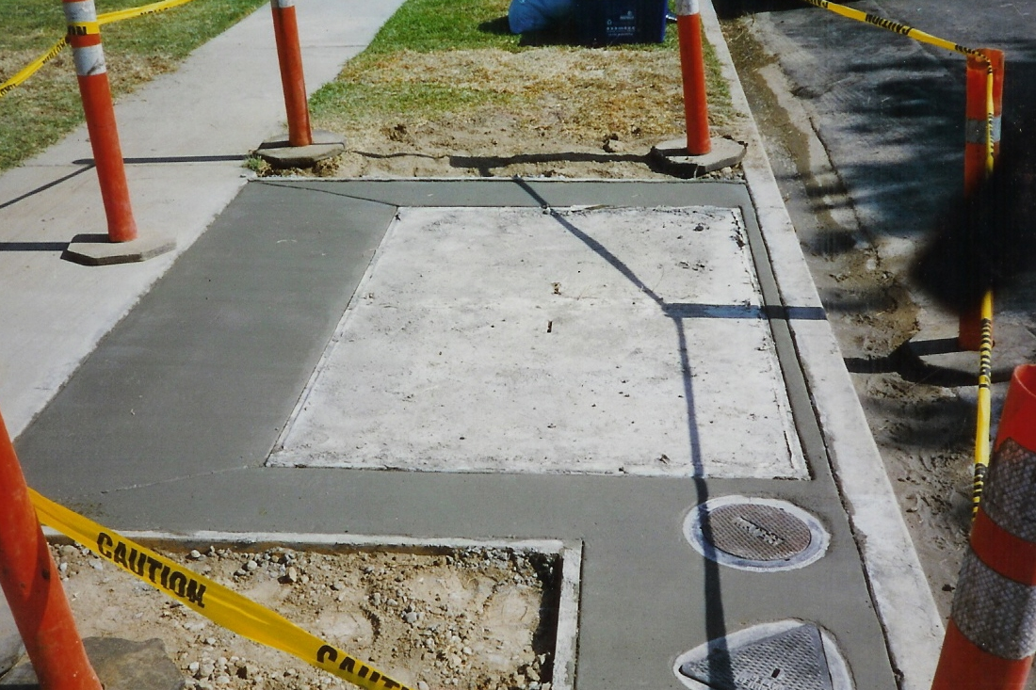
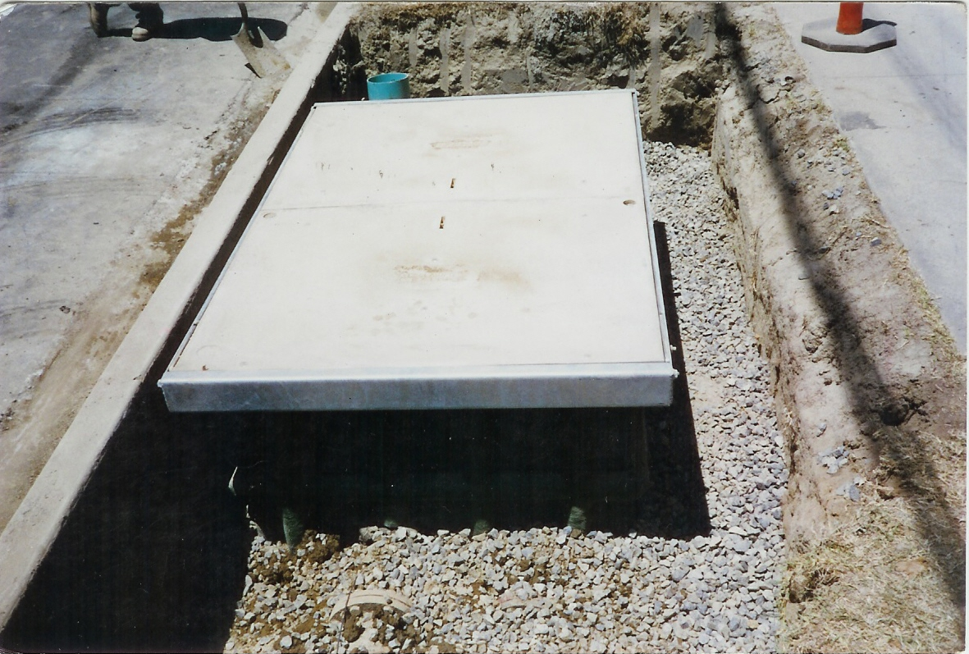


Slide 29


After – Polymer Concrete Torsion Assisted Vault
Before

Slide 30
Questions, comments or concerns?

Slide 31
THANK YOU
Raffi Soghomonian
rsoghomonian@hubbell.com
(818) 618-2034

