Slide 1

Lead Service Line Inventory Requirements of the LCRR:
How do I start? And Other Questions…
EPA RULES
MICHAel Miyahira, P.e.
Engineering section supervisor
Hawaii safe drinking water branch
May 24, 2023 HRWA Training & Technical Conference

Slide 2

Mysteries we’re covering this morning:
What does “LCRR” stand for and does this presentation apply to me?
What is an LSL? an LSLI? and what are the requirements and deadlines?
Can I ask questions outside this presentation’s LSLI requirements?
Is he going to finish in time for lunch?

Slide 3
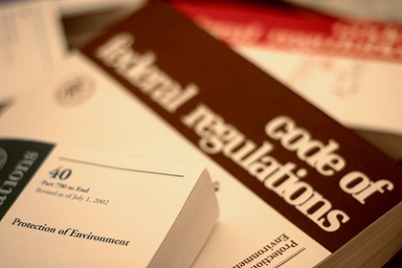
What does LCRR stand for?
…and Other EPA Acronyms
SDWA: Safe Drinking Water Act
CWS & NTNCWS: Community Water Systems & Non-transient, Non-Community Water Systems
GRR: Galvanized Requiring Replacement
LCR: the original Lead and Copper Rule, 1991
LCRR: Lead and Copper Rule Revisions, 2021
LSLI: Lead Service Line Inventory
LSL RP: Lead Service Line Replacement Plan
LCRI: Lead and Copper Rule Improvements
proposed September 2023?

Slide 4
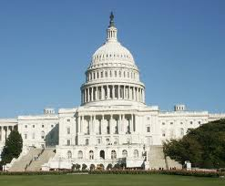
A Recent History of Regulating Lead
Safe Drinking Water Act Amendments of 1986 (Lead Ban)
Lead Contamination Control Act of 1988
Lead and Copper Rule (LCR) (1991)
Reduction of Lead in Drinking Water Act of 2011
Water Infrastructure Improvements for the Nation (WIIN) Act of 2016
America’s Water Infrastructure Act of 2018 (AWIA)
Proposed LCR Revisions (Nov 2019)
2020 Drinking Water Infrastructure Needs Survey & Assessment (DWINSA), results published by EPA in April 2023
2021 Final LCRR (January 2021), subsequent June 2021 F.R. notice delays compliance date to October 2024
Notes:
MAJOR LEAD-RELATED LEGISLATION:
1986 SDWA: Lead Ban included “lead free” definition; prohibition of pipe, pipe fittings (8%), solder and flux (0.2%) that is not lead free; special public notice requirements
Hawaii adopted these requirements in Hawaii Revised Statutes in 1988 (Title 19 Chapter 340E Section 7)
1988 LCCA (amended SDWA) mandated the repair, replacement or recall of drinking water coolers with lead lined tanks
1991 LCR affecting CWS and NTNCWS requiring tap sampling, evaluating for or requiring corrosion control treatment, public education and LSLR if necessary
2011 Reduction of Lead in Drinking Water Act: amended SDWA to redefine “lead free” from 8% to a weighted average of 0.25% of wetted surfaces; exemptions for non-potable uses
We need to update our HRS 340E-7!!!
2013 Community Fire Safety Act amended SDWA to exempt fire hydrants
2016 WIIN Section 2107 Lead Testing in School and Child Care Program Drinking Water
2018 AWIA – DWINSA requirements for LSL quantification and replacement costs
2019 proposed LCR revisions
2020 DWINSA – 7th DWINSA allotments released April 2023
2021 LCRR

Slide 5
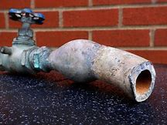
But a Lead Service Line (LSL) is just made of…Lead, right?
  Lead Service Line: A portion of pipe that is made of lead, which connects the water main to the building inlet.
    A “service line” is the pipe connecting the water main to the interior plumbing in a building, a.k.a. “building inlet”.
  Galvanized Requiring Replacement (GRR): A galvanized service line is considered a LSL if it ever was or is currently downstream of any LSL or service line of unknown material. If the water system is unable to demonstrate that the galvanized service line was never downstream of a lead service line, it must presume there was an upstream lead service line(!)
  Unknown: Any service line where there is no documented evidence supporting any material classification, i.e., lead, GRR or non-LSL

Slide 6
But a Lead Service Line (LSL) is just made of…Lead, right?
So what’s a non-Lead service line?
By definition¹: “Any service line that is determined through an evidence-based record, method, or technique not to be lead or a galvanized requiring replacement.” Examples include plastic and copper.
¹Guidance For Developing and Maintaining a Service Line Inventory, EPA 816-B-22-001, August 2022
Notes:
A wonderful 164 page read…

Slide 7
But a Lead Service Line (LSL) is just made of…Lead, right?
What about if there are only lead connectors like goosenecks, pigtails or other connectors? Are those LSLs too?
A galvanized service line that was never downstream of a LSL but is downstream or was previously downstream of a lead gooseneck, pigtail or other connector is not considered a GRR¹.
By the way, a gooseneck, pigtail or connector is a short section of piping, typically not exceeding two feet, which can be bent and used for connections between rigid service piping.
¹Guidance For Developing and Maintaining a Service Line Inventory, EPA 816-B-22-001, August 2022

Slide 8
How Many LSLs does Hawaii have?
Depends on who you ask…
AWWA Journal article (April 2016) used 2011 and 2013 AWWA-sponsored surveys and extrapolated nationwide data for Hawaii (2,800 total LSL) National Survey of Lead Service Line Occurrence - Cornwell - 2016 - Journal AWWA - Wiley Online Library
NRDC article (July 8, 2021) cited similar survey data and articles, including the April 2016 AWWA Journal reference https://www.nrdc.org/resources/lead-pipes-are-widespread-and-used-every-state
2021 7th DWINSA (infrastructure projects for the next 20 yrs) estimates 9,589 total LSL developed using a supposedly “state-specific” ratio of known LSLs-to-total laterals of all materials. In the absence of data, a national ratio was applied. https://www.epa.gov/system/files/documents/2023-04/Final_DWINSA%20Public%20Factsheet%204.4.23.pdf
Notes:
National ratios were utilized by EPA for Hawaii’s 9,589 LSLs. But maybe it should have been more appropriately West Coast biased instead of nationally. Using 2020 census numbers to develop my own ratios for LSLs/1,000, ratios in Washington, Oregon and California ranged from 0.34 – 2.86 (Ave 1.34 LSL/1,000), meaning the Hawaii estimate should have been more accurately portrayed within a range of 500-4,000 (Ave 2,000 LSL). That jives with my own gut feeling, is that we may find small pockets of true lead-composition laterals in older Hawaii ports, i.e., Honolulu, Hilo and Lahaina but very little elsewhere.
HI 9,589 LSL / 1,455,271 = 6.59 LSL/1,000
CA 13,476 LSL / 39,538,223 = 0.34 LSL/1,000 HI has 495 LSL then
OR 3,530 LSL / 4,237,256 = 0.83 LSL/1,000 HI has 1,208nLSL then
WA 22,030 LSL / 7,705,281 = 2.86 LSL/1,000 HI has 4,162 LSL then
MA 117,090 LSL / 7,029,917 = 16.66 LSL/1,000
MI 301,790 LSL / 10,077,331 = 29.95 LSL/1,000
IL 1,043,294 LSL / 12,812,508 = 81.43 LSL/1,000
DWINSA Fact Sheet link: https://www.epa.gov/system/files/documents/2023-04/Final_DWINSA%20Public%20Factsheet%204.4.23.pdf

Slide 9
How much does it cost to replace a LSL in Hawaii?
Depends on who you ask…
EPA estimates that an “average” LSL replacement may cost $4,700 with a range of between $1,200 – $12,300. See Strategies to Achieve Full Lead Service Line Replacement, October 2019 https://www.epa.gov/sites/default/files/2019-10/documents/strategies_to_achieve_full_lead_service_line_replacement_10_09_19.pdf
Economic Analysis for the Proposed Lead and Copper Rule Revisions, October 2019 (Chapter 5) provides the basis for the above numbers. https://www.regulations.gov/document/EPA-HQ-OW-2009-0819-7414
The 7th DWINSA just released estimated that Hawaii has 9,589 LSLs and estimated an annual $993,700 (2021 dollars) need over 20 years to fix them That’s $2,000/LSL (2021 dollars).

Slide 10

What exactly are the LSLI requirements of LCRR?
All affected water systems must develop an initial inventory to identify the materials of service lines connected to the public water distribution system by October 16, 2024, and submit it to the SDWB.
The inventory must include all service lines connected to the public water distribution system regardless of ownership status (e.g., where service line ownership is shared, the inventory would include the portion of the service line owned by both the water system and the customer.

Slide 11
What exactly are the LSLI requirements of LCRR? (cont.)
Are commercial and industrial service lines required to be included on the inventory?
Yes, all potable water service lines must be documented, including those serving commercial and industrial accounts.
What about service lines with no potable use?
Non-potable use service lines for dedicated fire and irrigation services do or do not have to be included in the inventory (EPA interpretation available?) The intent of the law is to identify lead service lines where the water is being used for human consumption, but some states are including dedicated fire, irrigation and emergency service lines…

Slide 12
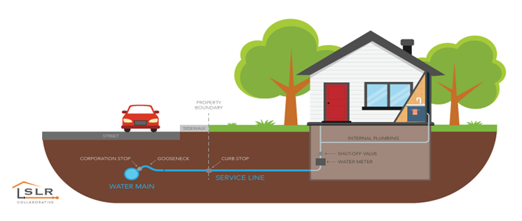
LSLI requirements (cont.)
Per 40 CFR 141.84(a)(6) and 141.90(e)(3) the water system must provide the State with an updated version of its inventory in accordance with its tap sampling monitoring period schedule (annually or triennially). The updated inventory must be submitted within 30 days of the end of each tap sampling monitoring period which ends September 30, i.e., October 30 of each year that LCR tap sampling is done by your water system.
But what if I’m on Standard Monitoring (two consecutive 6-month sampling periods) where my monitoring period ends either June 30 or Dec 31?
  Per 40 CFR 141.90(e)(3), updates are required no more frequently than annually. The updated inventory must be submitted within 30 days of the end of each tap sampling monitoring period, which I interpret to mean at the end of your second 6-month sampling period.

Slide 13

Wait…you mean???
YES! The LCRR have made it the PWS’ responsibility to inventory the entire service line - whether they have jurisdiction over it or not – or whether they own it or not
So where does the customer side end?
  The definition of a LSL (40 CFR 141.2) “…means a portion of pipe that is made of lead, which connects the water main to the building inlet.”

Slide 14

So, what’s a “building inlet”???
Some national thoughts from an ASDWA survey conducted on Hawaii’s behalf in April 2023:
  CA “…a singular point where the pipe goes into the building.”
  TX “TCEQ doesn’t have a defined meaning of building inlet yet.”
  ID “No singular or complex definition of “building inlet” exists for Idaho in the drinking water rules.”
  CT “Pipe penetrated into the building” and “Practical determination by the State Primacy Agency”
  MI “…to customer site piping or to the building plumbing at the first shut-off valve inside the building, or 18 inches inside the building, whichever is shorter.”
  CO “does not explicitly define 'building inlet' in regulation or guidance but considers this to be the point where the service line first enters the building.”
  MN “In most residential cases we will look at it as at the meter because our meters are typically in the houses in Minnesota. It was a practical determination made by the state primacy agency.
  CNMI “CNMI has no specific definition. I am of the mindset at least here the service line is from the main to the building entrance.”

Slide 15
I’m a visual person so…
Courtesy Honolulu Board of Water Supply, February 2023

Slide 16
What is this LSLI guidance everyone is talking about?
See EPA’s Guidance For Developing and Maintaining a Service Line Inventory, EPA 816-B-22-001, August 2022 found here: https://www.epa.gov/system/files/documents/2022-08/Inventory%20Guidance_August%202022_508%20compliant.pdf
…And here on our website: Safe Drinking Water Branch (hawaii.gov)
Major guidance topics include:
  Elements of the Inventory
  Inventory Planning
  Historical Records Review
  Service Line Investigation Methods
  Developing and Updating the Inventory
  Public Accessibility
NOTE: affected PWSs do not have to use this guidance, but SDWB is strongly recommending its use to ensure that all required elements are captured.

Slide 17
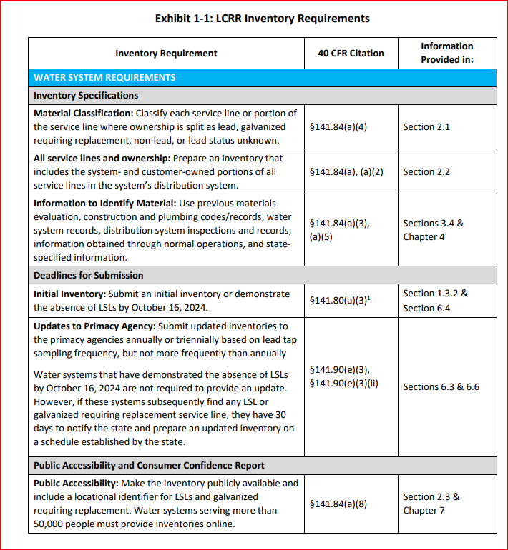
What is this LSLI guidance everyone is talking about?

Slide 18
What is this LSLI guidance everyone is talking about?
Other Non-EPA LSLI options can be found amongst various states.
The Association of State Drinking Water Administrators (ASDWA) have developed templates to input data for lead service line inventories. Examples from ASDWA: Wisconsin, Minnesota, Michigan and Kansas, are available at the following link: https://www.asdwa.org/lead-and-copper-rule-lcr/ or can be found at the individual State’s website.

Slide 19
Where do I find the required information to do a proper LSLI?
All construction and plumbing codes, permits, and existing records or other documentation which indicates the service line materials used to connect structures to the distribution system.
All water system records, including distribution system maps and drawings, historical records on each service connection, meter installation records, historical capital improvement or master plans, and standard operating procedures.
All inspections and records of the distribution system that indicate the material composition of the service connections that connect a structure to the distribution system.
Any resource, information, or identification method provided or required by the State to assess service line materials.
Verbatim from 40 CFR141.84 (a)(3)

Slide 20
BWS Records Search (2020-2022)
BWS geographic information system (GIS)
As-built drawings
Field reports
Customer data
Pipe material information
BWS operational information
City and County of Honolulu Agencies
Department of Planning and Permitting
Department of Environmental Services –Division of Wastewater Engineering and Construction
Courtesy Honolulu Board of Water Supply, February 2023

Slide 21
BWS Records Search (continued)
State Archives
Large community developers
Plumbers and pipe fitters
Water System Standards and Code Research
University of Hawaii at Manoa Hamilton Library –Hawaiian/Pacific Collection
Standards dating back to 1952 called for the uses of copper and appropriate materials in the Standard Details
Honolulu Plumbing Codes –Lead material is absent from the Code as far back as 1905
Revised Ordinance of Honolulu Revision in 1961 shows deletion of lead from the code.
Courtesy Honolulu Board of Water Supply, February 2023

Slide 22
Any other resources that I can use?
Anecdotal interviews, properly documented, may be used but are not enough to solely determine LSL material composition
What if my customers want to check their service lines themselves? Try this
  https://apps.npr.org/find-lead-pipes-in-your-home/en/#intro
When in doubt about the useability of these resources to perform your LSLI, contact the SDWB for guidance…
Notes:
What if we contact the customer to obtain information for the “Customer Owned Portion” of the EPA LSLI template and the customer refuses? There are drop down fields for “Other” in which an explanation can be made. There is also a field for “Notes” and options to indicate “Unknown” or “Don’t Know”
If the Hawaii lead ban was in 1988, can we assume that all service lines constructed after that are non-lead? No. Some form of documentation is still required that meets the previous slides’ categories. Some states like TN flat out make an assumption that it is all Lead Free.
Do customers need to be notified if their service line is designated as “unknown, lead likely”? There is no such designation or requirement under the proposed LCRR. There is only lead, GRR, unknown and non-lead. However, EPA LSL guidance (Section 2.1.2) encourages “subclassification” to facilitate material classification and inform the public about service line material types in their community as a par of the public accessibility requirement.

Slide 23

Don’t forget to use the Guidance Luke…
Chapter 4: Historical Records Review
Chapter 5: Service Line Investigation Methods
  Visual inspection of service line material (Section 5.1)
  Water quality sampling (Section 5.2)
  Excavation (Section 5.3)
  Predictive modeling (Section 5.5)
  Emerging methods (Section 5.6)
Appendix E: Michigan Minimum Service Line Verification Requirements
The EPA LSLI Template “Inventory Methods” tab also has some useful ideas
…and much, much more!
Guidance For Developing and Maintaining a Service Line Inventory, EPA 816-B-22-001, August 2022

Slide 24
And now a word about Prioritizing Field Investigations…
EPA recommends that systems conduct on-site investigations to reduce the number of unknowns in the system as quickly as possible.
After all, establishing an inventory of service line materials and identifying the location of LSLs is a key step in getting them replaced and protecting public health.
Guidance For Developing and Maintaining a Service Line Inventory, EPA 816-B-22-001, August 2022

Slide 25
And now a word about Prioritizing Field Investigations…
EPA recommends that systems consider using multiple prioritization criteria in planning for investigations.
  Consider vulnerable or environmental justice populations when targeting areas for investigations.
  For example, a water system may want to consider prioritizing investigations at locations served by unknown service lines where children are present, such as schools or childcare facilities. In some cases, smaller childcare facilities operated out of single-family residences could be more likely to be served by an LSL based on the diameter of the service line.
  Systems could also consider income-based prioritization, conducting investigations at sites serving customers who qualify for reduced rates, etc.
Guidance For Developing and Maintaining a Service Line Inventory, EPA 816-B-22-001, August 2022

Slide 26
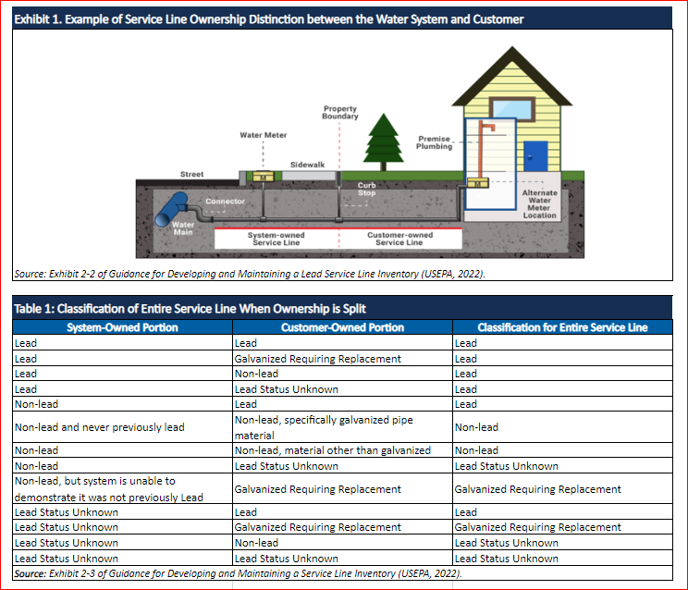
Classifying the Entire Service Line When Ownership Is Split

Slide 27
What do I do after I complete the LSLI?
Hopefully, you have been working with a consultant and the SDWB to guide you in performing and completing your initial LSLI by October 16, 2024. If you’re pau or will finish this year, don’t wait! Turn it in to the Safe Drinking Water Branch for our review and comment.
There is a requirement that a water system must notify customers being served by a LSL (lead, GRR or unknown) within 30 days of completion of the LSL inventory (40 CFR 141.85(e)(1 & 2)
  What defines “completion” of the inventory?
  My initial read: 30 days after October 16, 2024, submittal to SDWB (November 15, 2024) - or when SDWB approves of the contents of your initial inventory, whichever is later…
  …We are waiting for EPA’s technical guidance for more information about the notification requirements related to the LSL inventory, possibly in the Lead and Copper Rule Improvements Proposed Rule due out in September 2023 at the earliest.

Slide 28

Do I need to make this LSLI publicly accessible?
Yes, per 40 CFR 141.84(a)(8). In addition, water systems serving greater than 50,000 persons must make the publicly accessible inventory available online.
How? Using a location identifier, such as a street address, block, intersection, or landmark, associated with each lead service line and GRR service line.
NOTE: Water systems may, but are not required to, 1) include a locational identifier for lead status “Unknown” service lines or 2) list the exact address of each service line.

Slide 29

Will SDWB provide guidance and templates for this publicly accessibility requirement?
This is expected to be in the LCRR and LCRI Implementation Guidance…
…but in their absence, past LCR notification letter templates may be used. Water systems can work with the SDWB to develop such templates in this interim period.

Slide 30
How soon must this publicly accessible information be made available?
CFR doesn’t say…
Immediately following LSLI inventory submittal to SDWB on or before October 16, 2024?
  What if the initial submittal to SDWB is grossly inadequate? Does the system have to wait until the SDWB determines that the LSLI meets all LCRR requirements of 40 CFR 141.84?
After the LSLI is reviewed and approved by SDWB?
When the next Consumer Confidence Report is issued per 40 CFR 141.84(a)(10)?
  What if the initial LSLI is not approved by then?
The LSLI updates that you submit annually/triennially to us must be reflected in the publicly accessible inventory no less frequently than when required to be submitted to the State (40 CFR 141.90(a)(6)), i.e., it is up to SDWB to determine when you make LSLI updates publicly accessible.
Notes:
“The service line materials inventory must be publicly accessible.” Doesn’t say when.

Slide 31
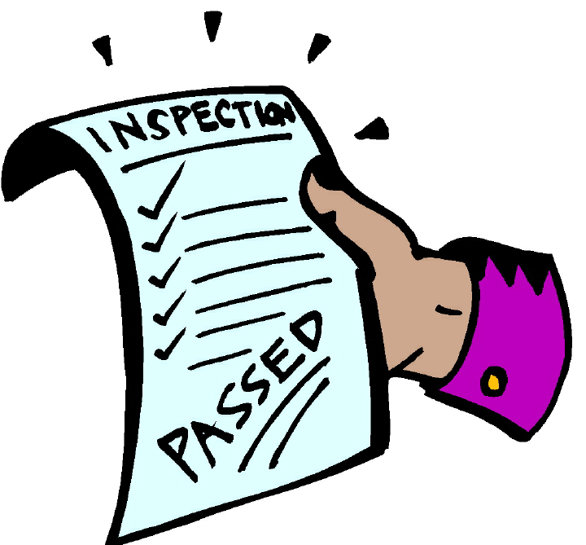
What information should be publicly accessible?
Location identifier for all service lines, regardless of material (NR)
An exact street address as the location identifier (NR)
Actual material for non-lead, i.e., copper, PVC (NR)
A summary of the total number of LSLs, GRRs, unknowns, and non-lead
Clear disclaimer language
Instructions on how to read and interpret the inventory
Information on steps that consumers served by LSLs can take to protect themselves
Statements that other lead sources may exist in drinking water plumbing or the building
A schedule for investigating unknowns
Information on the water systems’ actions to reduce lead
Information about tap sampling
EPA Guidance for Developing and Maintaining a Service Line Inventory (Chapter 7)
EPA 816-B-22-001 August 2022

Slide 32
How about some examples?
DC Water Service Information
Greater Cincinnati Water Works Service Line Information (arcgis.com)
Tuscon Water: Get The Lead Out Parcel Search (arcgis.com)
Lead Service Line Records (milwaukee.gov)
Private Side Lead Lines - Louisville Water Company
Lead Reduction Program Key Metrics Dashboard | Denver Water
Lead Service Line Replacement Program — Newark's Lead Service Line Replacement Program (newarkleadserviceline.com)
EPA Guidance for Developing and Maintaining a Service Line Inventory (Chapter 7)
EPA 816-B-22-001 August 2022

Slide 33
What if I conduct my initial inventory and I have no LSL?
When a water system has no lead, GRR, or lead status “Unknown” service lines (regardless of ownership) in its initial inventory, it may provide to the SDWB a written statement - in lieu of the inventory - declaring that the distribution system has no lead or GRR service lines. Additionally, the water system may identify the actual material of the service lines, i.e., plastic or copper, in its statement. The statement must include a general description of all applicable sources used to make this determination (Consult EPA Guidance, Section 6.3)
As long as the above condition remains, the PWS does not have to provide future LSLI updates to SDWB or make their LSLI publicly accessible
HOWEVER, If the water system finds Lead, GRR or Unknown service lines in the future, an updated LSLI must be provided to the SDWB.
40 CFR141.84 (a)(6)(i)

Slide 34
One more thing about publicly accessible LSLIs…
Instructions on 1) how to access the LSLI or 2) a statement of no LSLs must be included in water system’s annual Consumer Confidence Report (CCR)
Verbatim from 40 CFR141.84 (a)(10)

Slide 35
What if I don’t meet the October 16, 2024 deadline?
Not addressed explicitly in the current January 2021 LCRR
May be addressed in the Lead and Copper Rule Improvements (LCRI) due out later this year (September 2023)
Probably…either a treatment technique (TT) or monitoring/reporting (M/R) violation requiring public notification (Public Notification Rule) and publishing in the annual Consumer Confidence Report (CCR)

Slide 36

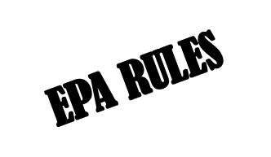
But Wait! There’s More!!!
EPA reviewed the original January 2021 LCRR and in a December 2021 Federal Register publication recommended actions to protect the public from lead in drinking water in the following priority improvement areas:
replacing 100 percent of LSLs is an urgently needed action to protect all Americans from the most significant source of lead in drinking water systems;
equitably improving public health protection for those who cannot afford to replace the customer-owned portions of their LSLs;
improving the methods to identify LSLs and trigger action in communities that are most at risk of elevated drinking water lead levels (schools and childcare facilities); and
exploring ways to reduce the complexity of the regulations.

Slide 37
Here comes the LCRI!!!
To achieve these policy objectives, EPA announced its decision to proceed with a proposed rule that would revise the LCRR while allowing the January 2021 rule to take effect. Through the Lead and Copper Rule Improvements (LCRI), EPA stated that it does not expect to propose changes related to the initial service line inventory requirements because continued progress to identify LSLs is integral to lead reduction efforts regardless of potential revisions to the rule
Publication of the Proposed LCRI Rule is expected in September 2023…

Slide 38

Some more good reads:
SDWB Website: Safe Drinking Water Branch (hawaii.gov)
EPA Websites: Revised Lead and Copper Rule | US EPA and Guidance for Developing and Maintaining a Service Line Inventory (epa.gov)
Lead Service Line Replacement Collaborative: https://www.lslr-collaborative.org/
Environmental Policy Innovation Center: https://www.policyinnovation.org/water/leadfree

Slide 39
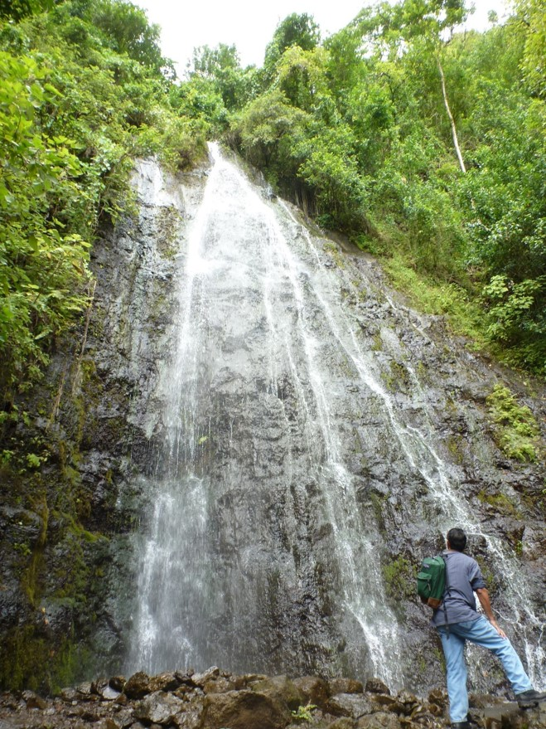
Mahalo for your attention!
OK, OK, if you have additional questions that you want integrated into this presentation…michael.miyahira@doh.hawaii.gov

Slide 40
Miscellaneous Info slides:
Standards 53 and 58 now require drinking water treatment units to reduce the lead in drinking water to 5 ppb or less—a 50% drop from the previous 10 ppb—and a threshold that matches Health Canada’s new maximum allowable concentration level of 5 ppb.
The new lead pass/fail criteria of 5 ppb has been published for NSF/ANSI 53: Drinking Water Treatment Units - Health Effects and NSF/ANSI 58: Reverse Osmosis Drinking Water Treatment Systems.
Previously, a water treatment system could be certified if it reduced lead to 10 ppb or lower and met other requirements set by the standard, such as material safety and structural integrity. These other requirements remain unchanged.
Updates to both standards were published in December 2019 and are effective immediately for any new filter or filtration device claiming to reduce lead.
To be certified by NSF, drinking water filters and treatment devices are tested with challenge water containing 150 ppb lead, 10 times the U.S. Environmental Protection agency’s action level of 15 ppb.

Slide 41
Miscellaneous Info slides:
Hawaii ALEs through the years…
Three (3) Action Level Exceedances (>15 ppb) in the last 10 years of LCR monitoring (thru 2019)!

Slide 42
Leave for HRWA trainer to address
LSL Replacement Plan and all requirements
Defn of full LSL replacement iaw SDWA Section 1417 and 1461 (defn of lead free)
Select tap water sampling locations based on results of the inventory and collect five 1-liter samples at each site.
Conduct tap water testing in schools and day-care facilities. Prior WIIN testing qualifies?
Utilities with lead service lines (LSLs) must prepare and implement an LSL replacement plan.
Trigger levels (TL), Action Level Exceedance (ALE) required actions
Public Outreach and Reporting for TL, ALE, etc.
Funding options (Joan)

