Slide 1
PFAS – Treatment for a Moving Target
Joe Klimek (for Cathy Swanson)
Hawai’i Rural Water Association
5/25/2023

Slide 2


Slide 3


Slide 4
Topics
PFAS – what are they & where do they come from?
Why do we care?
Current & future regulations (the “Moving Target”)
Treatment technologies
GAC and IX Resin
Design & operation of IX Resin System for PFAS removal
GAC vs IX Resin – Treatment Costs & Considerations

Slide 5
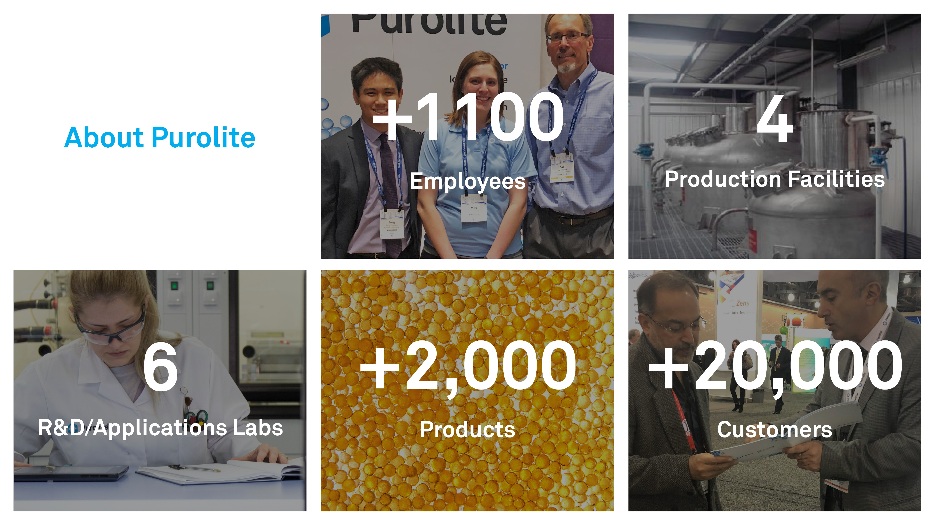

Slide 6
PFAS Basics

Slide 7
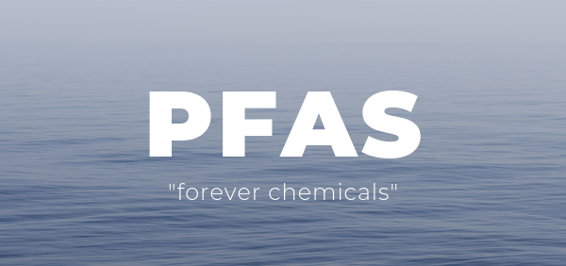

Slide 8
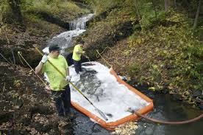
What are PFAS?
Man-made Per and Polyfluoroalkyl Substances (PFAS)
PFAS been manufactured since the 1940’s for many applications
PFAS is pervasive & persistent in the environment
PFAS can cause adverse health effects

Slide 9
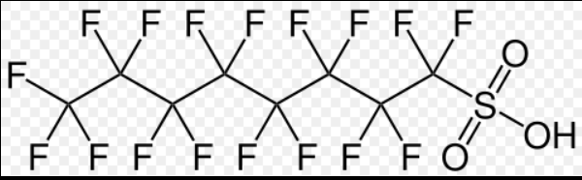
Categories of PFAS
~ 14,000 poly- and perfluoroalkyl substances
Hydrophobic “Tail”
Ionized “Head”
Perfluoroalkyl
Carboxylic Acids (PFCAs)
Perfluorinated
Perfluoroalkyl Sulfonic Acids (PFSAs)
PFOS
e.g. PFOS
PFAS
Fluorotelomer Alcohols (FTOHs)
6:2 FTS
Polyfluorinated
N-alkylated fluorooctane sulfonamides (FOSAs)
N-alkylated sulfonamidoethanols (FOSEs)
Source: ITRC Perfluorinated Chemicals Information Paper, August 2015
Images above:: Wikipedia
Notes:
They further sub divided from non polymer into Per fluorinated(carbon tail are fully fluorinated) and Polyflourinated carbon tail is only partially fluorinated) out of this two PFAS catargories is there # of carbon in the tail and it’s functional group either Sulfonates or Carboxylates
Per fluorinated compounds are referred to Terminal PFAS
As the Polyflourinated PFAS are referred to the prescursors since they can break down to Perflourinated compounds
The Alkyl in Per fluoroalkyl refers to a chain of carbons

Slide 10
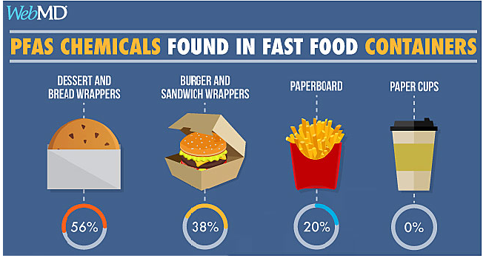
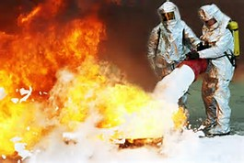
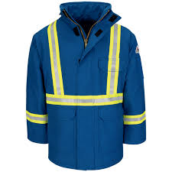
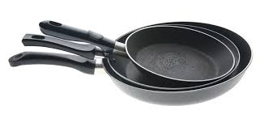
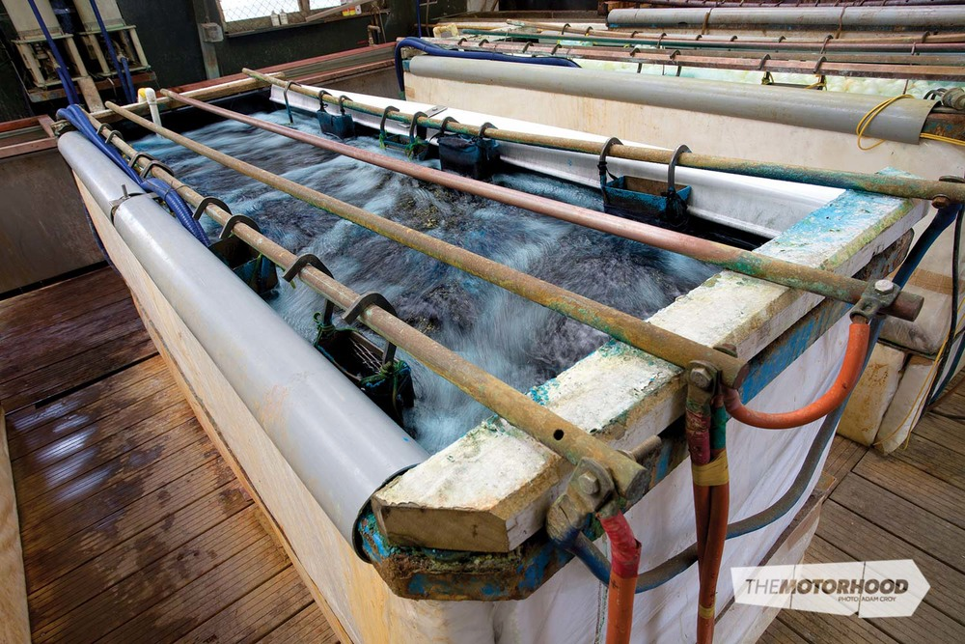
Sources of PFAS
Fire-fighting foams – “AFFF”
Coatings - stain, water, & fire resistant
Adhesives
Cosmetics
Cleaning products
Food Packaging
Coatings of paper/fiberboard
Chrome plating
Feb 1, 2016

Slide 11
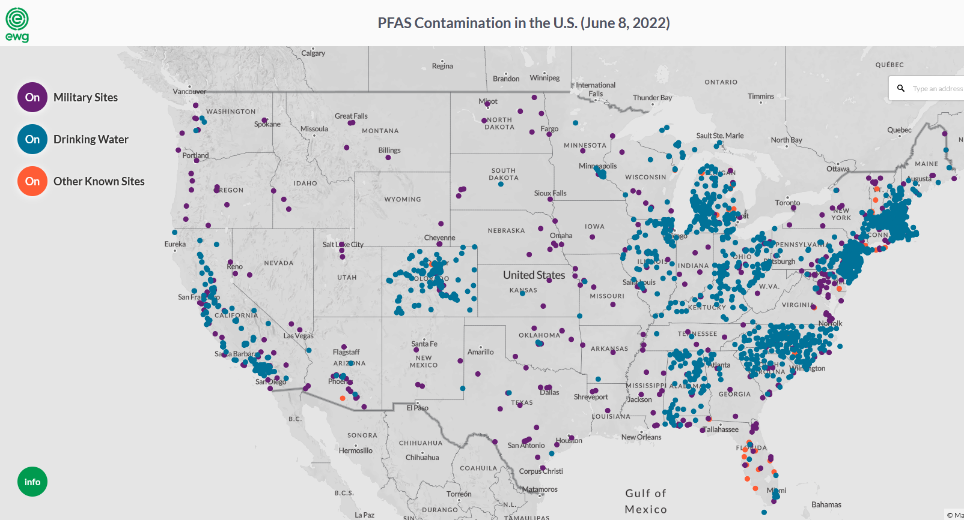
Where are PFAS Found? – Groundwater
Source: https://www.ewg.org/interactive-maps/pfas_contamination/map/
https://www.ewg.org/interactive-maps/pfas_contamination/map/

Slide 12
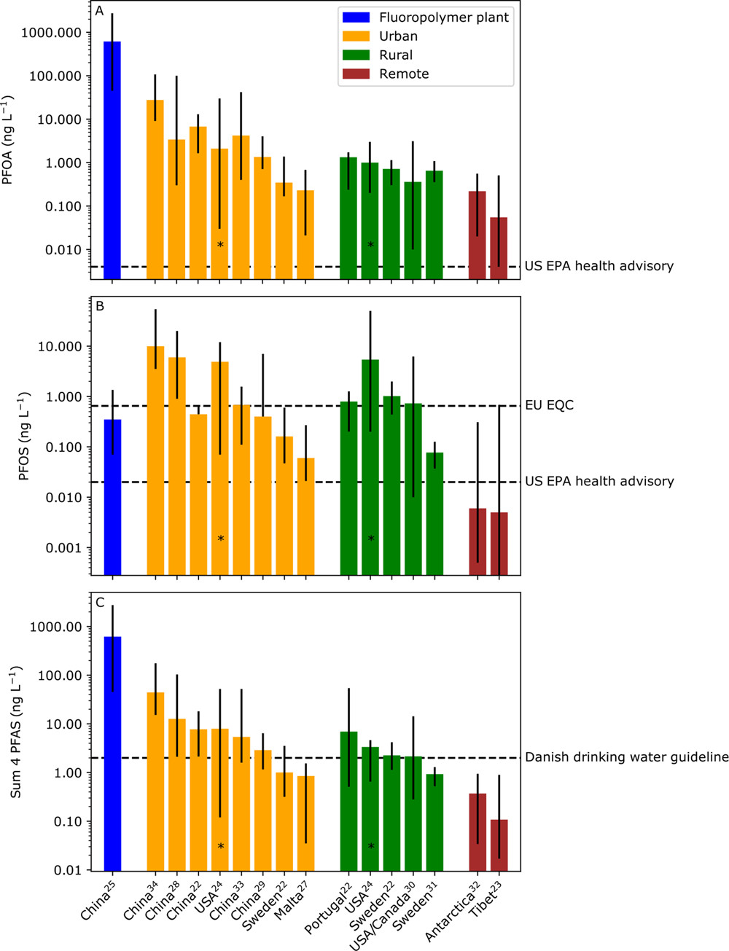
Where are PFAS Found? – Rainwater
The US EPA Lifetime Drinking Water Health Advisories for PFOS and PFOA Are Often Lower than Their Respective Levels in Rainwater
Source: Outside the Safe Operating Space of a New Planetary Boundary for Per- and Polyfluoroalkyl Substances (PFAS)
Ian T. Cousins, Jana H. Johansson, Matthew E. Salter, Bo Sha, and Martin Scheringer
Environmental Science & Technology 2022 56 (16), 11172-11179
DOI: 10.1021/acs.est.2c02765

Slide 13
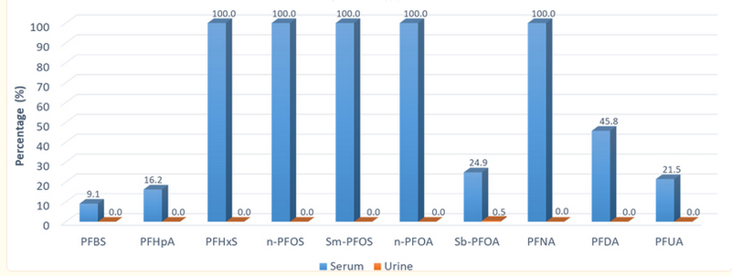
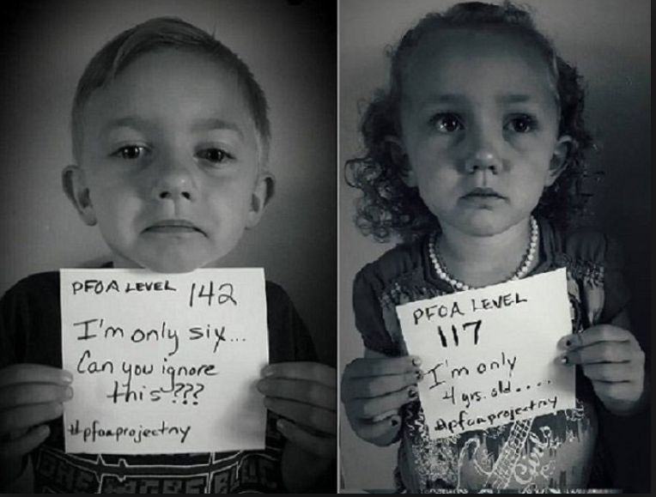
PFAS – Why Should We Care?
accumulation
PPT in the water -----→ PPB in the blood
Exposure to long-chain PFAS in the United States is widespread as suggested by nearly universal detection of these chemicals in serum among the U.S. general population
Estimated proportion of the population with detectable concentrations of individual PFAS 6 to 11 years of age, 2013, 2014
pfasproject.com
Source: Calafat AM, Kato K, Hubbard K, Jia T, Botelho JC, Wong LY. Legacy and alternative per- and polyfluoroalkyl substances in the U.S. general population: Paired serum-urine data from the 2013-2014 National Health and Nutrition Examination Survey. Environ Int. 2019 Oct;131:105048. doi: 10.1016/j.envint.2019.105048. Epub 2019 Jul 31. PMID: 31376596; PMCID: PMC7879379.

Slide 14
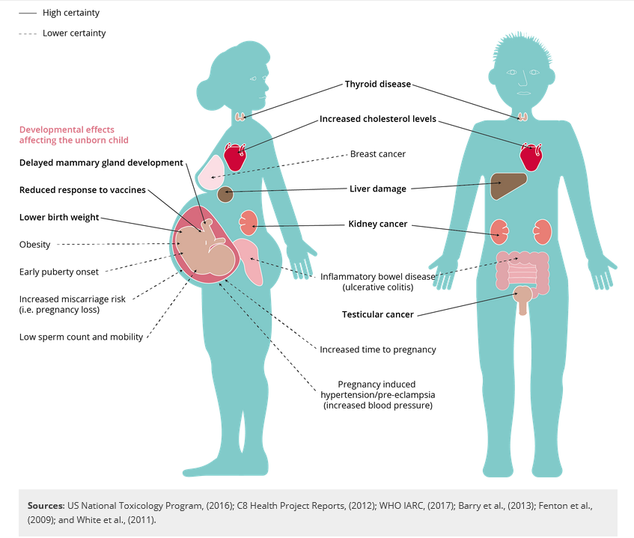
Effects of PFAS on Human Health

Slide 15
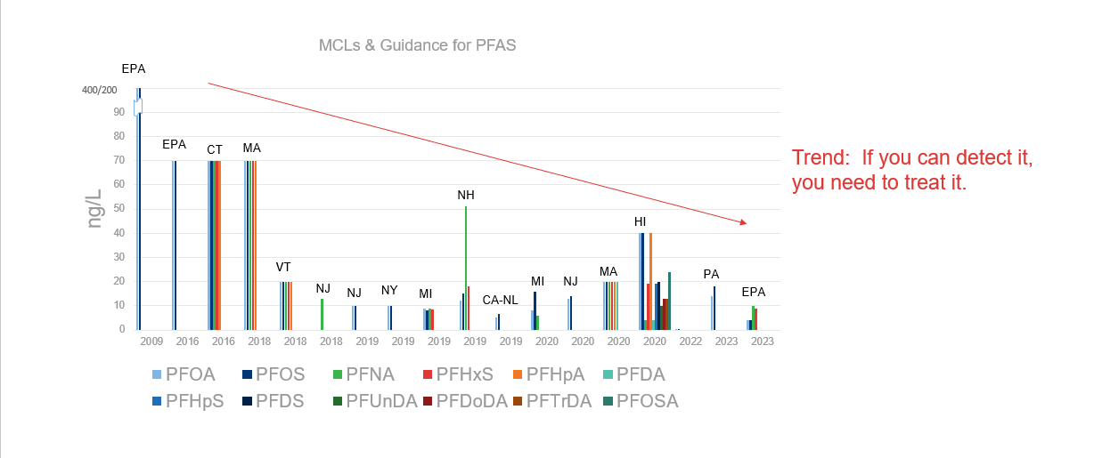
MCLs and Health Advisories over Time in USA
Updated 4/26/23

Slide 16
US EPA National Standard to Protect Communities from PFAS in Drinking Water
March 14, 2023
PFOA and PFOS:
  Proposing regulation at 4 parts per trillion each
    This level can be reliably measured
PFNA, PFHxS, PFBS, and GenX Chemicals:
  Proposing regulation of any mixture containing one or more of these
  Hazard Index calculation
    Determines if the combined levels of these PFAS pose a potential risk

Slide 17
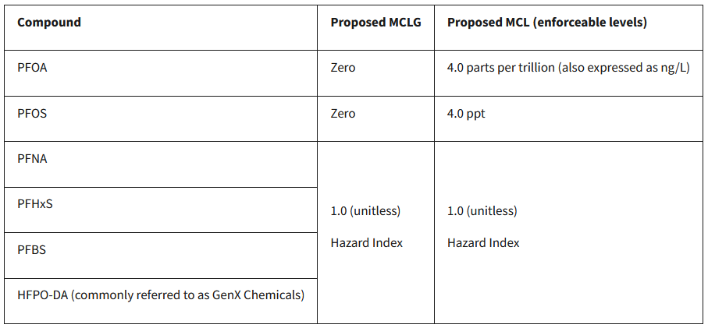
Proposed MCLG and MCL
MCLG = Maximum Contaminant Level Goal, maximum level of a contaminant in drinking water at which the EPA determines that no adverse health effects would occur. Whenever there is an identified cancer risk, the MCLG is set at zero.
MCL - Maximum Contaminant Level
The proposed rule would require public water systems to:
Monitor for these PFAS
Notify the public of the levels of these PFAS
Reduce the levels of these PFAS in drinking water if they exceed the proposed standards.

Slide 18
Hazard Index (“HI”)
Hazard Index uses the following Health Based Water Concentration (HBWCs):
PFHxS - 9 ppt
PFNA - 10 ppt
PFBS – 2,000 ppt
GenX - 10 ppt
Definition of Hazardous Index:
“Hazard index (HI) is the sum of component hazard quotients (HQs), which are calculated by dividing the measured regulated PFAS component contaminant concentration in water (e.g., expressed as ppt) by the associated HBWC expressed as ppt. For PFAS, a mixture HI greater than 1.0 is an exceedance of the MCL.”

Slide 19
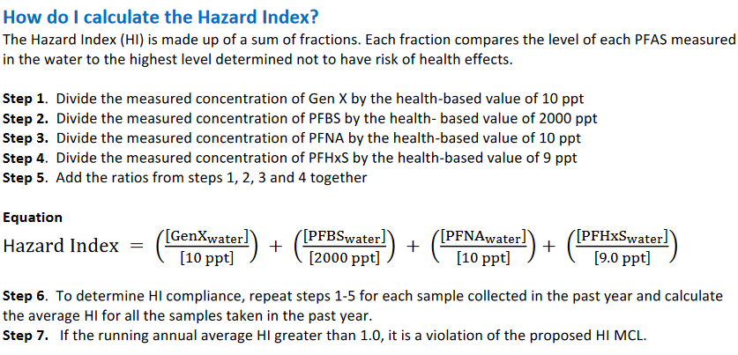
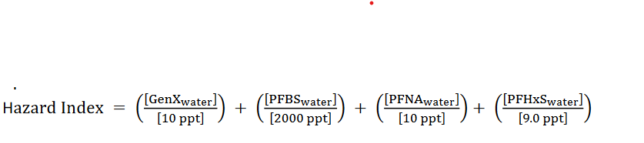
Hazard Index – Example
Description |  |  | Influent Water
 |  | Units | Avg | Max
Perfluorohexanoic acid | PFHxA | ng/L (ppt) | 16
Perfluoroheptanoic acid | PFHpA | ng/L (ppt) | 8.4
Perfluorooctanoic acid | PFOA | ng/L (ppt) | 22
Perfluorononanoic acid | PFNA | ng/L (ppt) | 2.5
Perfluorododecanoic acid | PFDoDA | ng/L (ppt)
Perfluorotetradecanoic acid | PFTeA | ng/L (ppt)
Perfluorobutanesulfonic acid | PFBS | ng/L (ppt) | 21
Perfluorohexanesulfonic acid | PFHxS | ng/L (ppt) | 9.8
Perfluoroheptanesulfonic acid | PFHpS | ng/L (ppt)
Perfluorooctanesulfonic acid | PFOS | ng/L (ppt) | 21
4:2 FTS (fluorotelomer sulfonate) | 4:2 FTS | ng/L (ppt)
6:2 FTS (fluorotelomer sulfonate) | 6:2 FTS | ng/L (ppt)
8:2 FTS (fluorotelomer sulfonate) | 8:2 FTS | ng/L (ppt)
GenX | GenX | ng/L (ppt) | ND
Gen X
0
PFBS
21
PFNA
2.5
PFHxS
9.8
HI = 0/10 ppt + 21/2000 + 2.5/10 + 9.8/9
HI = 0 + 0.0105 + 0.25 + 1.09 = 1.34 ( > 1 !)

Slide 20
EPA Timeline
EPA expects to finalize the regulation by end of 2023.
Under the SDWA, EPA then has until 9/3/24 to finalize the new drinking water standards.
Drinking water utilities will then have ~ 3 to 5 years to comply.
UCMR5 - most water utilities required to test drinking water for 29 PFAS (from 2023 to 2025)
  Will more compounds be regulated…..?

Slide 21
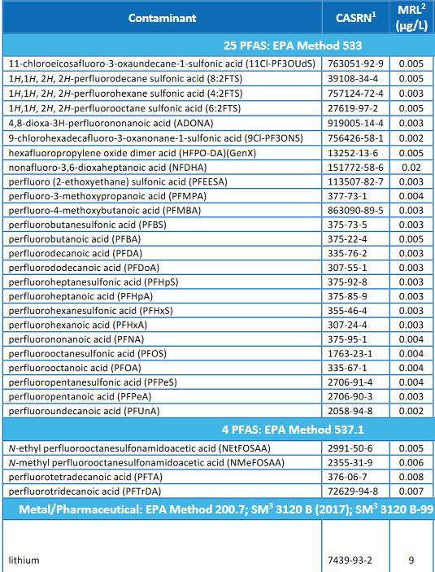
UCMR5:
The 5th Unregulated Contaminant Monitoring Rule
All public drinking water systems serving
> 3,300 people
A few systems < 3,300 people
29 PFAS species plus lithium
Frequency of sampling
  Surface water – 4 samples in a year, 3 months apart
  Groundwater – 2 times per year, 5-7 months apart

Slide 22

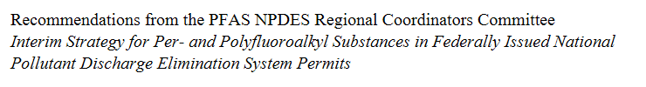
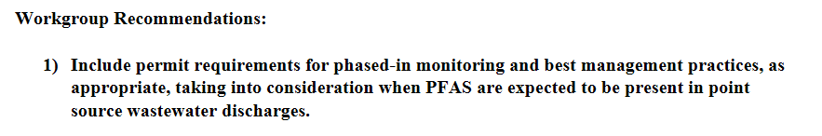
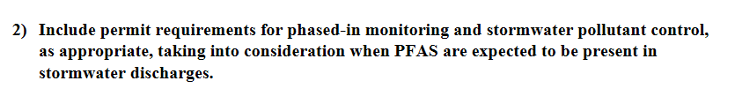
EPA and NPDES

Slide 23
PFAS Treatment

Slide 24
PFAS Treatment Categories
Capture
Bulk removal of high concentrations
  Part per million levels
  Military bases, airports, industrial sites
Trace removal – most drinking water
  Part per trillion to low part per billion levels
Destroy
Incineration
Other high energy experimental technologies (SCWO, etc)
Capture & Destroy are often used in combination

Slide 25
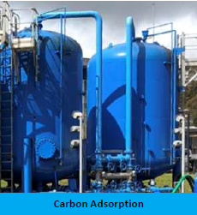
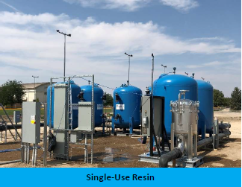
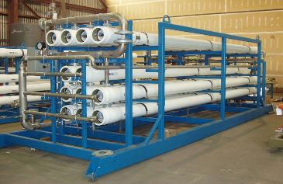
EPA “Best Available Technology” for PFAS Treatment
Membrane Filtration
Source: https://www.epa.gov/research-states/pfas-treatment-drinking-water-and-wastewater-state-science
Notes:
We know there are a number ex-situ treatment options that are being pursued.
These include RO, GAC, Polymeric adsorbents and ion exchange. For ion exchange we have two categories – single use resins and regenerable resins. In both cases the empty bed contact time is quite short compared what is needed if using GAC and today we will see how this translates into savings in both capital and operating costs for single-use resin.

Slide 26

Treatment Options – Reverse Osmosis
97 to 98% removal rate of everything
  Adv – reduces all contamination
  Disadv – all minerals are also removed. Water is corrosive (~12 µS) and needs to be re-mineralized.
RO requires significant pretreatment – typically anti-scalent, pH adjust, TSS filtration
If a membrane fails, no easy way to tell. Lose “belt and suspenders.” No online PFAS instrumentation.
Bacteria can blind, so may need to chlorinate, dechlorinate, treat, and re-chlorinate
Only captures – does not destroy PFAS
15-25% reject stream that needs to be discharged or treated.
Can be complex to operate
OPEX can be $800 to $1500 per acre foot – not including disposal of waste.
High recovery dependent on TDS levels

Slide 27
Treatment Options – Reverse Osmosis
$
97 to 98% removal rate of everything
  Adv – reduces all contamination
  Disadv – all minerals are also removed. Water is corrosive (~12 µS) and needs to be re-mineralized.
RO requires significant pretreatment – typically anti-scalent, pH adjust, TSS filtration
If a membrane fails, no easy way to tell. Lose “belt and suspenders.” No online PFAS instrumentation.
Bacteria can blind, so may need to chlorinate, dechlorinate, treat, and re-chlorinate
Only captures – does not destroy PFAS
15-25% reject stream that needs to be discharged or treated.
Highly complex system to operate
OPEX can be $800 to $1500 per acre foot – not including disposal of waste.
High recovery dependent on TDS levels

Slide 28
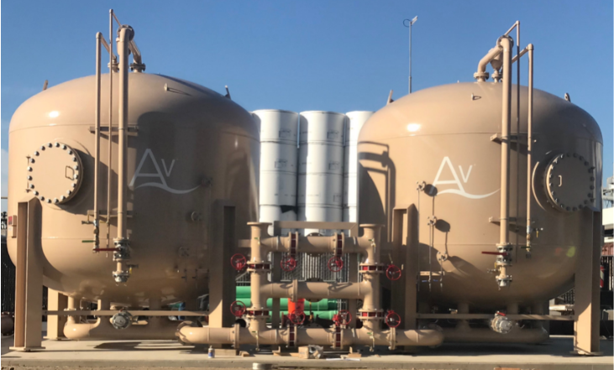
Granular Activated Carbon (GAC)
Initial “default” treatment
Will remove PFAS to non-detect
10+ min EBCT per vessel
Requires backwash
Removes all organics in the water
  Good if other organics are targeted….
  But will reduce capacity for PFAS

Slide 29
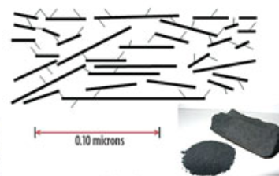
GAC Mechanism
  Van Der Waals forces
  Takes contact time
  One of the weakest chemical reactions
Photo Source: http://www.gasprocessingnews.com/features/201608/manage-activated-carbon-effects-on-mdea-solution-foaming.aspx

Slide 30
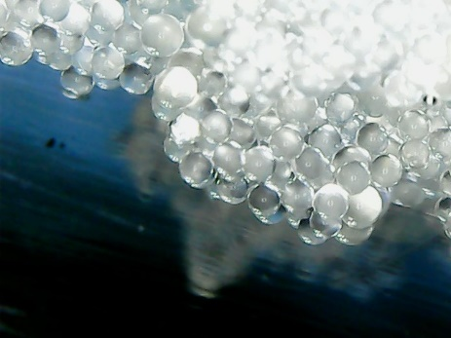
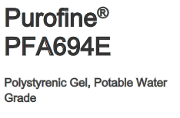
PFAS-Selective Ion Exchange Resin
Can achieve more than 99.99% removal to non-detect (< 2 ppt)
Effective on short and long chain PFAS
High capacity / long treatment life
2 to 3 minute EBCT
Resin capacity for PFAS depends on competing anions:
  SO4, NO3, HCO3, Cl, TOC

Slide 31
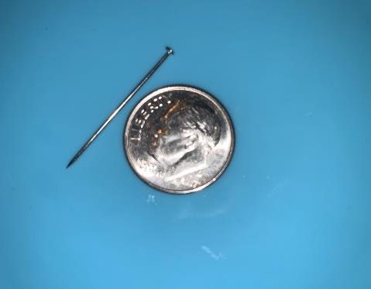
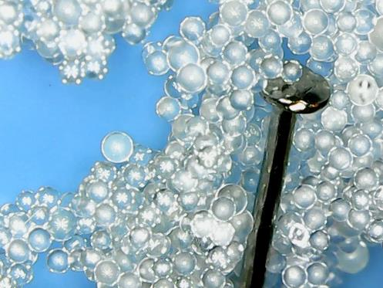
PFAS Resin (300 – 1,200 micron diam.)

Slide 32

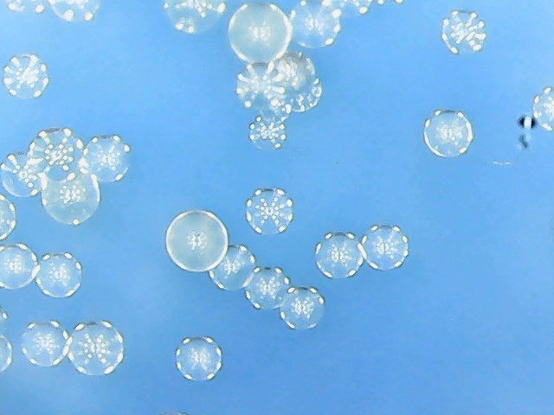

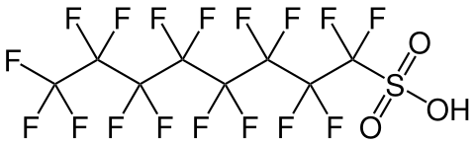
Ion Exchange – Fast Attraction / Reaction
Cl-
+
Resin
Bead
→
Harmless salt
-

Slide 33
PFAS Removal Mechanisms
PFOS – Perfluoro octane Sulfonic Acid
Hydrophobic “Tail” Ionized “Head”
Sulfonic group
⁻ H⁺
GAC
removes by adsorption
using hydrophobic “Tail”
PFAS - Selective IX Resins
removes by both ion exchange and adsorption using both “Head” & “Tail”
Notes:
So the reason that ion exchange removal is so relevant for removal of these compounds is shown in these two examples of the chemical structures for PFOA and PFOS. You can see that both chemicals have a part of the structure that is known as a head a and part known as the tail. The head is ionized and hydrophilic, resulting in a negatively charged carboxylic group for PFOA and a sulfonic negatively charged group for PFOS. Both groups are well ionized over the range of pHs seen in drinking water, making anion exchange resins suitable for their removal.
The tail is non-ionized and hydrophobic in nature, which means removal can be achieved by the adsorption mechanism, such as with GAC and synthetic adsorbents. The beauty with our Purofine PFA694E is that it is designed to take advantage of both the hydrophilic and hydrophobic properties of the molecule; so the mechanism of removal with this resin is by both ion exchange and adsorption.

Slide 34
PFAS Resin Selectivity
PFOS
PFHxS
PFBS
PFTrDA
PFTA
PFDoA
PFUnA
PFDA
PFNA
PFOA
ADONA
GenX
PFHpA
ClO4
PFHxA
PFPeA
PFBA
NO3
SO4
Cl
HCO3
F
  Sulfonic acids are removed more easily than carboxylic acids
  Longer chains are removed more easily than shorter chains
  Scale on the right is an approximation of selectivity

Slide 35
Bed Volume (“BV”): Volume of Media in Vessel
Influent
Bed depth x Area = Bed Volume
Effluent

Slide 36
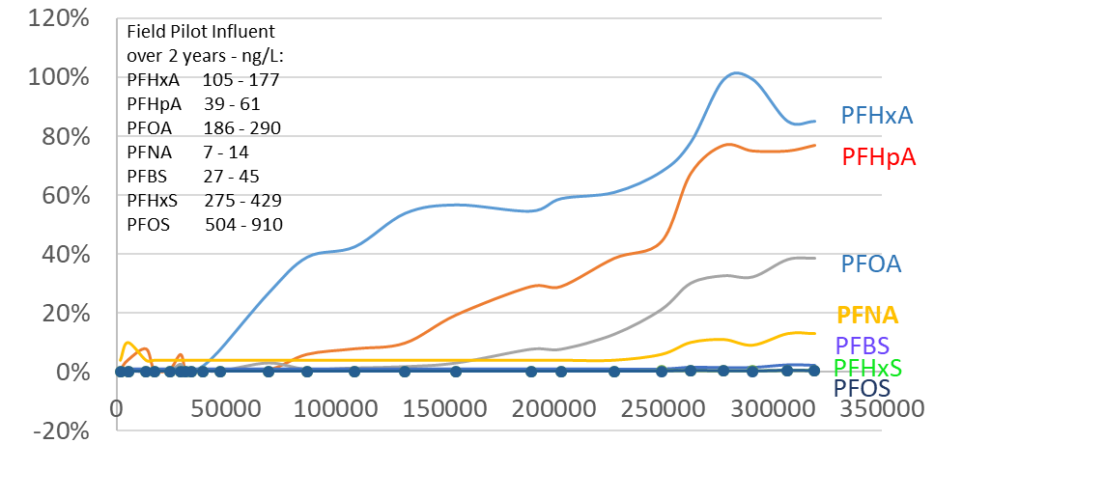
Order of PFAS Breakthrough – IX Resin
PFHxA < PFHpA < PFOA < PFNA < PFBS < PFHxS < PFOS
% Breakthrough
Bed Volumes

Slide 37
Resin System Design

Slide 38
Parameter | Units
Operational Flow Rate | gpm
Operational Schedule | hour/day
Daily Volume (average) | Gallons
Sulfate | mg/L
Nitrate | mg/L
Alkalinity (as CaCO₃) | mg/L
Chloride | mg/L
Fluoride | mg/L
Perchlorate | ppb
Arsenic | ppb
Hexavalent chromium | ppb
Uranium | ppb
Calcium | mg/L
Magnesium | mg/L
Sodium | mg/L
Potassium | mg/L
Iron | ug/L
Manganese | ug/L
pH
TDS | mg/L
Parameter | Abrv. | Units
Suspended Solids |  | mg/L
Oil & Grease |  | mg/L
Total Organic Carbon |  | mg/L
Perfluorobutanoic acid | PFBA | ppt
Perfluoropentanoic acid | PFPeA | ppt
Perfluorohexanoic acid | PFHxA | ppt
Perfluoroheptanoic acid | PFHpA | ppt
Perfluorooctanoic acid | PFOA | ppt
Perfluorononanoic acid | PFNA | ppt
Perfluorododecanoic acid | PFDoDA | ppt
Perfluorotetradecanoic acid | PFTeA | ppt
Perfluorobutanesulfonic acid | PFBS | ppt
Perfluorohexanesulfonic acid | PFHxS | ppt
Perfluoroheptanesulfonic acid | PFHpS | ppt
Perfluorooctanesulfonic acid | PFOS | ppt
4:2 FTS (fluorotelomer sulfonate) | 4:2 FTS | ppt
6:2 FTS (fluorotelomer sulfonate) | 6:2 FTS | ppt
8:2 FTS (fluorotelomer sulfonate) | 8:2 FTS | ppt
GenX | GenX | ppt
VOC | VOC | ppb
Starts with Water Quality
Critical parameters in blue
If not provided, assumed ND
Endpoint criteria key!

Slide 39
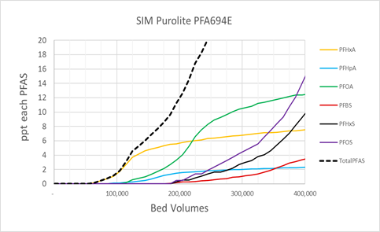
Process of Modeling - Chemistry
Resin selectivity for individual PFAS species (proprietary)
Impact of major anions
Predict effluent breakthrough curves
High accuracy models for “the usual PFAS suspects” in drinking water

Slide 40
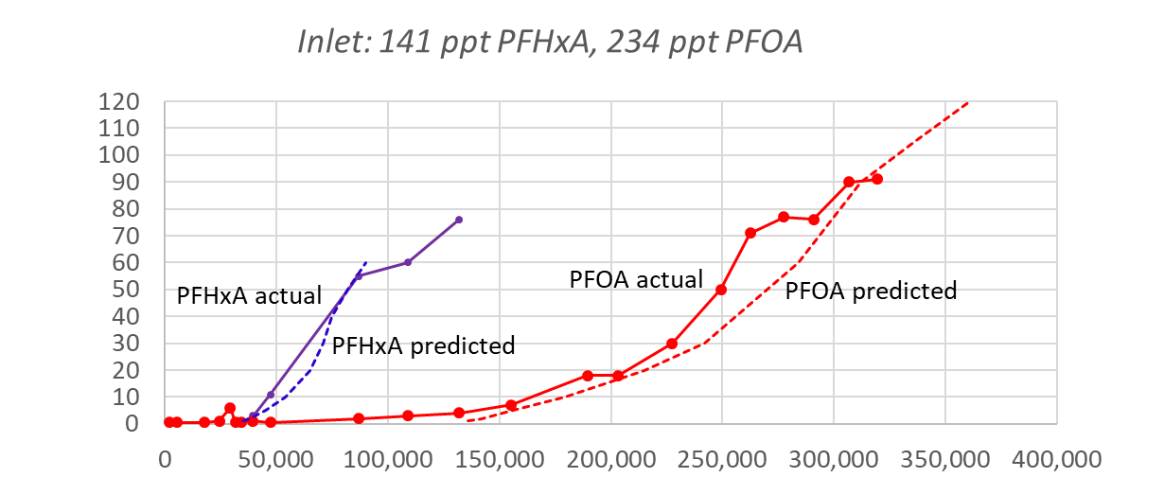
Warminster, PA Well 26 - Model vs Actual Results
PFA694E Resin Modeling
PFAS (ppt)
Bed Volumes Treated

Slide 41
Horsham, PA Well 10 – Model vs Actual Results
Conservative
Model
Actual pilot

Slide 42
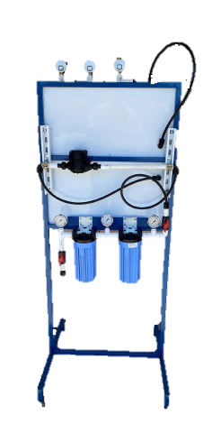
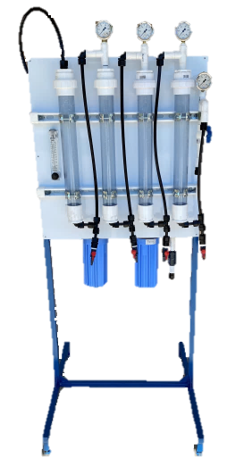
Resin Piloting
Piloting validates the throughput modeling
Use segmented columns to simulate 25%, 50%, 75% and effluent sample ports
Reduces time to obtain results
25%, 50%, 75% and effluent sample ports

Slide 43
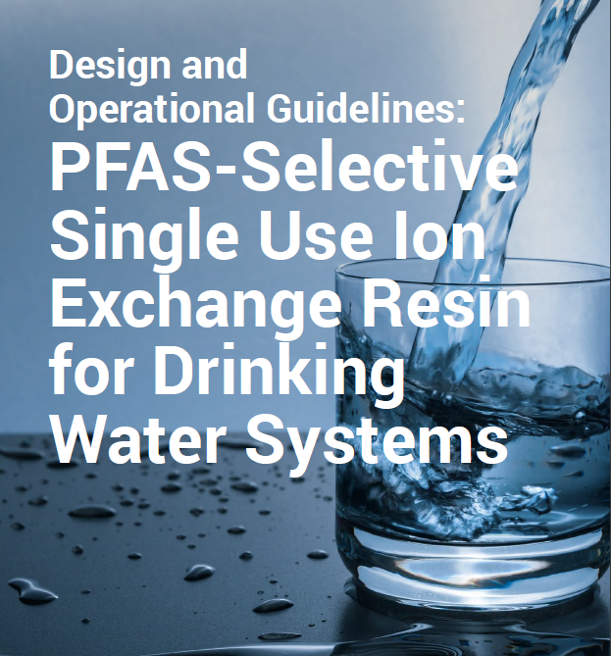
Design Guidelines for IX Resin
Vessel Parameter | Design Goal
Linear Velocity (LV) | 6 to 18 gpm/ft² (15 to 45 m/h)
Bed Depth for LV <= 12 gpm/ft² (30 m/h) | 3 ft (0.91m) minimum
Bed Depth for LV > 12 gpm/ft² (30 m/h) | 3.7 ft (1.1 m) minimum
Specific Flowrate | 1 to 5 gpm/ft³ (8 to 40 BV/h)
Empty Bed Contact Time (EBCT) | 2 min for drinking water 3 min for higher concentrations

Slide 44
Single Vessel vs Lead/Lag
Influent
Influent
Lead
Lag
Effluent
Effluent
Sample Point

Slide 45
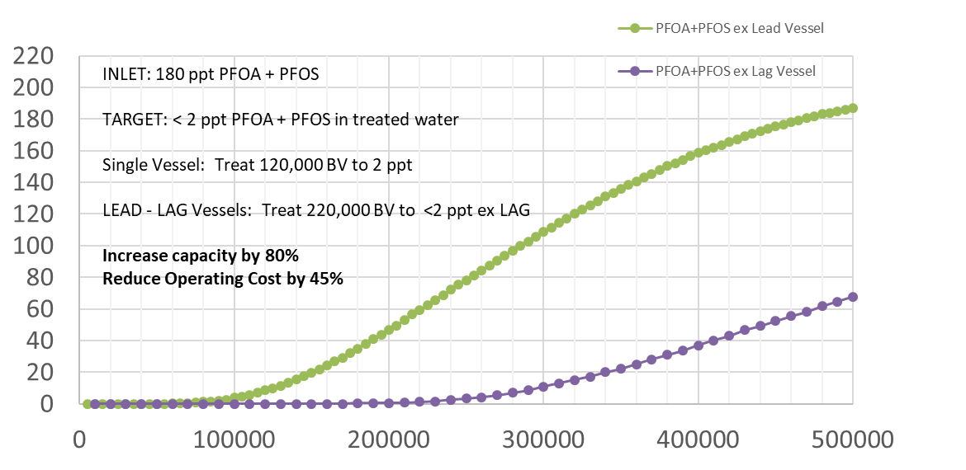


Using Lead/Lag to Minimize Operating Cost
ppt
PFOS + PFOA
LEAD
LEAD - LAG
X
LAG
2 ppt
Bed Volumes

Slide 46
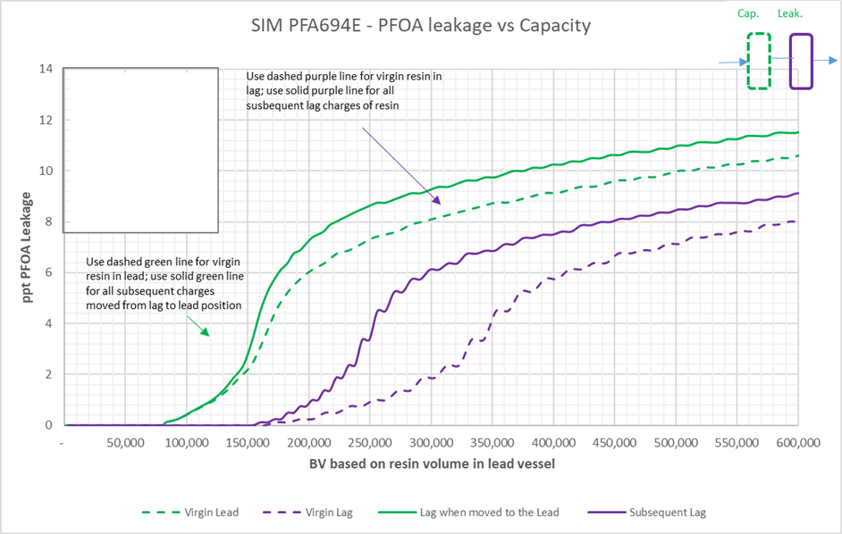
First Cycle vs Subsequent Cycles
Resin lasts longer the first time its used compared to subsequent runs

Slide 47
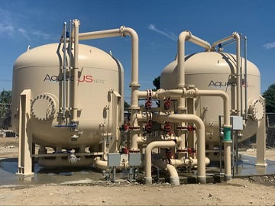
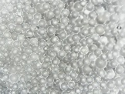
PFAS Selective Single-Use Ion Exchange Resin System
PFAS in water
PFAS – free water
PFAS loaded resin
Disposal
EBCT ~ 2 - 3 mins. per vessel

Slide 48

Pretreatment
Harmful Parameters: | Pretreatment may be needed for RO / NF or GAC or IX
Suspended Solids
TOC
Oxidants
Oil & Grease
Iron/manganese
Scaling compounds
Microbes

Slide 49
PFAS Waste Management
Landfill
Incineration
Reactivation (GAC)
Mechanochemical
Supercritical Water Oxidation
Electrochemical
Chemical
Biological
Plasma
Sonolysis
Ebeam
UV
Deep Well injection
Sorption / stabilization
Land application
Currently commercial
Promising technologies
Technologies also being developed
Less desirable

Slide 50

How do you choose your treatment?
Life Cycle Costs
  Capital/ Footprint (CAPEX)
  Operational (OPEX)
    Water Quality
    Removal Efficiency
    Bed Life
    Waste Generation

Slide 51
CAPEX – IX Resin vs GAC
EBCT difference drives lower CAPEX for Resin
  Typical EBCT: IX = 2 - 3 min and GAC = 10 min
IX can treat up to 5 x’s the flow in same footprint as GAC
    Example: 350 gpm system
      IX = (2) x 6’ diam. vessels
      GAC = (2) x 10’ diam. vessels
  → Capex for IX is 25% to 50% less than GAC

Slide 52
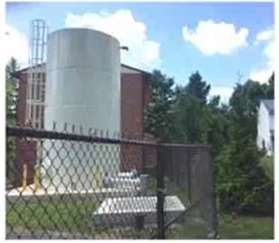
GAC – Backwash Issues
Large Backwash Tank
Large Footprint / Building
Regulated Backwash Discharge
Not neighborhood friendly

Slide 53
OPEX – Inlet Water Quality Drives IX Resin
Background WQ impacts IX Resin capacity
  Capacity ---> OPEX
  Modeling, piloting will confirm
Lower TDS water = increased performance advantage for IX resin vs GAC = lower OPEX

Slide 54
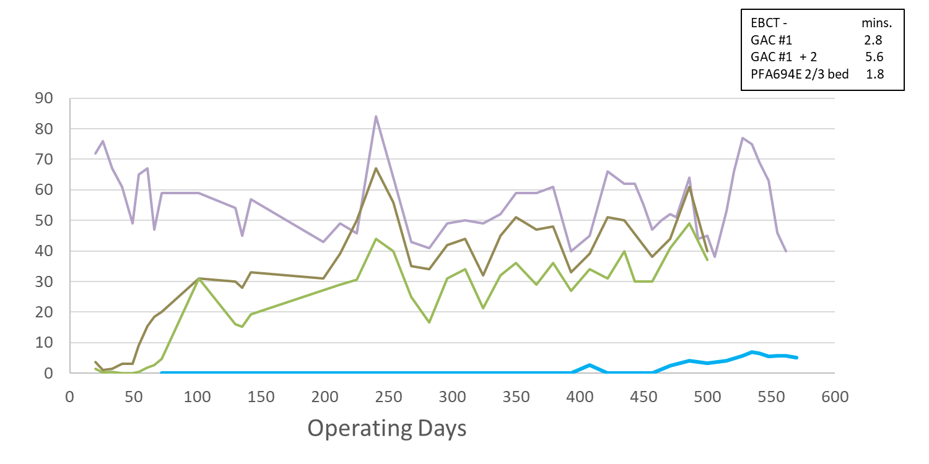
PFOA & PFOS: GAC vs IX Resin
Horsham Well 10: PFOS + PFOA Removal
20 x’s higher capacity with IX Resin
Water Quality will drive bed life
IX can be 5 to 20 times higher throughput than GAC
Results in lower lifecycle cost for IX Resin
PFOS + PFOA
ppt
GAC 1
PFA694E resin 2/3rd sample pt.
GAC 2
1 liter resin treats > 456,000 liters of water to ND

Slide 55
Example: 350 GPM PFAS Treatment System
Comparing IX Resin to GAC:
Design Parameters | IX Resin |  |  | Design Parameters | GAC
Flow Rate | 350 | gpm |  | Flow Rate | 350 | gpm
Number of Trains | 1 |  |  | Number of Trains | 1
Vessel Diameter | 6 | feet |  | Vessel Diameter | 10 | feet
Flow per Vessel | 350 | gpm |  | Flow per Vessel | 350 | gpm
 |  |  |  | GAC per Vessel | 20,000 | lbs
Media Volume per vessel | 126 | cubic feet |  | Media Volume per vessel | 595 | cubic feet
Media Volume on site | 252 | cubic feet |  | Media Volume on site | 1190 | cubic feet
Vessel Area | 28 | square feet |  | Vessel Area | 79 | square feet
Bed Depth | 4 | feet |  | Bed Depth | 8 | feet
Linear Velocity: | 12 | gpm/ft2 |  | Linear Velocity: | 4 | gpm/ft2
Specific Flowrate | 3 | gpm/ft3 |  | Specific Flowrate | 1 | gpm/ft3
Empty Bed Contact Time | 2.7 | minutes |  | Empty Bed Contact Time | 13 | minutes
BV/hour | 22 | BV/hr |  | BV/hour | 5 | BV/hr
Projected throughput | 200,000 | BV |  | Projected throughput | 30,000 | BV
Days between exchanges | 374 | days |  | Days between exchanges | 265 | days

Slide 56
Example: 350 GPM - CAPEX
Comparing Ion Exchange to GAC: Lead/Lag Design
Design Parameters | IX Resin |  |  | Design Parameters | GAC
Flow Rate | 350 | gpm |  | Flow Rate | 350 | gpm
Number of Trains | 1 |  |  | Number of Trains | 1
Vessel Diameter | 6 | feet |  | Vessel Diameter | 10 | feet
Flow per Vessel | 350 | gpm |  | Flow per Vessel | 350 | gpm
 |  |  |  | GAC per Vessel | 20,000 | lbs
Media Volume per vessel | 126 | cubic feet |  | Media Volume per vessel | 595 | cubic feet
Media Volume on site | 252 | cubic feet |  | Media Volume on site | 1,190 | cubic feet
Vessel Area | 28 | square feet |  | Vessel Area | 79 | square feet
Bed Depth | 4 | feet |  | Bed Depth | 8 | feet
Linear Velocity: | 12 | gpm/ft2 |  | Linear Velocity: | 4 | gpm/ft2
Specific Flowrate | 3 | gpm/ft3 |  | Specific Flowrate | 1 | gpm/ft3
Empty Bed Contact Time | 3 | minutes |  | Empty Bed Contact Time | 13 | minutes
BV/hour | 22 | BV/hr |  | BV/hour | 5 | BV/hr
Projected throughput | 200,000 | BV |  | Projected throughput | 30,000 | BV
Days between exchanges | 374 | days |  | Days between exchanges | 265 | days
GAC requires more media / larger vessels because of EBCT requirements.

Slide 57
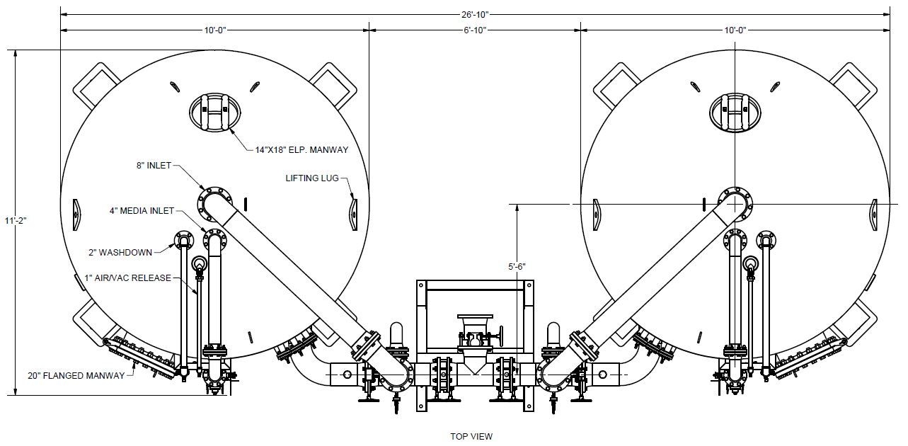
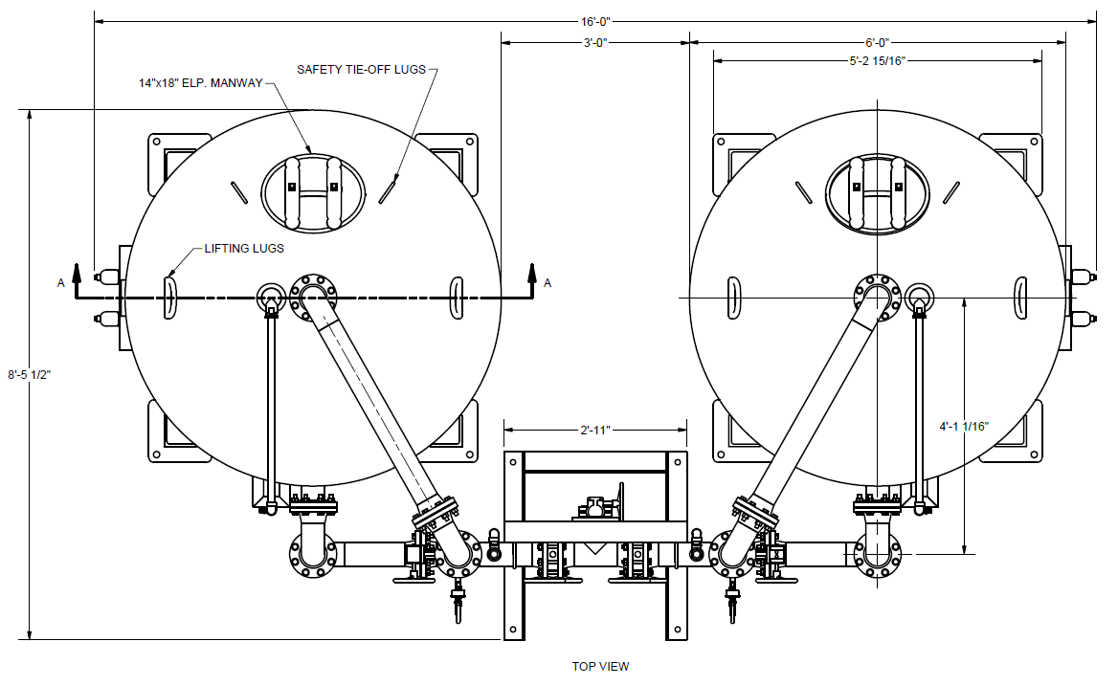

Example: 350 GPM System
Ion Exchange is less than half the footprint with lower equipment costs.
Comparing IX Resin to GAC: Footprint
Ion Exchange
6’ diameter vessels
11'-2 1/2“ tall
135 ft²
Alternative arrangement:
  2 systems with 4’ d-vessels, 8’ high, which would easily fit in a building
GAC
10’ diameter vessels
16’-6” tall
300 ft²
Also requires backwash tank and backwash waste handling
Drawings approximately to scale
Drawings from:

Slide 58
Example: 350 GPM - OPEX
Comparing Ion Exchange to GAC: Media Life & Change-out Frequency
Design Parameters | IX Resin |  |  | Design Parameters | GAC
Flow Rate | 350 | gpm |  | Flow Rate | 350 | gpm
Number of Trains | 1 |  |  | Number of Trains | 1
Vessel Diameter | 6 | feet |  | Vessel Diameter | 10 | feet
Flow per Vessel | 350 | gpm |  | Flow per Vessel | 350 | gpm
 |  |  |  | GAC per Vessel | 20,000 | lbs
Media Volume per vessel | 126 | cubic feet |  | Media Volume per vessel | 595 | cubic feet
Media Volume on site | 252 | cubic feet |  | Media Volume on site | 1190 | cubic feet
Vessel Area | 28 | square feet |  | Vessel Area | 79 | square feet
Bed Depth | 4 | feet |  | Bed Depth | 8 | feet
Linear Velocity: | 12 | gpm/ft2 |  | Linear Velocity: | 4 | gpm/ft2
Specific Flowrate | 3 | gpm/ft3 |  | Specific Flowrate | 1 | gpm/ft3
Empty Bed Contact Time | 3 | minutes |  | Empty Bed Contact Time | 13 | minutes
BV/hour | 22 | BV/hr |  | BV/hour | 5 | BV/hr
Projected throughput | 200,000 | BV |  | Projected throughput | 30,000 | BV
Days between exchanges | 374 | days |  | Days between exchanges | 265 | days
Throughput listed is typical for each media - dependent on water quality.

Slide 59
Example: 350 GPM - OPEX
Comparing Ion Exchange to GAC: Annual Operating Costs
Treatment Costs | IX Resin |  |  | Treatment Costs | GAC
IX consumed per year | 123 | CF |  | GAC consumed per year | 820 | CF
IX consumed per year | 5,166 | lbs |  | GAC consumed per year | 27,552 | lbs
Cost per cu ft | 400 | $/CF |  | Cost per pound | 3 | $/lb
IX Costs per year | $49,200 |  |  | GAC cost per year | $82,656
Ion Exchange is ~ 60% the cost of GAC

Slide 60
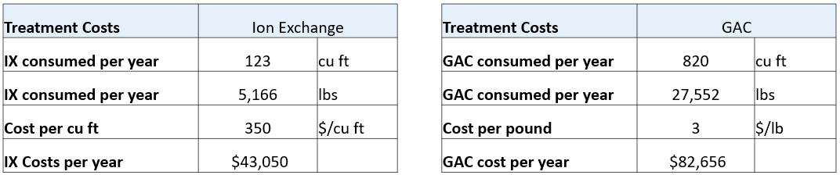
Example: 350 GPM System
Comparing IX Resin to GAC: Waste Generation
IX Resin produces < 20% the amount of waste per year.
Very important if / when the EPA declares PFAS hazardous.

Slide 61
How do you choose your treatment: Operational Cost
Relative Treatment Costs:
  IX Resin: $0.10 – $0.80/kgal
  GAC: $0.19 – $1.00/kgal
  RO: $3.20 - $6.00/kgal
Notes:
Costs based on 4/23/23. Calculated based on current market conditions

Slide 62
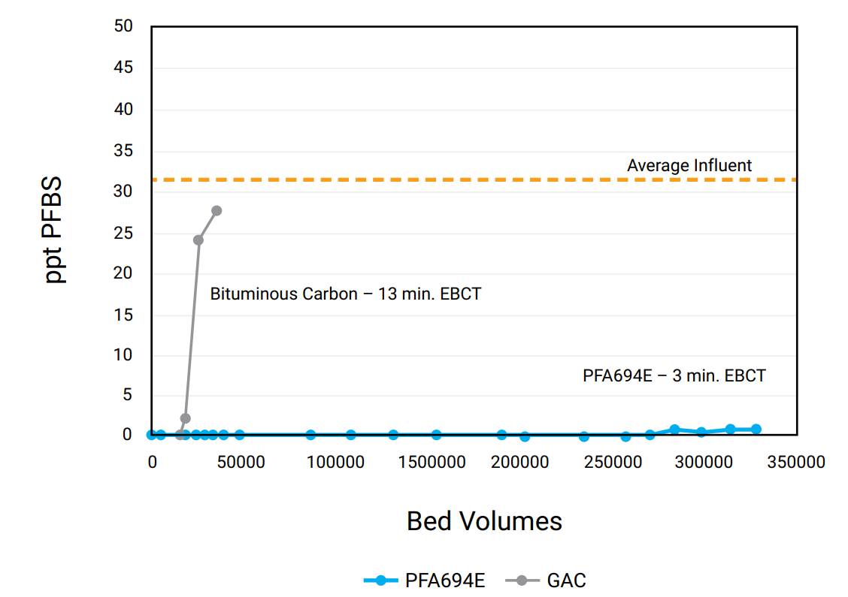
How do choose your treatment: Removal Efficiency
EPA has proposed MCLs and Hazard Index for:
  PFOA
  PFOS
  PFBS
  GenX or HFPO-DA
  PFHxS
  PFNA
  Ion Exchange does a better job at removing these compounds than GAC.
Removal of PFBS with Resin vs GAC

Slide 63
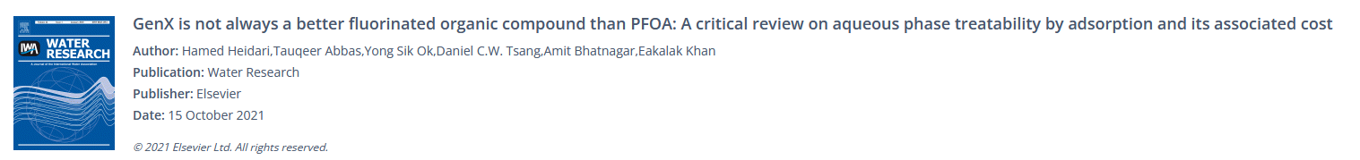
Removal Efficiency for GenX: Resin outperforms GAC
“Both AC and AEs can treat GenX and PFOA, but AEs are a more promising choice with higher removal efficiency.”
“It also showed that for AC, the estimated treatment cost for GenX is 4.4 times higher than that for PFOA, while the GenX treatment cost is approximately the same as PFOA for AEs.”
AC = Activated Carbon, AE = Anion Exchange (Resin)
For IX Resin, treatment cost of GenX is approximately equal to that of PFOA.
Source:

Slide 64


Water Quality Considerations: Sloughing
GAC can slough contaminants: Nitrate, PFAS, and other TOC

Slide 65


WQ Considerations: Arsenic Leaching
Coal based GAC has been shown to have naturally occurring arsenic.
Arsenic Content
“All coal contains some arsenic, which is present primarily within the mineral pyrite interspersed in the coal (USGS, 2005). This means that widely used bituminous and sub-bituminous products often contain arsenic.”
Source: https://www.wateronline.com/doc/implementing-granular-activated-carbon-systems-important-design-and-start-up-considerations-0001

Slide 66


WQ Considerations: Impact on Raw Water pH
New media start-up:
IX Resin (Cl form) drops pH, increases CSMR
Equilibration in 100 to 1,000 BV
Buffered Resin to minimize if needed
GAC raises pH, stabilization takes up to 400 BV

Slide 67

Seasonal Operation
IX Resin can be used seasonally
  Re-start procedure - full-flow flush
  Shut-downs – drain vessel completely
GAC – tends to grow bacteria
  GAC holds TOC which is a food source
  Restart procedure - caustic wash

Slide 68
Thank You!
Cathy.Swanson@Purolite.com 714-292-2531
Dan.Teeters@Purolite.com 714-292-0110
©2023 Purolite, An Ecolab Company. All rights reserved.

